Slide 1
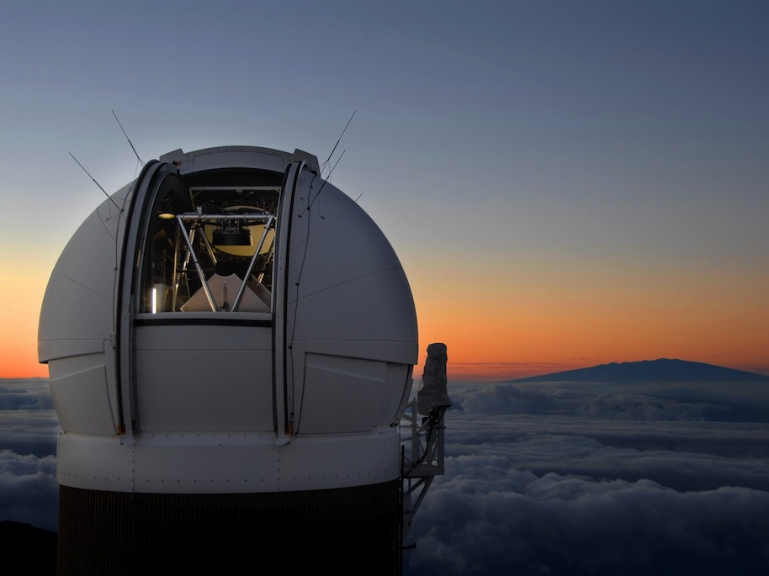
The Pan-STARRS Archive at STScI
Armin Rest
Rick White Brian McLean Bernie Shiao Anton Koekemoer
Knox Long Jeff Valenti Lou Strolger
and the STScI/JHU PS1 team
MAST Users Group, 2014 December 2
Notes:
Middle group lists people in the archive who are working on Pan-STARRS
Bottom group lists major contributors from the science staff (and there are more)

Slide 2
The PS1 public archive
STScI will provide the public archive for PS1 data
Planned services:
Catalog access
Simple form interface
Web services (including VO-compatible interfaces)
SQL query interface
Image access
Whole images
Image cutouts either as FITS files or JPEG previews
Interactive display
We will use products from the PS1 project with existing tools developed by MAST and PS1

Slide 3
MAST and Pan-STARRS
Pan-STARRS is not a MAST-funded project!
STScI research funding for archive development; NSF funding requested for long-term operations
PS1 images & database are large compared with current MAST data holdings
GALEX photon database is ~150 TB
Larger than PS1 but simpler data
Total MAST holdings currently ~ 300 TB
PS1: ~ 2000 TB
Large future missions: JWST (4 PB), WFIRST-AFTA (9 PB)
MAST is very heavily used
> 5000 users, 1 million searches/month, 18 TB/month downloaded
Requires a new scale of infrastructure, but MAST experience is relevant
Notes:
Pan-STARRS at STScI funded by STScI research funding
Proposal submitted for NSF funding for ongoing operations

Slide 4
PS1 data @ STScI: Images
Coadded stacked images and single-epoch warps
All PS1 surveys will be included:
3PI (30,000 sq deg north of declination -30°)
Medium Deep Surveys (10 fields, 7 sq deg each)
Celestial North Pole, Ecliptic Plane, M31
Images dominate total data volume (mainly 3PI, MDS)
Total data volume without difference images ~ 1.8 PB
Includes auxiliary images (wt, expwt, exp, mask, num)

Slide 5
PS1 data @ STScI: Catalogs
Catalog databases
Including stack detections, single-epoch detections, forced photometry & objects (linking multiple epoch detections)
High-quality photometry and astrometry
Total database volume ~100 TB
Most database volume is in single-epoch detections
3PI database (PV1: ~90% of 3PI sky area, still incomplete in plane):
29.4 x 10⁹ detections
5.9 x 10⁹ objects
1.4 x 10⁹ objects with nDetections > 1
For comparison, SDSS DR9: 469 M objects (14,000 sq deg)

Slide 6
PS1 3π survey versus SDSS
 | SDSS | Pan-STARRS 3π
Sky area | 10,000 sq deg | 30,000 sq deg
Sky region | High Galactic latitude | δ > -30°, includes Galactic plane
Filters and Magnitude limits | u 22.5
 | g 23.2 | g 23.4
 | r 22.6 | r 23.2
 | i 21.9 | i 22.7
 | z 20.8 | z 22.0
 |  | y 21.1
Median Seeing FWHM | 1.3” | 1.1”
Cadence | 1 epoch | 12 epochs per filter

Slide 7
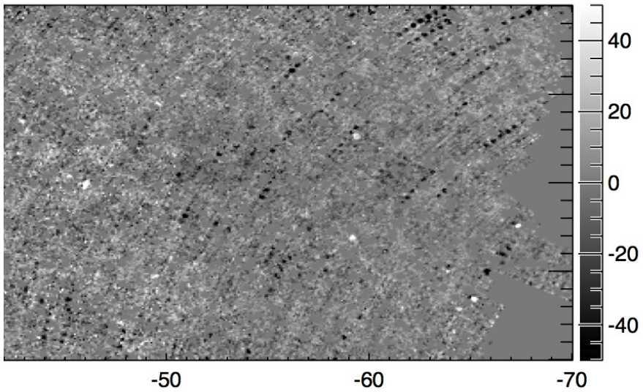
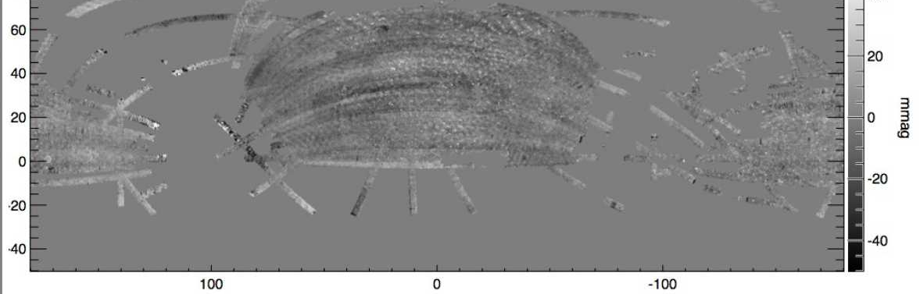
PS1 Relative Photometric Calibration: Ubercal
Uebercal (Finkbeiner, Schlafly): use repeat observations of PS1
Differences between SDSS and PS1
SDSS issues: stripes, north-south offsets
PS1 issues: squares
PS1 Issue: white spots due to 2 bad chips that will be masked
SDSS Issue: sets of 6 dark spots are clouds or contrails in SDSS
1 year PS1
Dec in Degrees
RA in Degrees

Slide 8
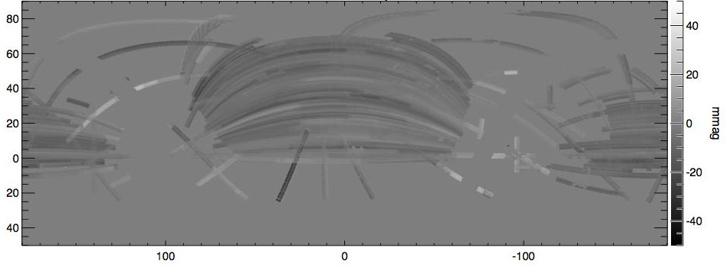
PS1 Relative Photometric Calibration: Ubercal
Ubercal (Finkbeiner, Schlafly): use repeat observations of PS1
Differences between SDSS and PS1
SDSS issues: stripes, north-south offsets
Systematics down to 2-3 mmag!
3.5 years PS1
1 year PS1
Dec in Degrees
RA in Degrees

Slide 9
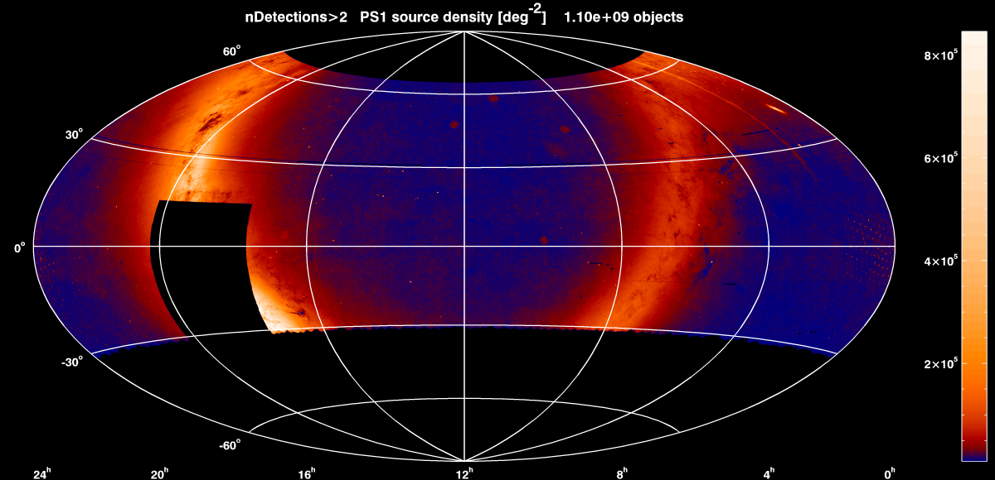
3PI Object counts, nDetections>2 1.10x10⁹ objects

Slide 10
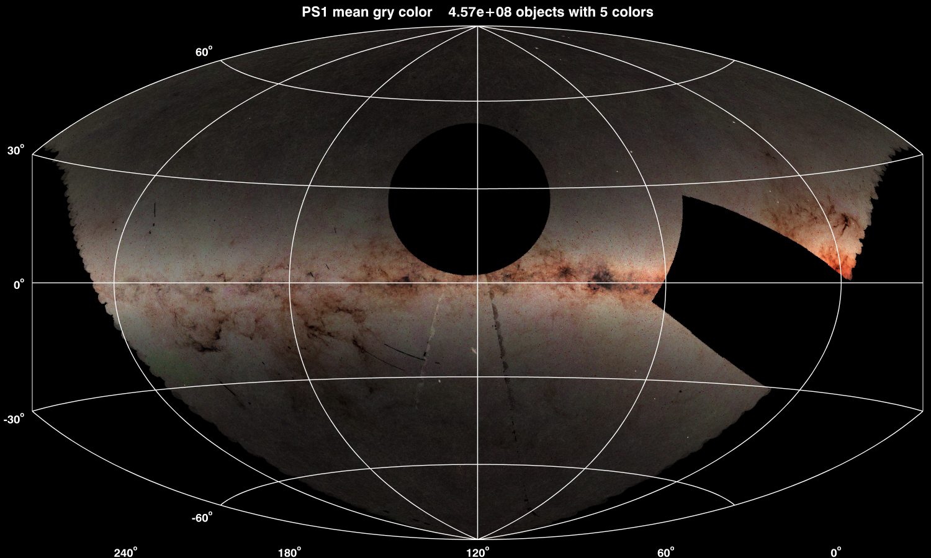
3PI g/r/y mean colors 4.57x10⁸ objects
Notes:
Includes objects detected in all 5 grizy bands
Color comes from mean gry
Brightness comes from object counts
Note the clearly visible artifacts (PRs exist for those)

Slide 11
3PI g/r/y mean colors 4.57x10⁸ objects
North Equatorial Cap
Galactic plane
Galactic center
Dec = -30º Survey Limit
Notes:
Includes objects detected in all 5 grizy bands
Color comes from mean gry
Brightness comes from object counts
Note the clearly visible artifacts (PRs exist for those)

Slide 12
Status of archive preparations
2 PB of disks purchased for image storage
Located at Hawaii for use in data processing
Will be shipped back to STScI (with data) in January 2015
Database servers purchased & are now set up
Faster, more memory & cores than the current PS1 database machines in Hawaii
Current database was transferred via network and is available to PS1 science consortium
Final database will be copied in 2015

Slide 13
High-level schedule
STScI Specific PS1 Milestone | Timeframe | Pan STARRS Project-Wide Milestone
1 PB of STScI disks delivered to Hawaii | 2012 May
1 PB of disks delivered to Hawaii | 2013 June
DB & image subsets at STScI for experiments | 2013 November
 | 2014 April | Pan STARRS observations complete
Database servers purchased | 2014 May | PV1 database complete; PV3 processing begins
Pan-STARRS workshop (@STScI) | 2014 June | Pan-STARRS consortium meeting (@STScI)
PV2 database copied to STScI | 2014 December | PV2 database complete
Prototype DB and image interfaces available for consortium testing at STScI | 2015 January | PV3 images complete
2 PB data-loaded disks shipped from Hawaii; PV3 database copied to STScI | 2015 January | PV3 database complete
All disks arrive at STScI, hardware and software integration begins | 2015 February
 | 2015 April | Public archive opens (1 year after end of obs)
PV1, PV2, PV2 are versions of the image & catalog processing
PSPS is the PS1 object catalog database
Post-ship schedule is optimistic; might release DB only to start, images later

Slide 14
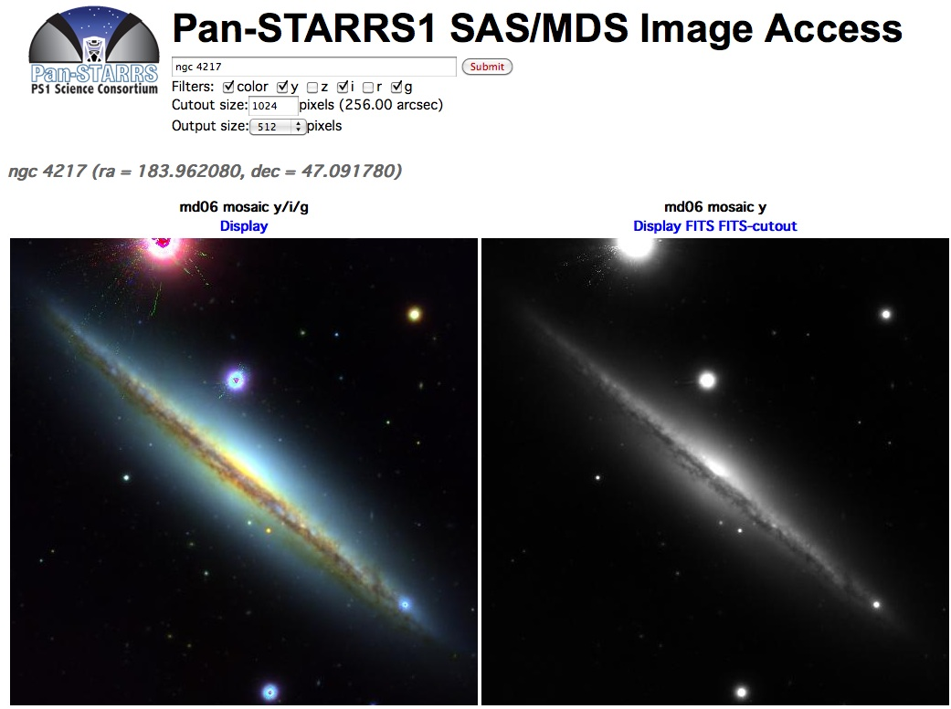
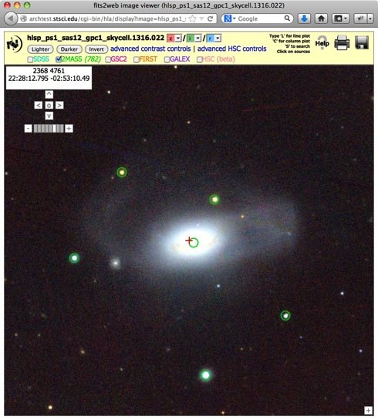
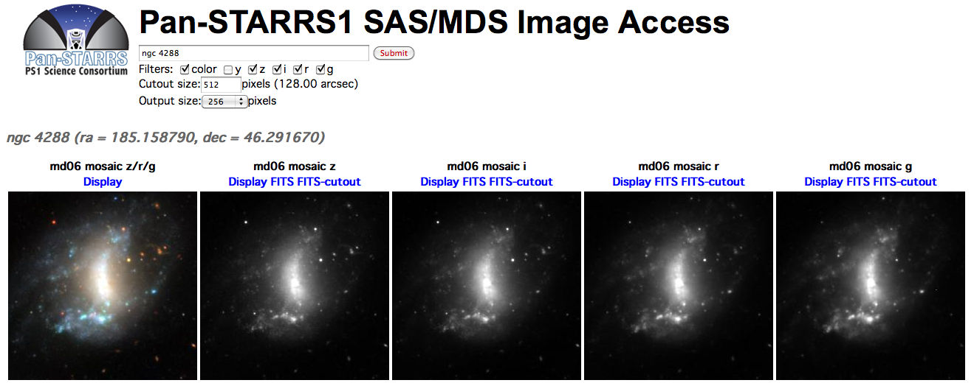
Sample PS1 image using HLA tools
Simple cutout search page for SAS2 + MDS field demo
Notes:
Demo positions:
ngc 7288
ngc 7222
334.073 0.4 (in md09, nice little cluster – choose z I r)
333 +5 (1024 pixel, shows bad region with stacking changes)

Slide 15
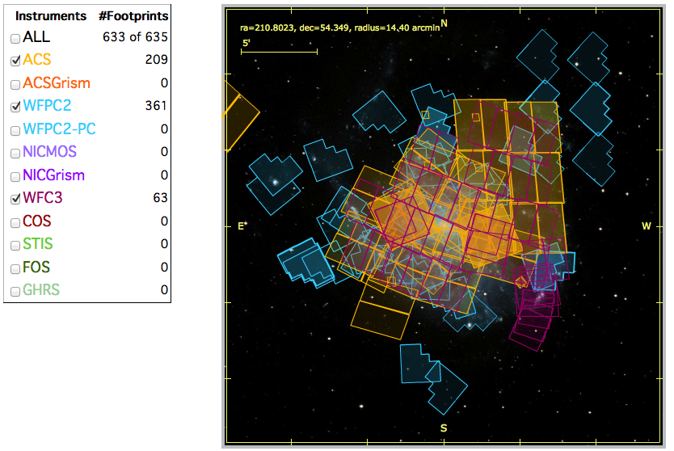
MAST Portal Catalog/Image Interface
Hubble Source Catalog portal interface will be adapted for PS1
Similar structure: multi-epoch, multi-filter observations integrated with image database
Cutout services, interactive display, etc., are also being used for PS1
MAST will incorporate & benefit from PS1 data
PS1 images are a better background for AstroView
Current PS1 catalog is already being used as a deep astrometric reference catalog for HSC
Note: Current PS1 catalog was used as astrometric reference for Hubble Source Catalog v0.3
Notes:
Note that the Hubble sky coverage is complex and highly uneven (footprints shown), which makes developing a Hubble object catalog challenging.

Slide 16
Summary
STScI archive will provide an integrated interface for access to PS1 catalogs & images
Reuse existing MAST and current PS1 databases and interfaces wherever possible
MAST will utilize PS1 images and catalogs to improve our other data products
Pan-STARRS is a step into big data for MAST
Valuable experience for future multi-petabyte datasets including JWST, WFIRST

Slide 17
Extra Slides

Slide 18
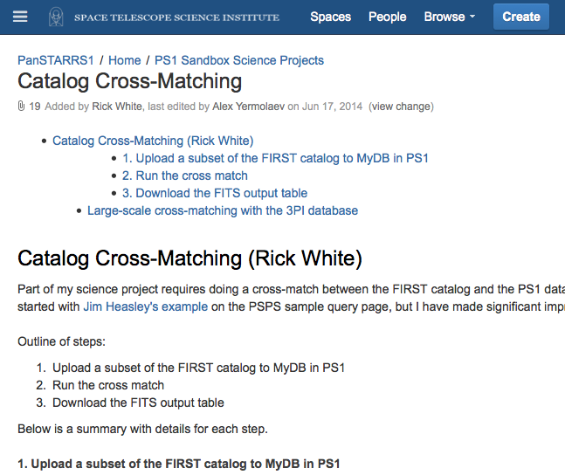
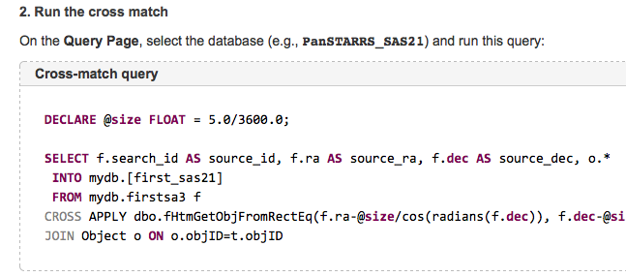
User Documentation
Confluence is being used to describe sample PS1 database queries in detail
Notes:
Examples include the SQL to run the queries

Slide 19
Data products not @ STScI
Difference images
Data volume large, probably fast enough to generate them on-the-fly
Convolved images
Images convolved to match PSFs
Have not reached quality of unconvolved images (yet)
Could also be generated on demand
Raw data
STScI will not run image processing pipeline

