Slide 1
Kepler / K2 / GALEX
Current Status
and
Future Updates
Scott Fleming
Dorothy Fraquelli
Bernie Shiao
Chase Million

Slide 2
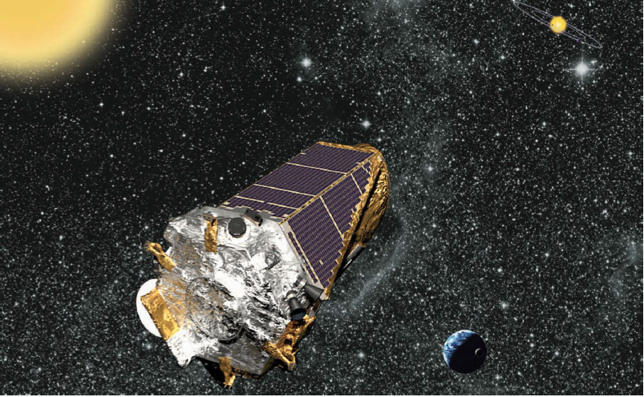
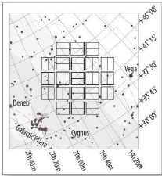
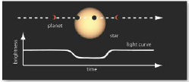
Kepler – Mission Description and Current Status
Two modes: short and long cadence (SLC, LLC).
Variety of FITS files (LC, TPF, FFI).
Primary mission ended in May 2013 with the loss of a second reaction wheel.
All data products from Q0 – Q17 are available at MAST. NExScI tables synced regularly.

Slide 3
Kepler – Future Updates
Kepler closeout activities happening now through 2017.
Next delivery will be SOC v9.2 (ongoing). This includes all data from Q0-Q17 processed uniformly. Delivered in groups of Quarters (not sequential), LLC only to begin with (SLC and FFI Spring 2015).
Future delivery plans are fluid. SOC v9.3.1 will include additional flags, calibration techniques, more automation of candidates. Summer 2016.
Handbooks will get final editions. Software doc. included!

Slide 4
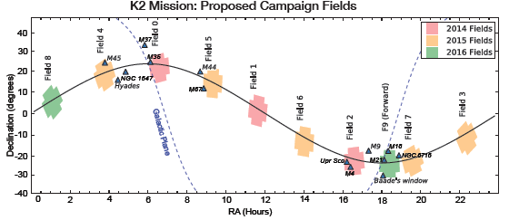
K2 – Mission Description
75-days per “campaign”, fields lie along the ecliptic, enables more science (stellar clusters, solar system objects, Baade’s Window).
Program is all GO, phot. precision is still pretty good (~400 ppm vs. ~100 ppm).

Slide 5
K2 – Current Status
Target catalog (EPIC) generated for each campaign and delivered to NExScI/MAST (up to Campaign 7 currently).
Target Pixel Files (TPF) delivered for Campaign 0.
Extracted lightcurves will be delivered starting in Campaign 3. The mission might not re-process Campaign {0,1,2} to extract lightcurves depending on resource availability.
Tools like PyKE can be used to extract lightcurves.
Without extracted lightcurves, there are also no Preview images at MAST (unless contributed).

Slide 6
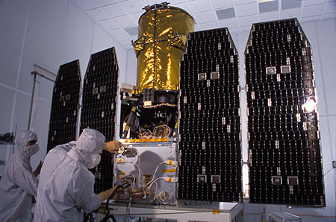
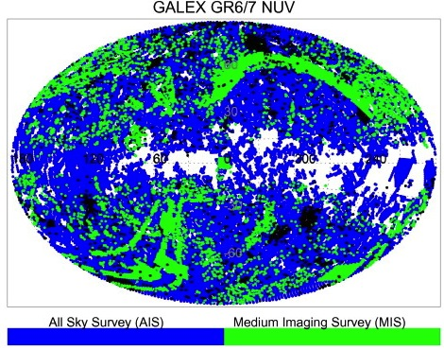
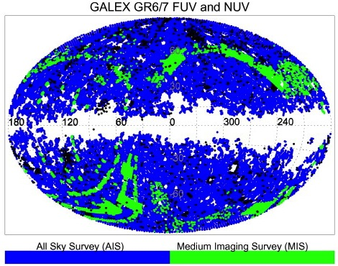
GALEX – Mission Description
Launched 28 April 2003
Retired 28 June 2013
1.2 deg. diameter FoV
1350-1750 Å and 1750-2750 Å
Phot. (5-6” resolution)
Spec. (R ~ 100-250)
Microchannel Plate Detector
Records photon event positions
Multiple Surveys: AIS, MIS, DIS, NGS, GII

Slide 7
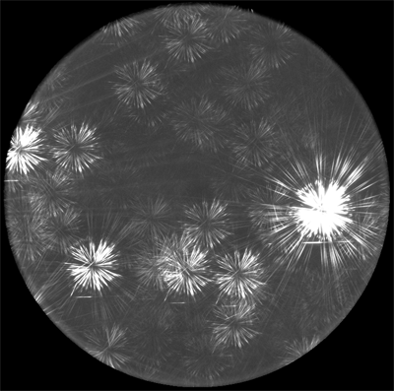
GALEX – Current Status
Available (Image) Products
Raw data
Visit and Coadd Intensity Maps (images)
Calibration Products (e.g., background)
SExtractor Source Lists
Available (Spectral) Products
Spectral Images
Extracted Spectra
Calibration Products

Slide 8
GALEX – Future Updates
All NASA-era GALEX data available at MAST (GR7)
The final ~18 months controlled by CalTech (CAUSE era). Most of that data not released yet.
CAUSE data poorer quality, some not fully processed, some taken using novel observing modes. Also, no real demand for it.
Minor housekeeping (but not minor in req. resources): organize raw+cal dat for GR7+CAUSE, update doc., capture external website content.
First release of gPhoton: a time-tagged database of GALEX photon events

Slide 9
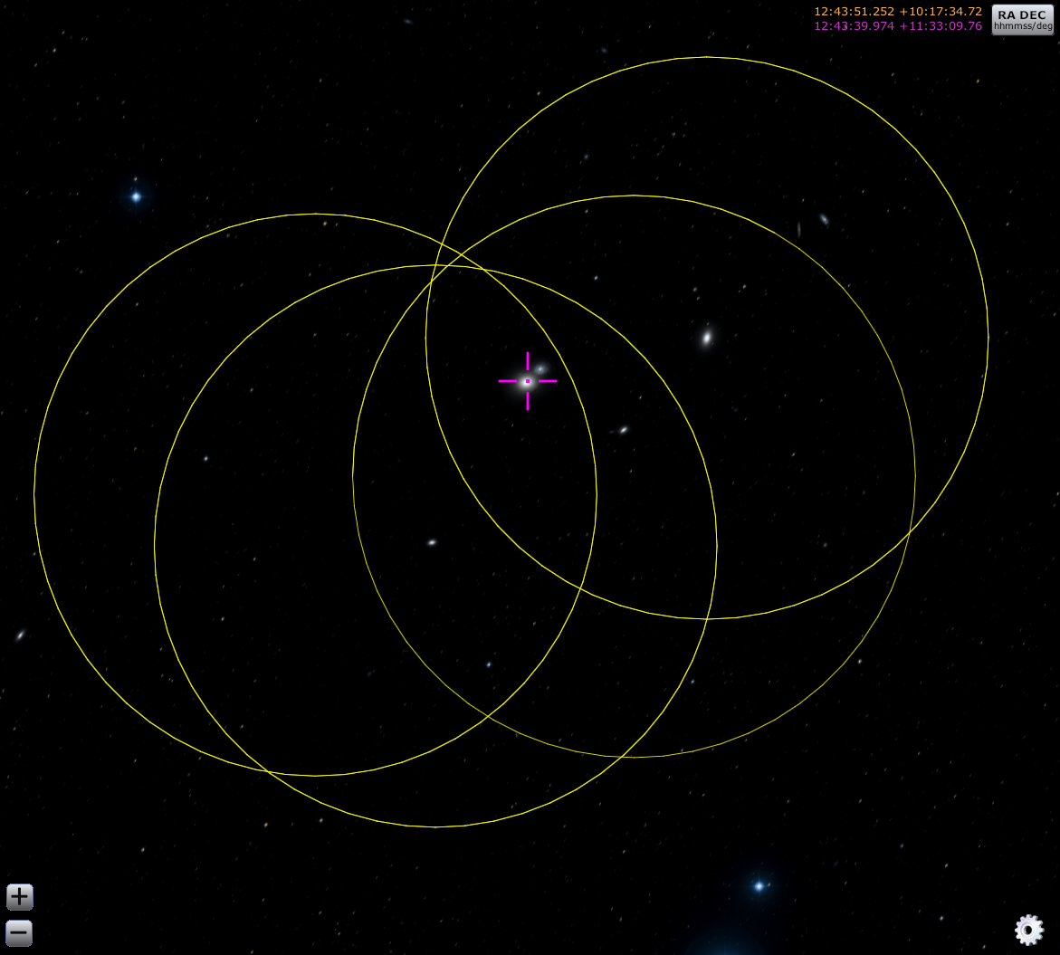
gPhoton
Raw Data
Open Source (python, git).
Create lightcurves, data cubes, calibrated images.
Can do so at user-specified spatial and temporal scales.
Re-implement most of the GALEX mission pipeline functionality.
Paper in prep. to coincide with v1.0 release.
gPhoton
Images
Sources
M 60
Exp. Time 90 – 11,000
Spans 6 years

Slide 10
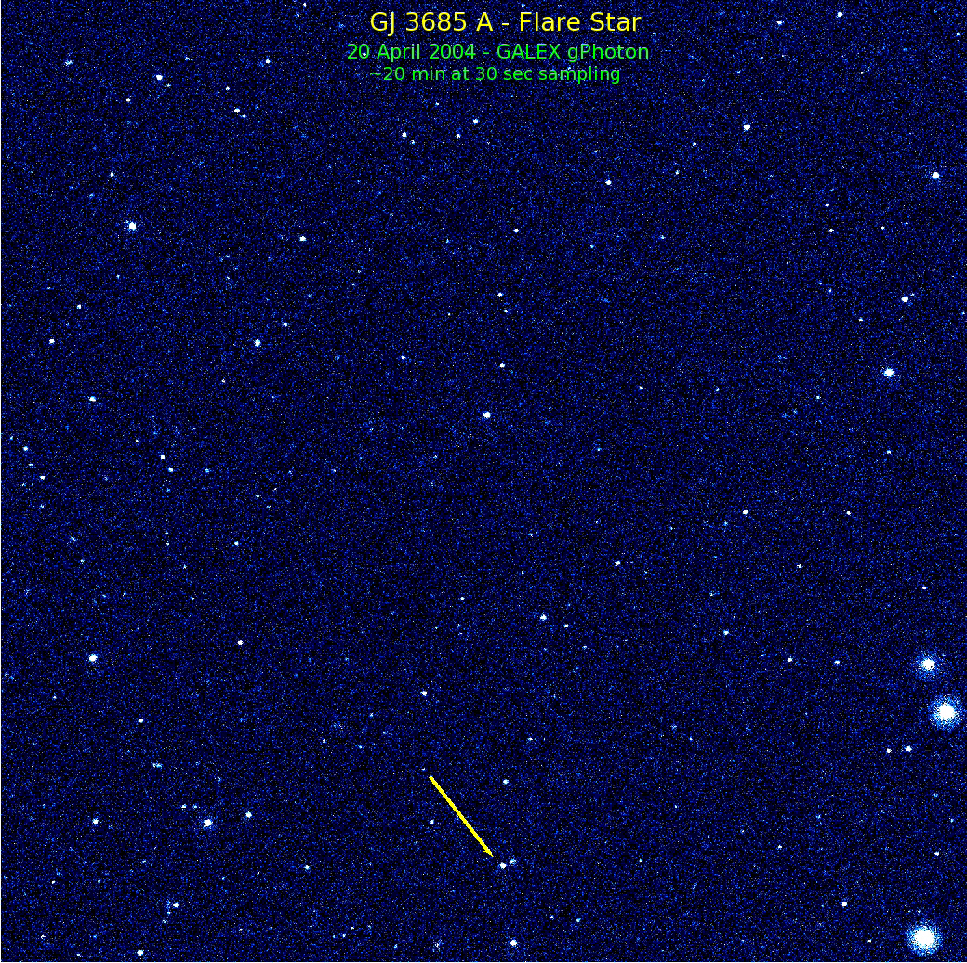
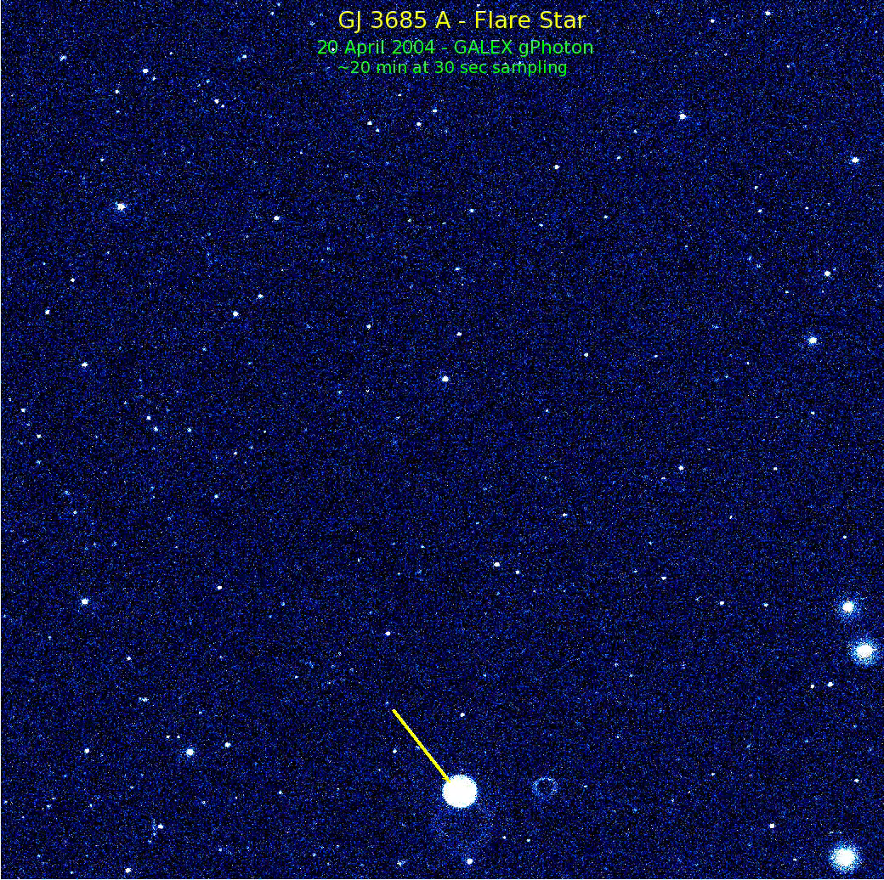
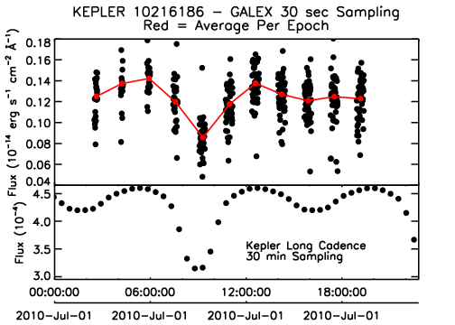
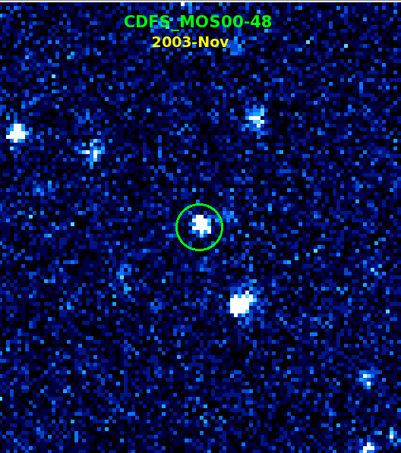
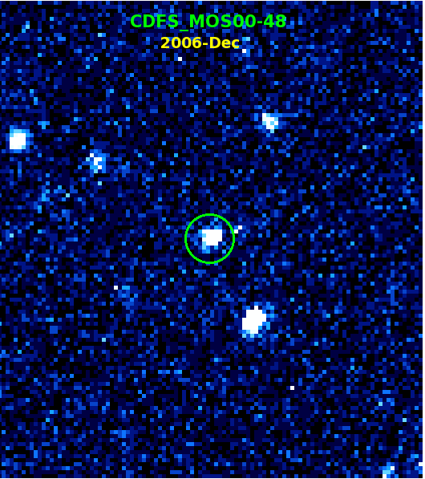
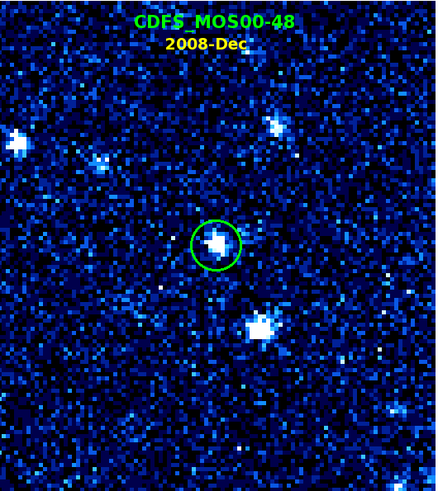
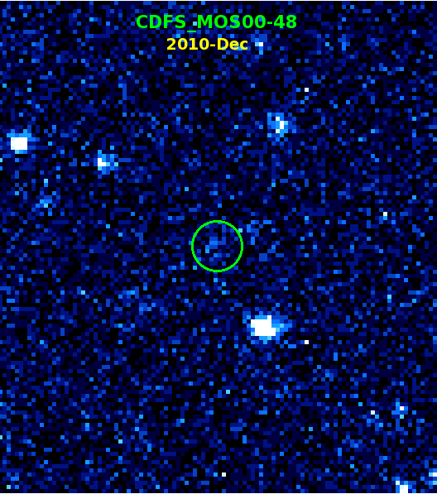
gPhoton

