Slide 1
Highlights of New and Recent High-Level Science Products (HLSPs) http://archive.stsci.edu/hlsp
1 – HST-imaging HLSP's: Anton Koekemoer
2 – non-HST-imaging HLSP's: Scott Fleming

Slide 2
1. HST Imaging HLSP's
Frontier Fields (PI: J. Lotz, M. Mountain)
HST 24th Anniversary (PI: Z. Levay)
CANDELS (PI: S. Faber, H. Ferguson)
CLASH (PI: M. Postman)
PHAT (PI: J. Dalcanton)
BoRG (PI: M. Trenti)

Slide 3
Frontier Fields http://archive.stsci.edu/prepds/frontier
4 (or 6) clusters, each with parallel field
each observed with 3 ACS, 4 WFC3 filters
total 140 orbits each cluster (and parallel)
Cumulative v0.5 releases during each epoch
1st year complete:
Abell 2744 (9x v0.5 releases + 2x v1.0 releases)
MACS0416 (8x v0.5 releases + 2x v1.0 releases)
2nd year in progress:
MACS0717 (2x v0.5 releases, v1.0 in progress)
MACS1149 (one v0.5 release to date)

Slide 4
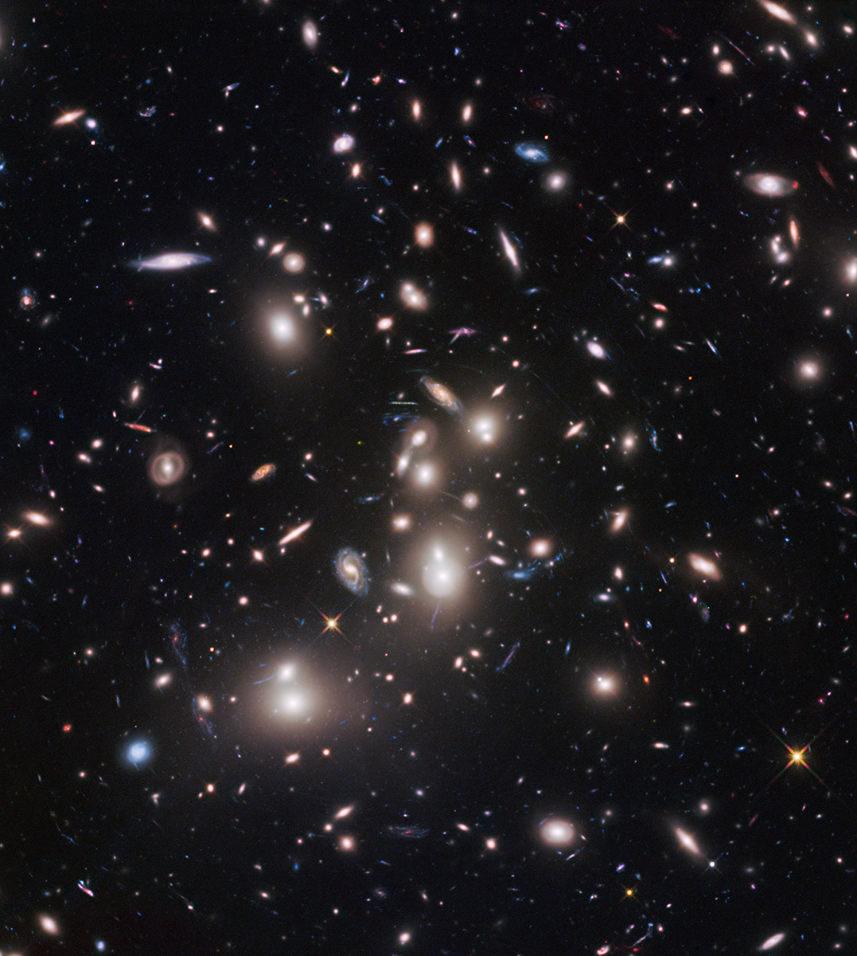
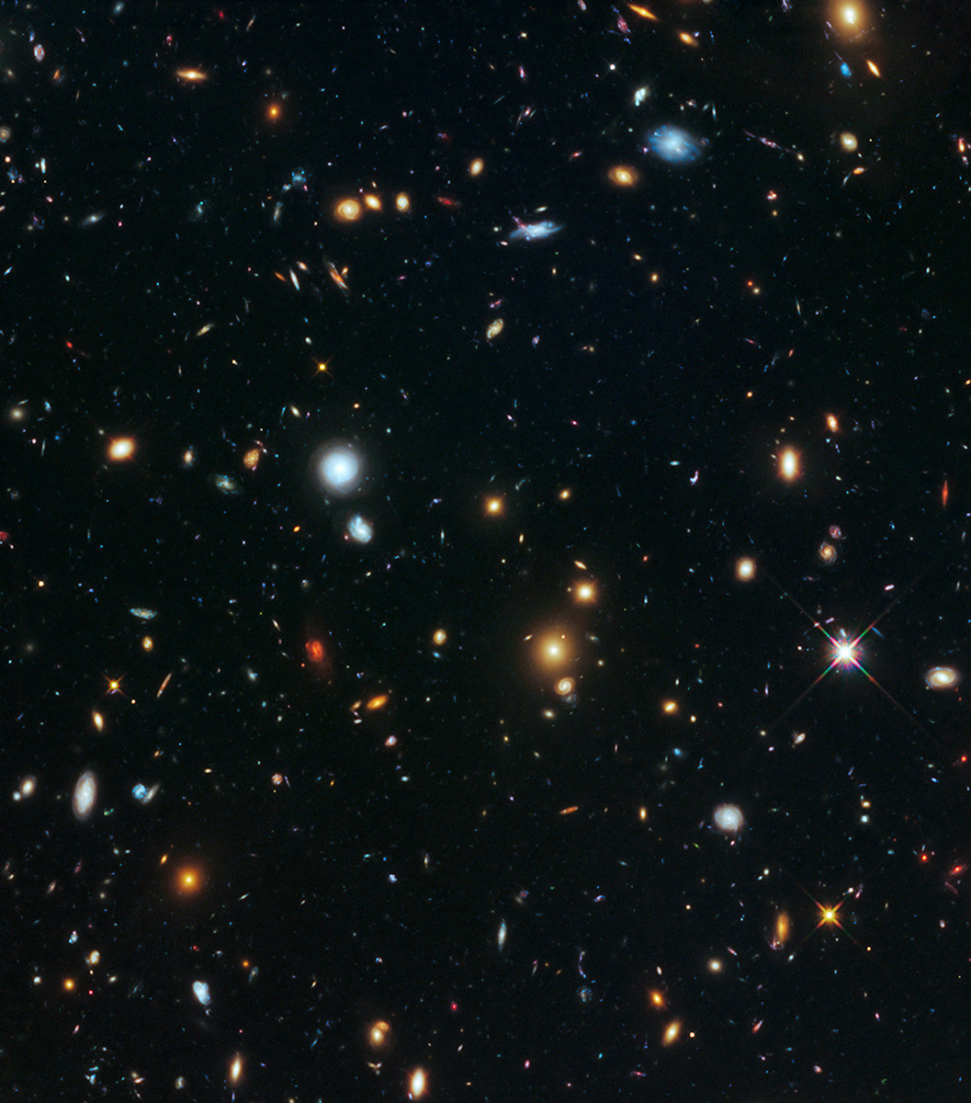
Frontier Fields: Abell 2744 http://archive.stsci.edu/prepds/frontier/abell2744.html
Abell 2744 main cluster and parallel field
(full depth: 140 orbits ACS+WFC3 on each field)

Slide 5
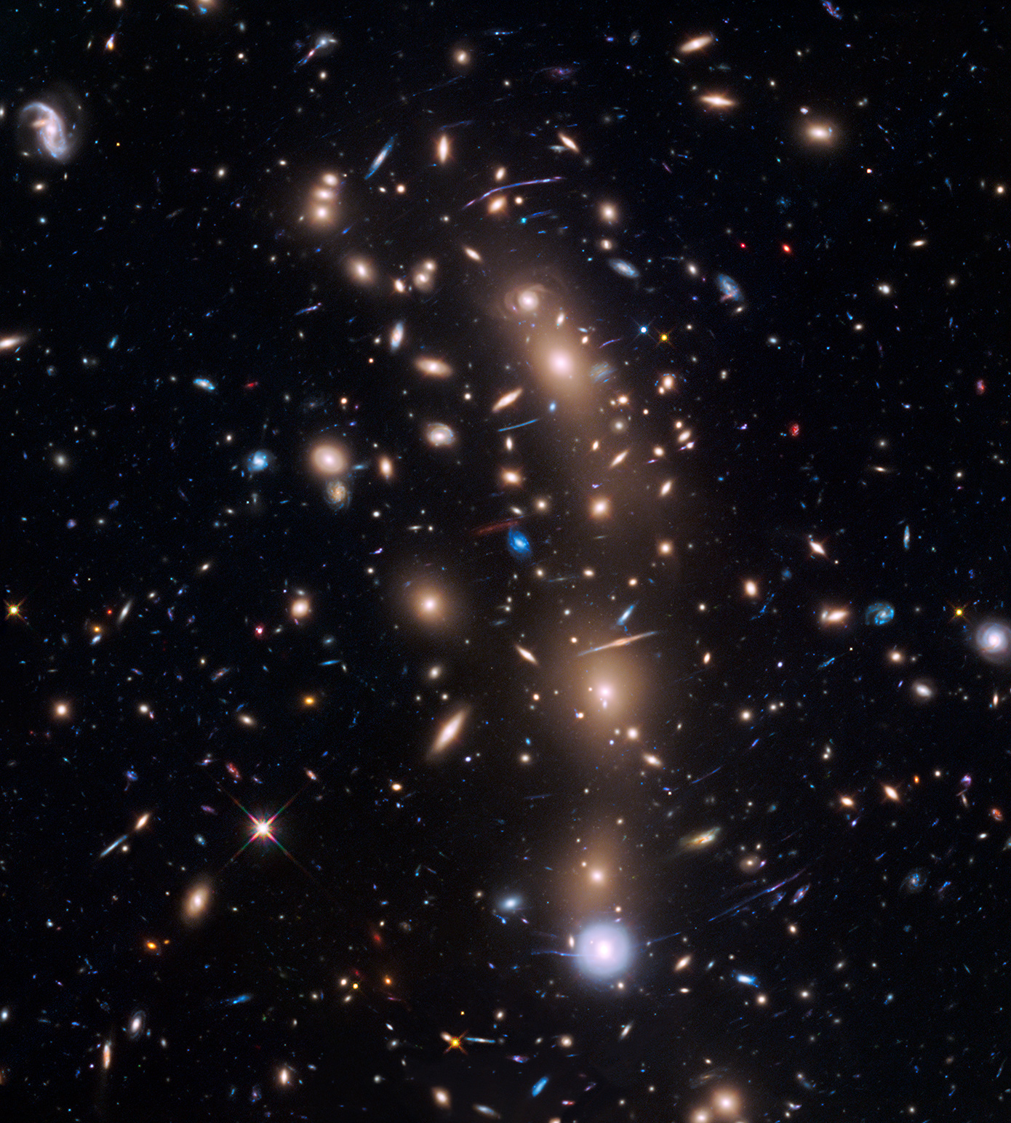
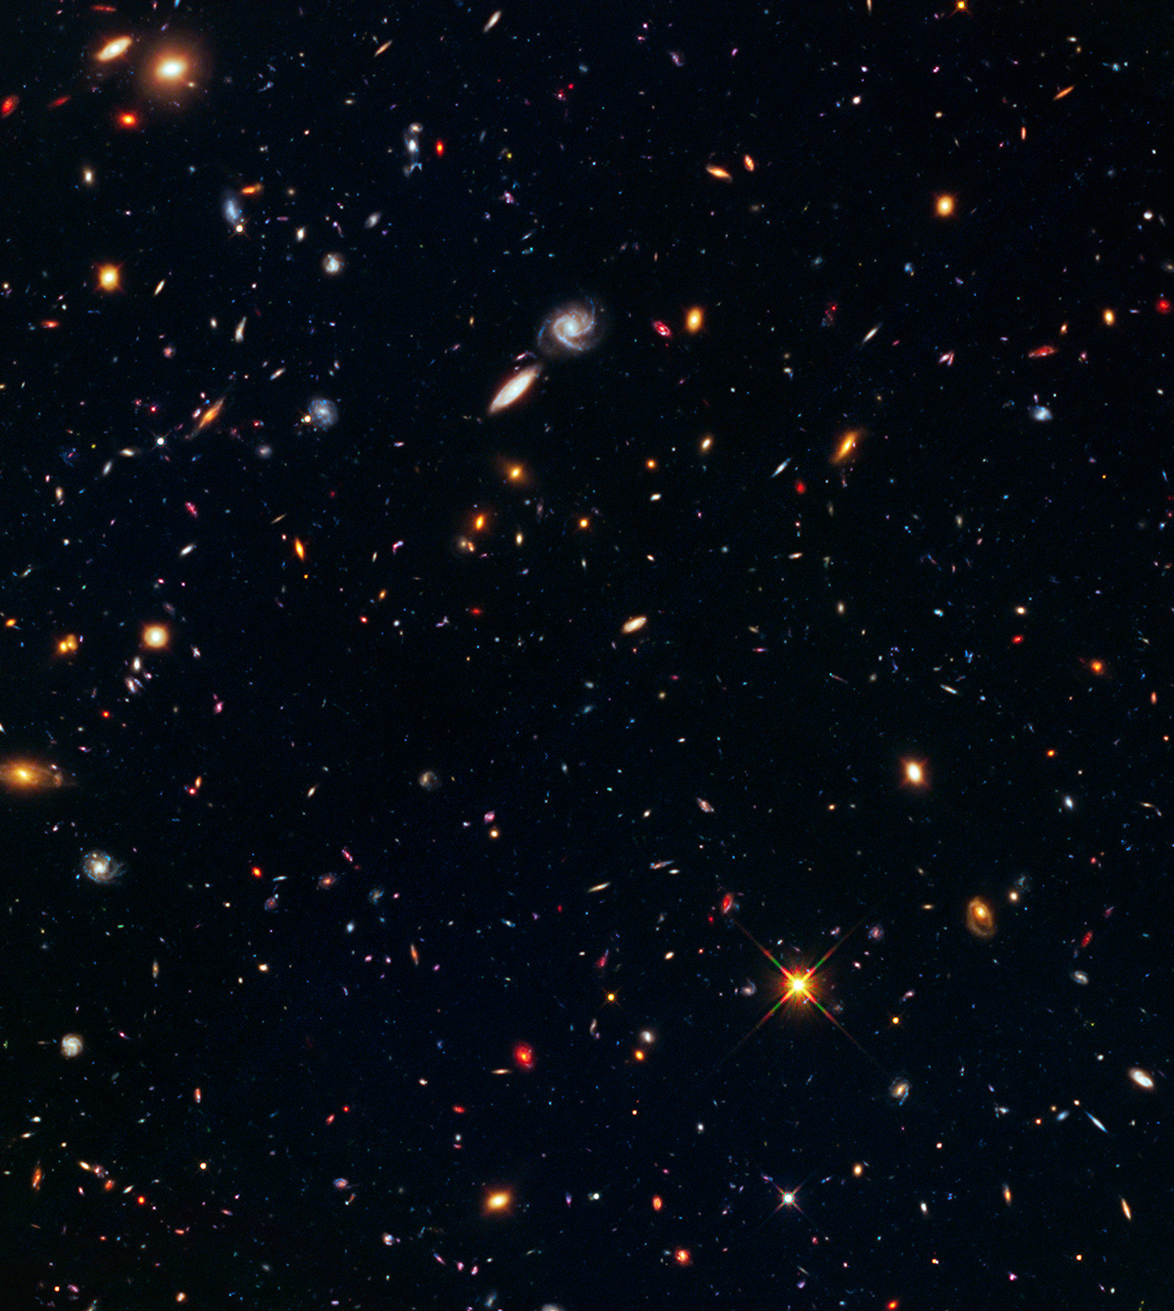
Frontier Fields: MACS0416 http://archive.stsci.edu/prepds/frontier/macs0416.html
MACS 0416 main cluster and parallel field
(full depth: 140 orbits ACS+WFC3 on each field)

Slide 6
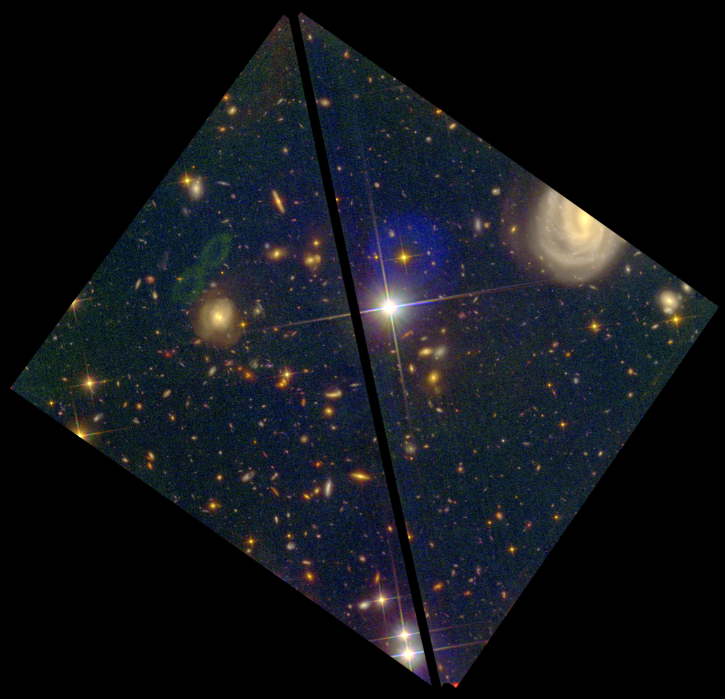
Frontier Fields: MACS 0717 http://archive.stsci.edu/prepds/frontier/macs0717.html
MACS 0717 main cluster and parallel field
(in progress: 70 orbits ACS on main cluster + 70 orbits WFC3/IR on parallel field)

Slide 7
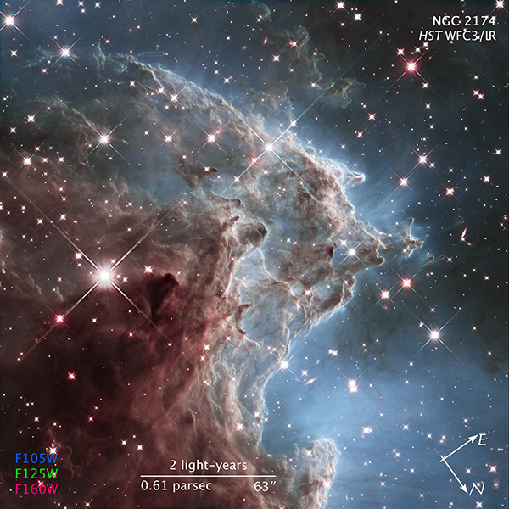
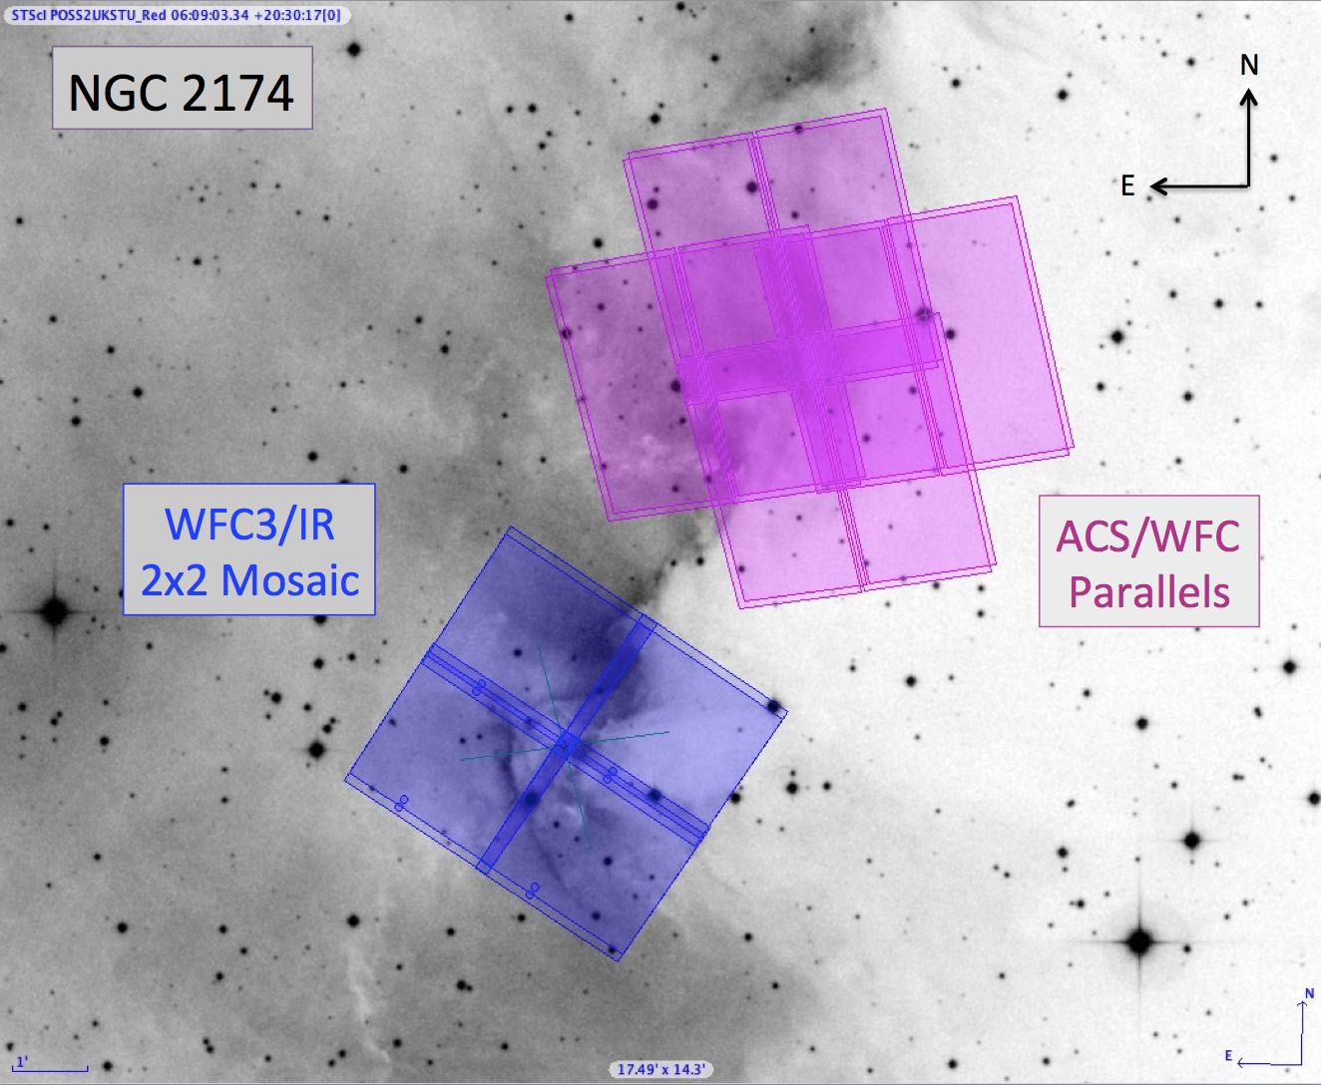
HST 24th Anniversary http://archive.stsci.edu/prepds/heritage/ngc2174
3-band WFC3/IR coverage (F105W, F125W, F160W) + ACS parallels

Slide 8
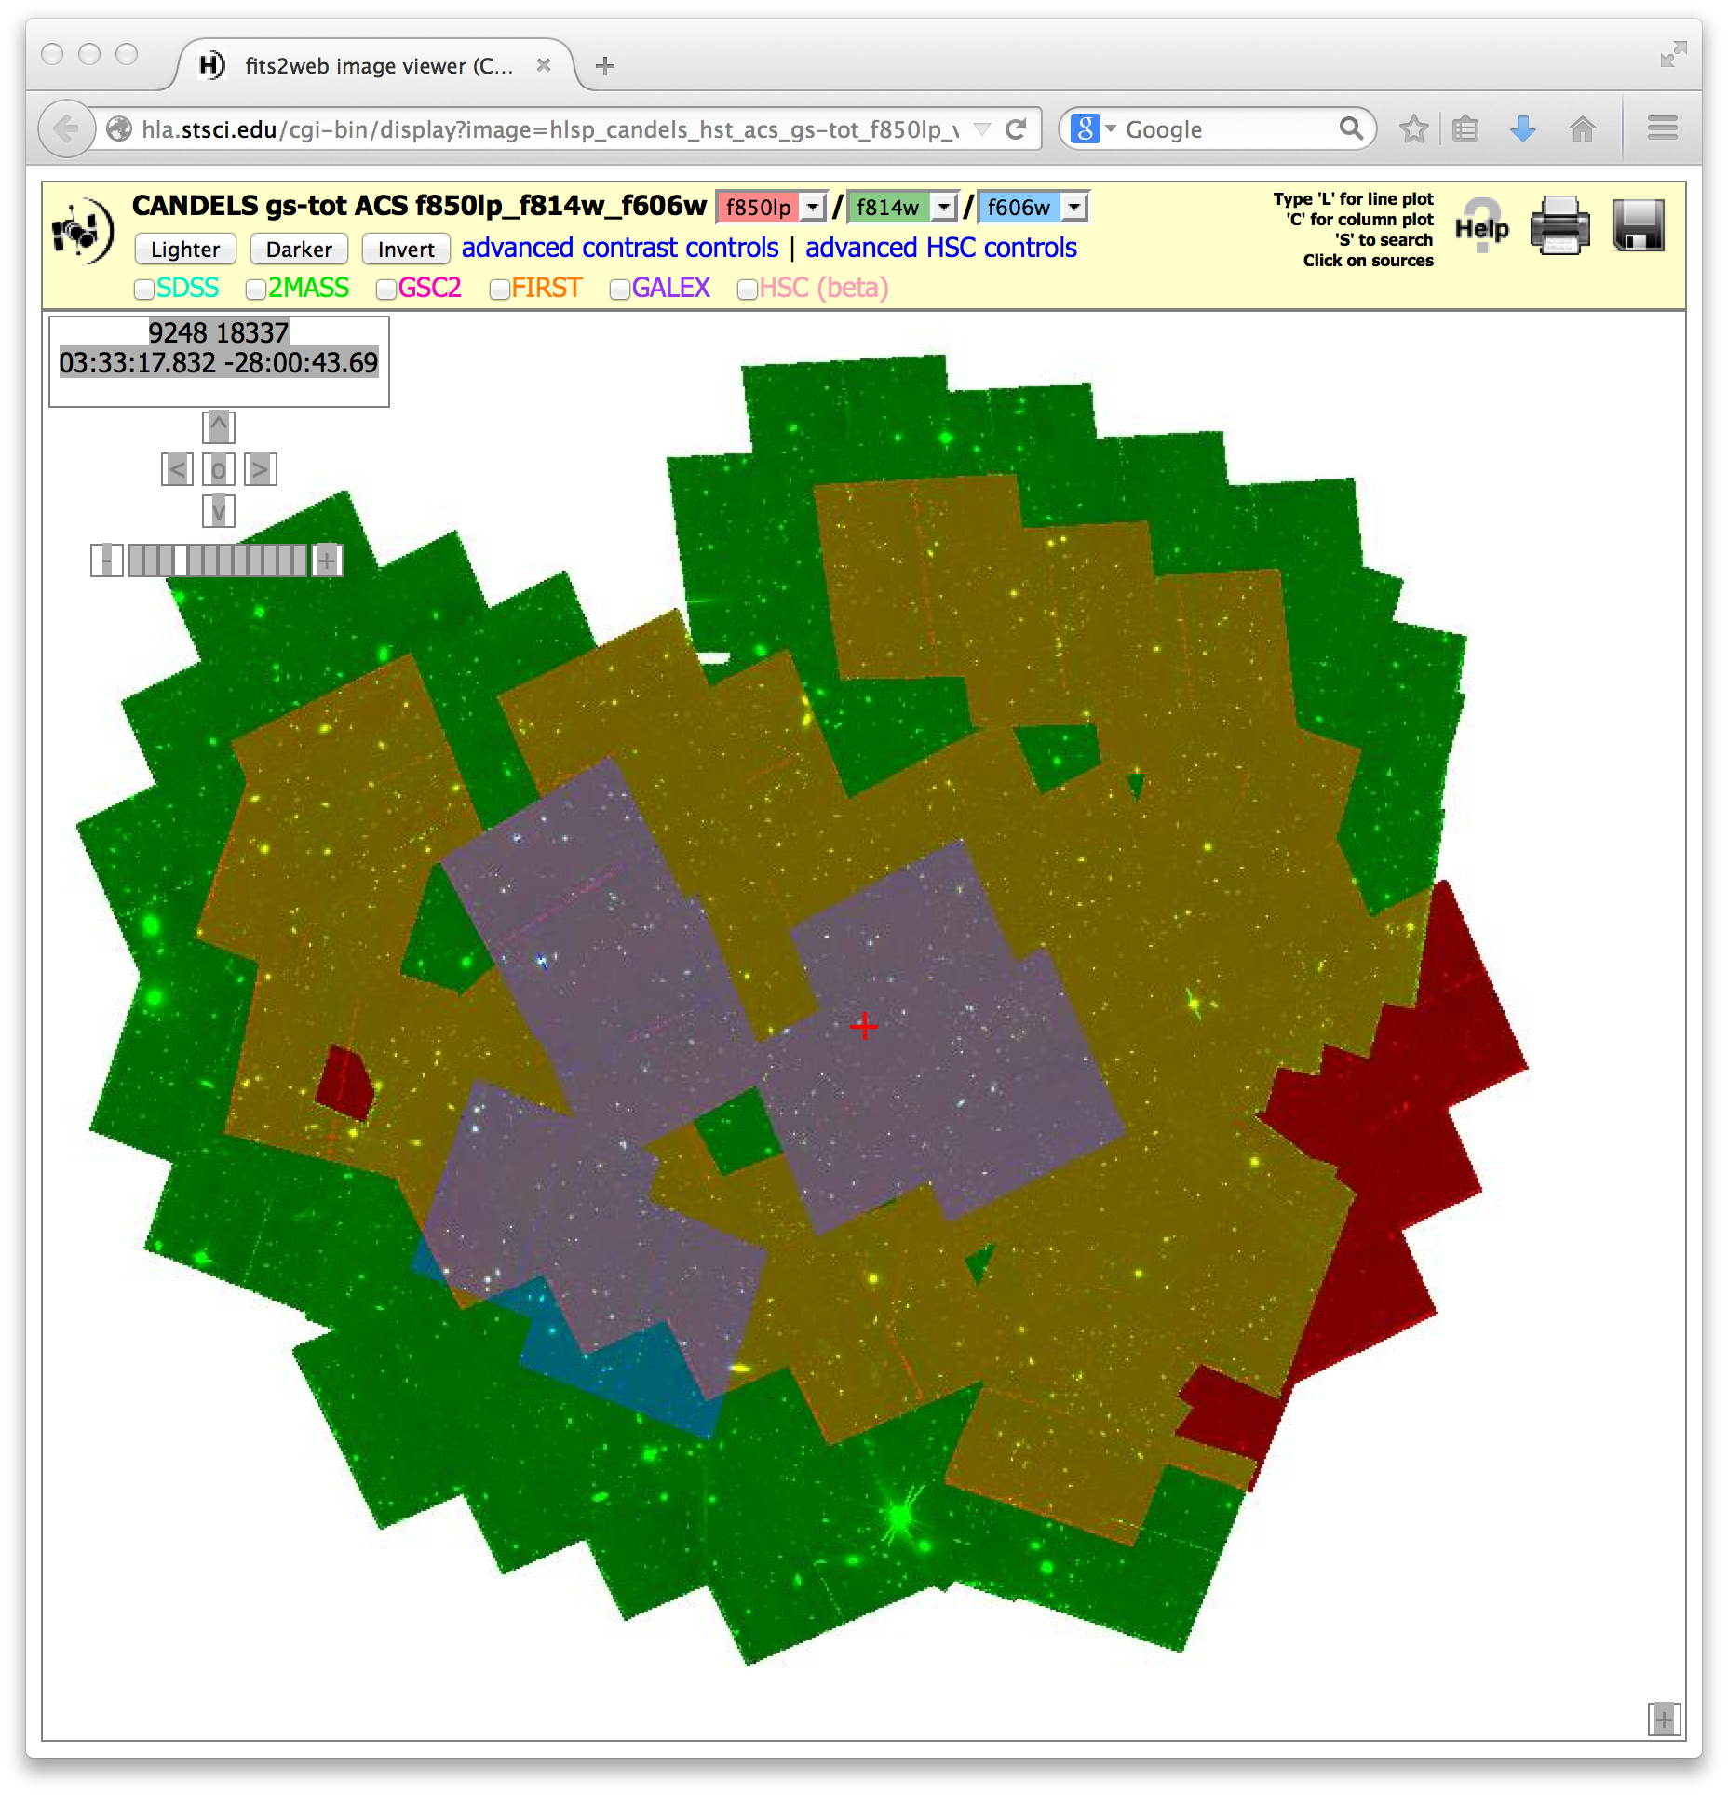
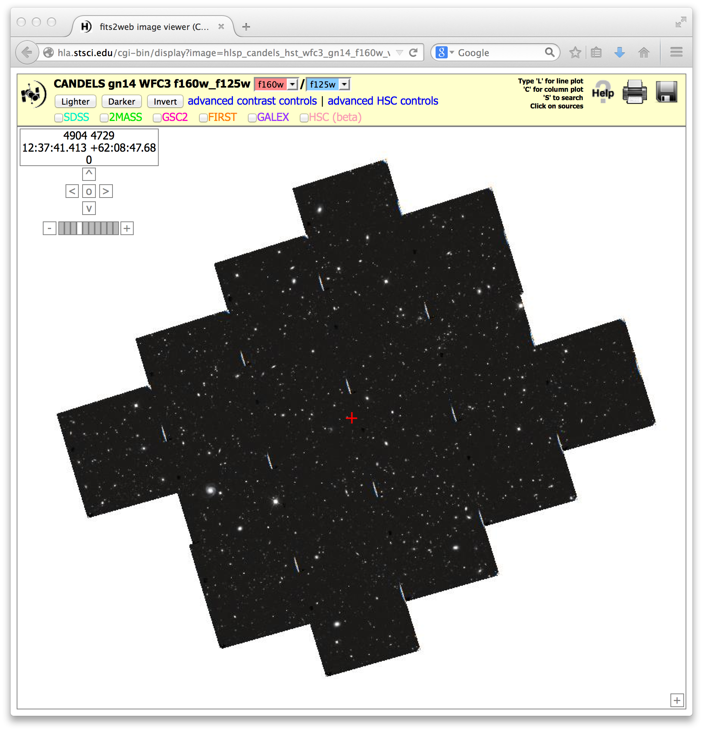
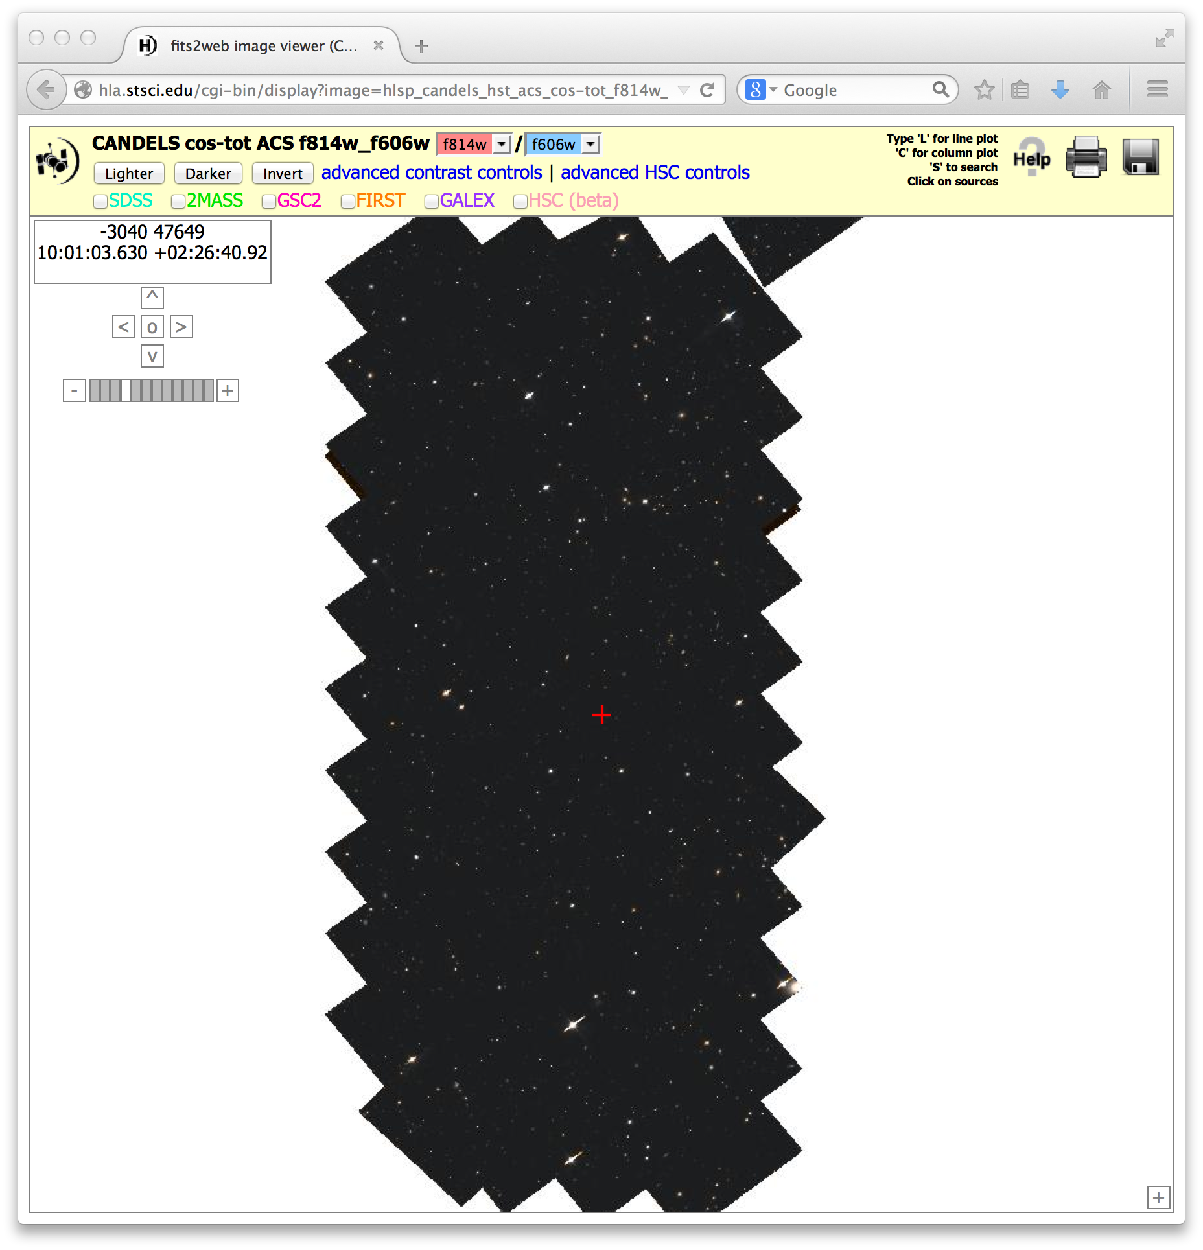
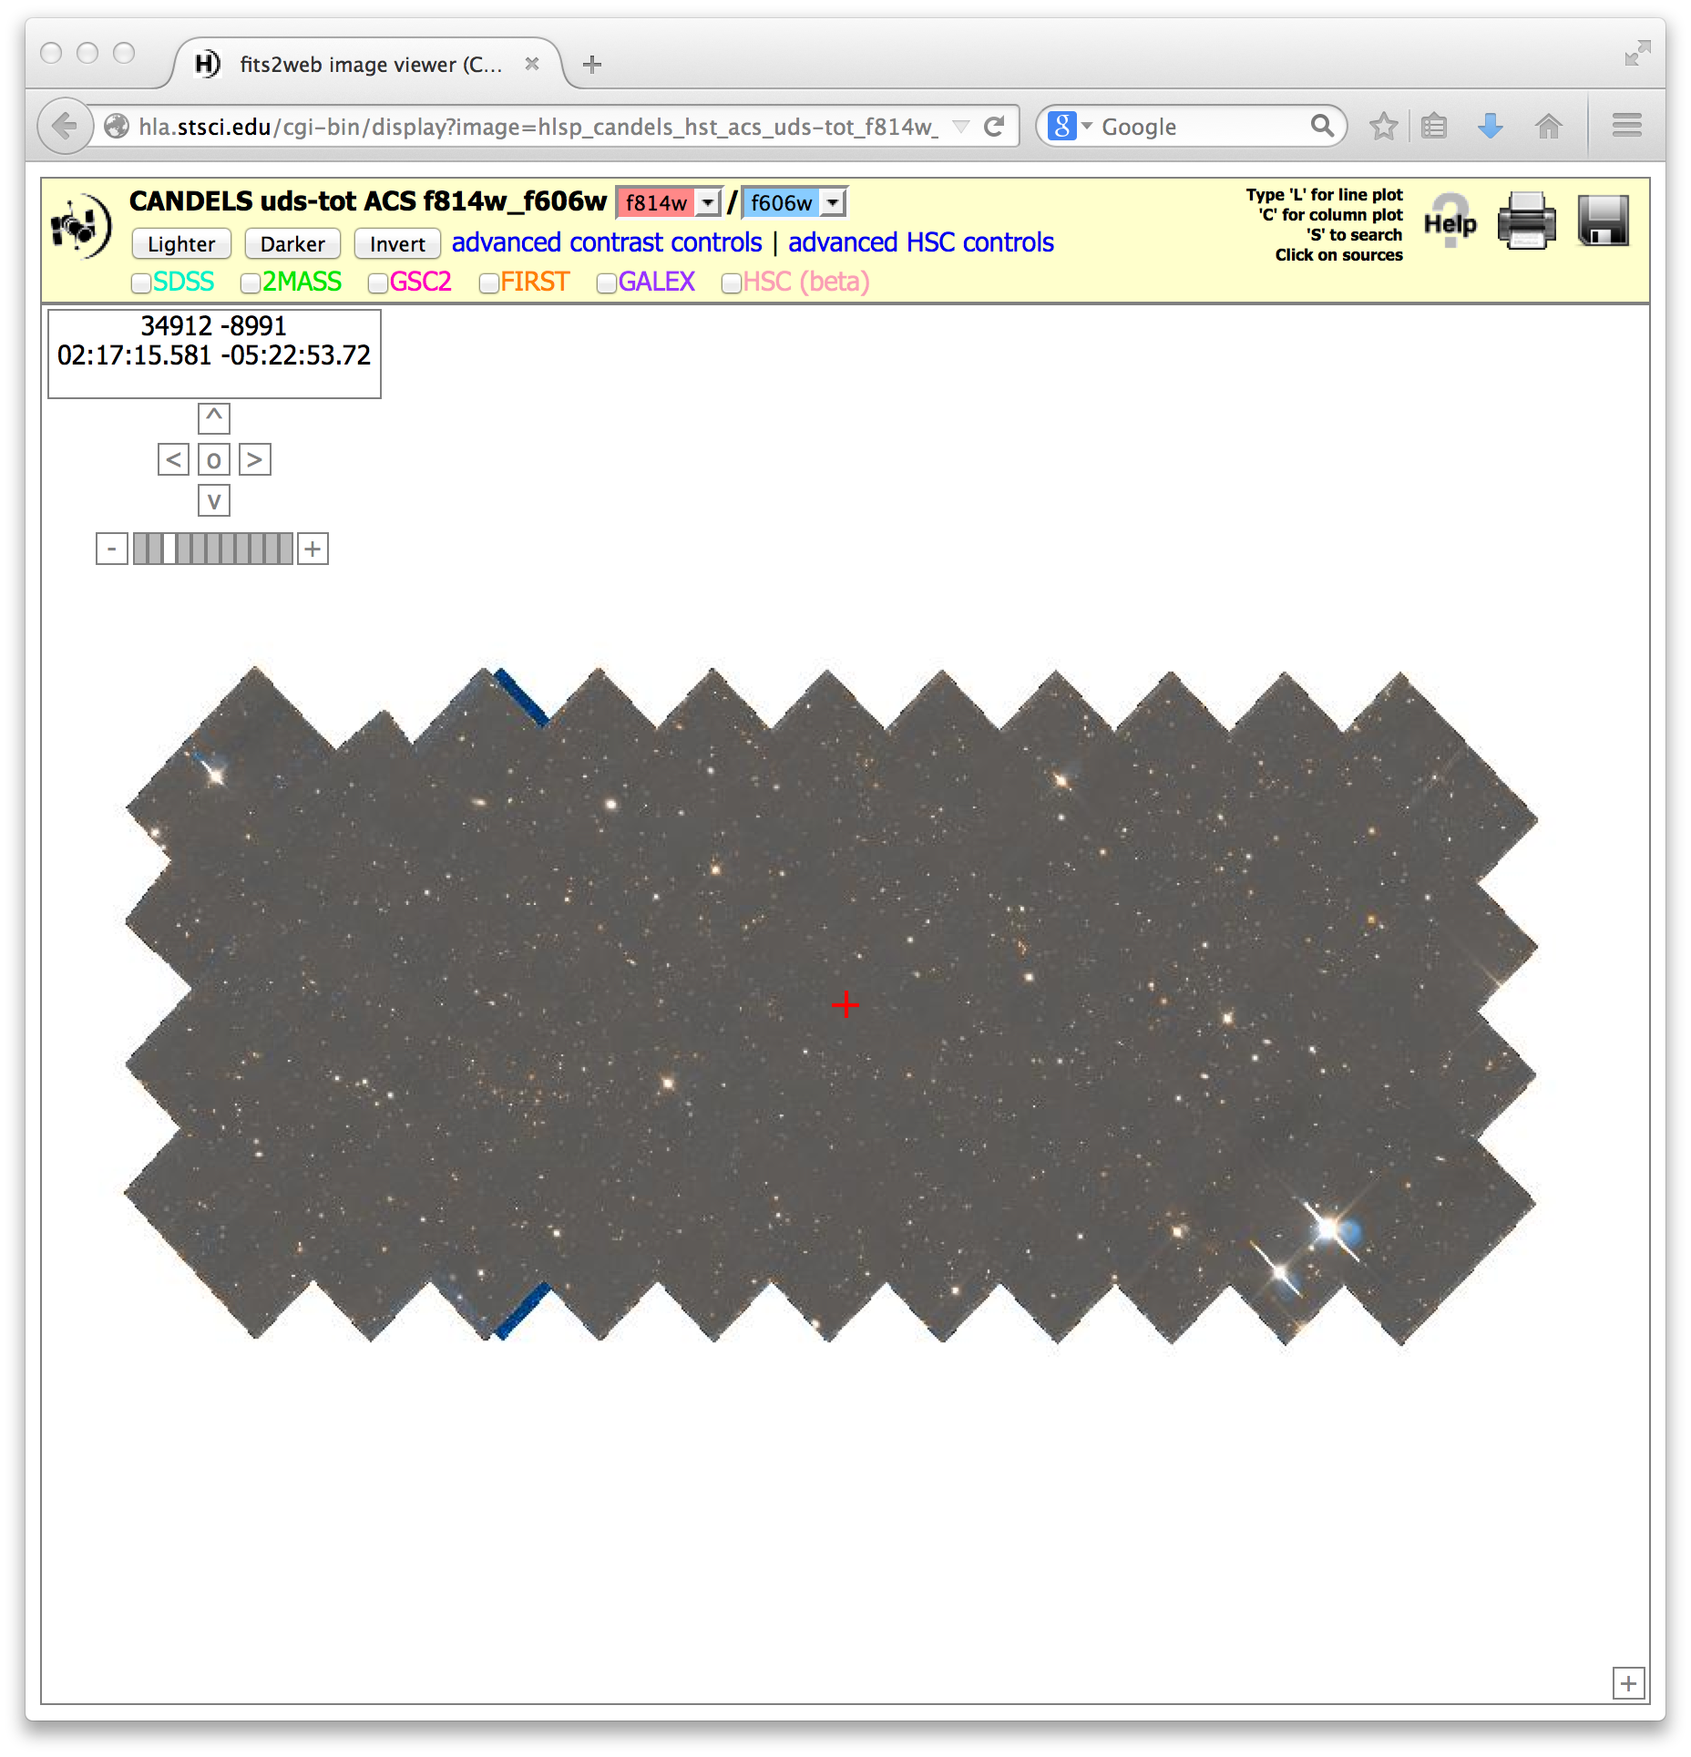
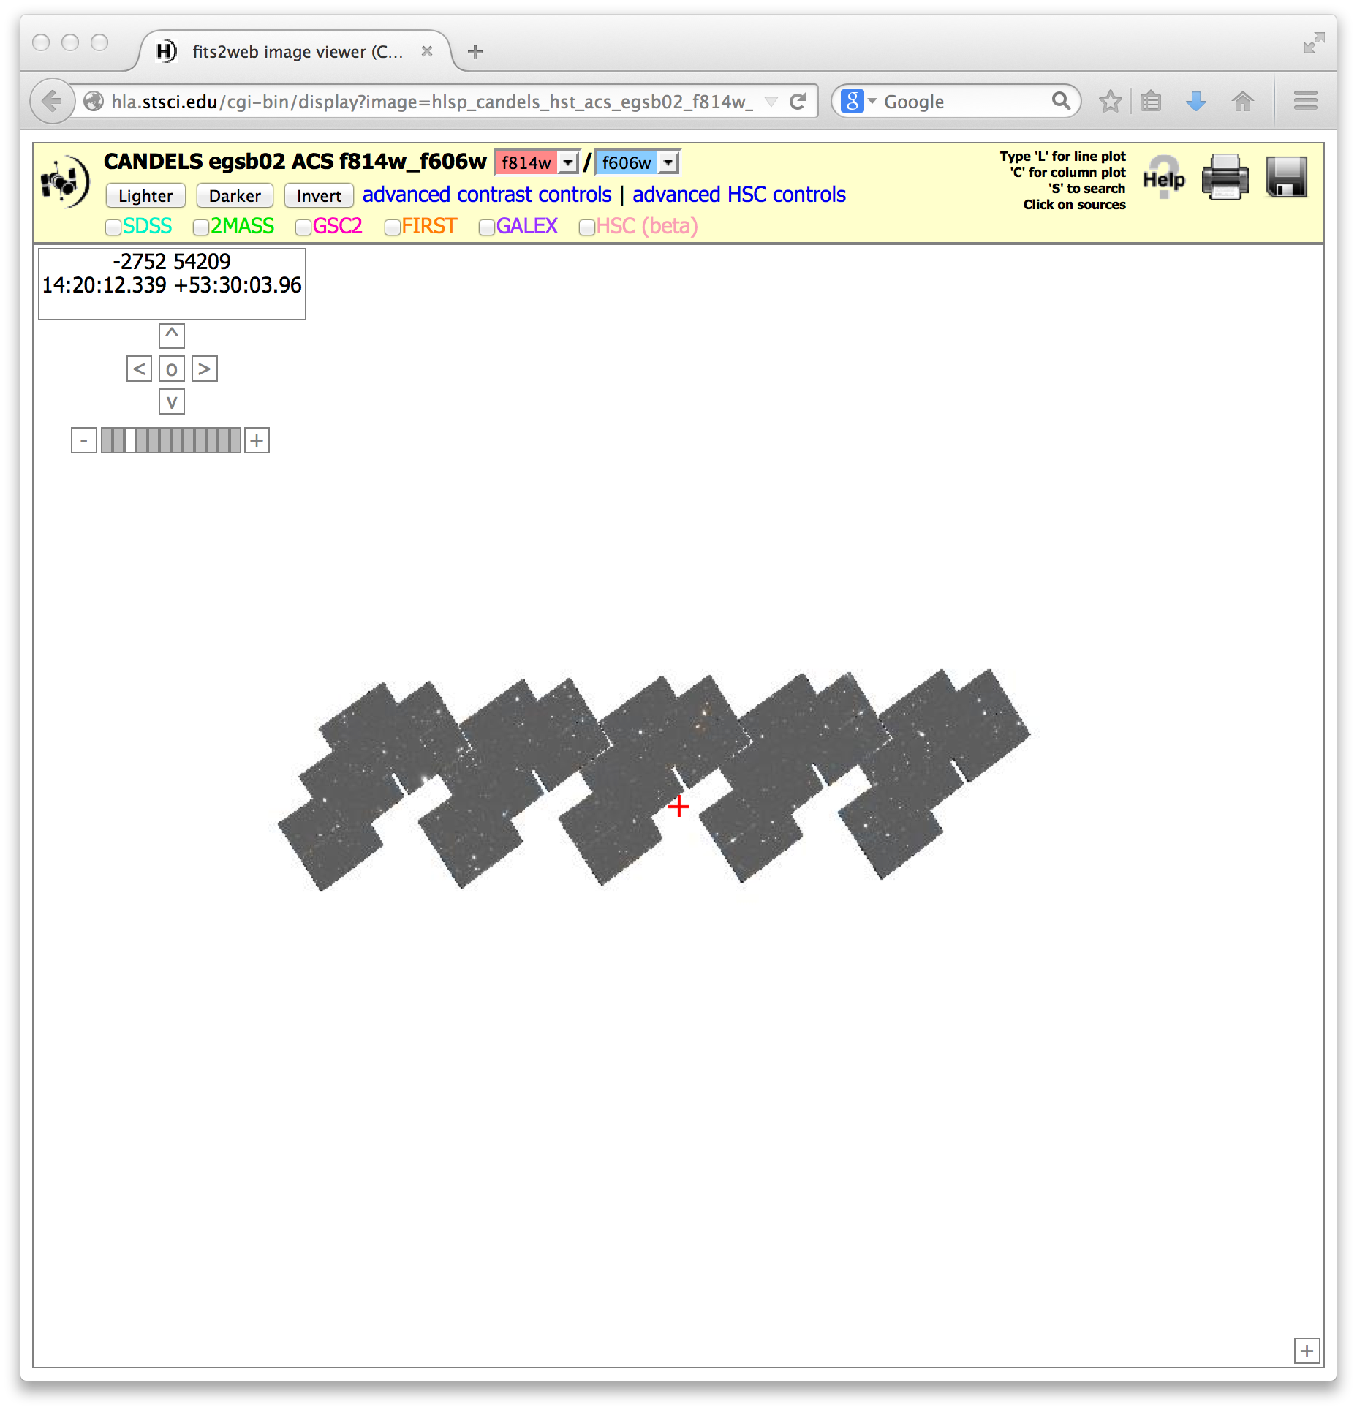
CANDELS http://archive.stsci.edu/prepds/candels
All 5 fields complete; mosaics delivered for all epochs; final mosaic was GOODS-N epoch 14
GOODS-S
GOODS-N
COSMOS
EGS
UDS

Slide 9
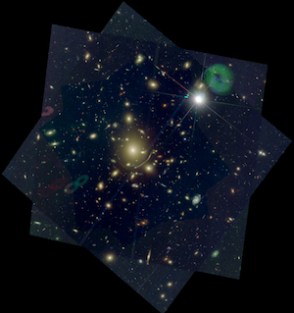
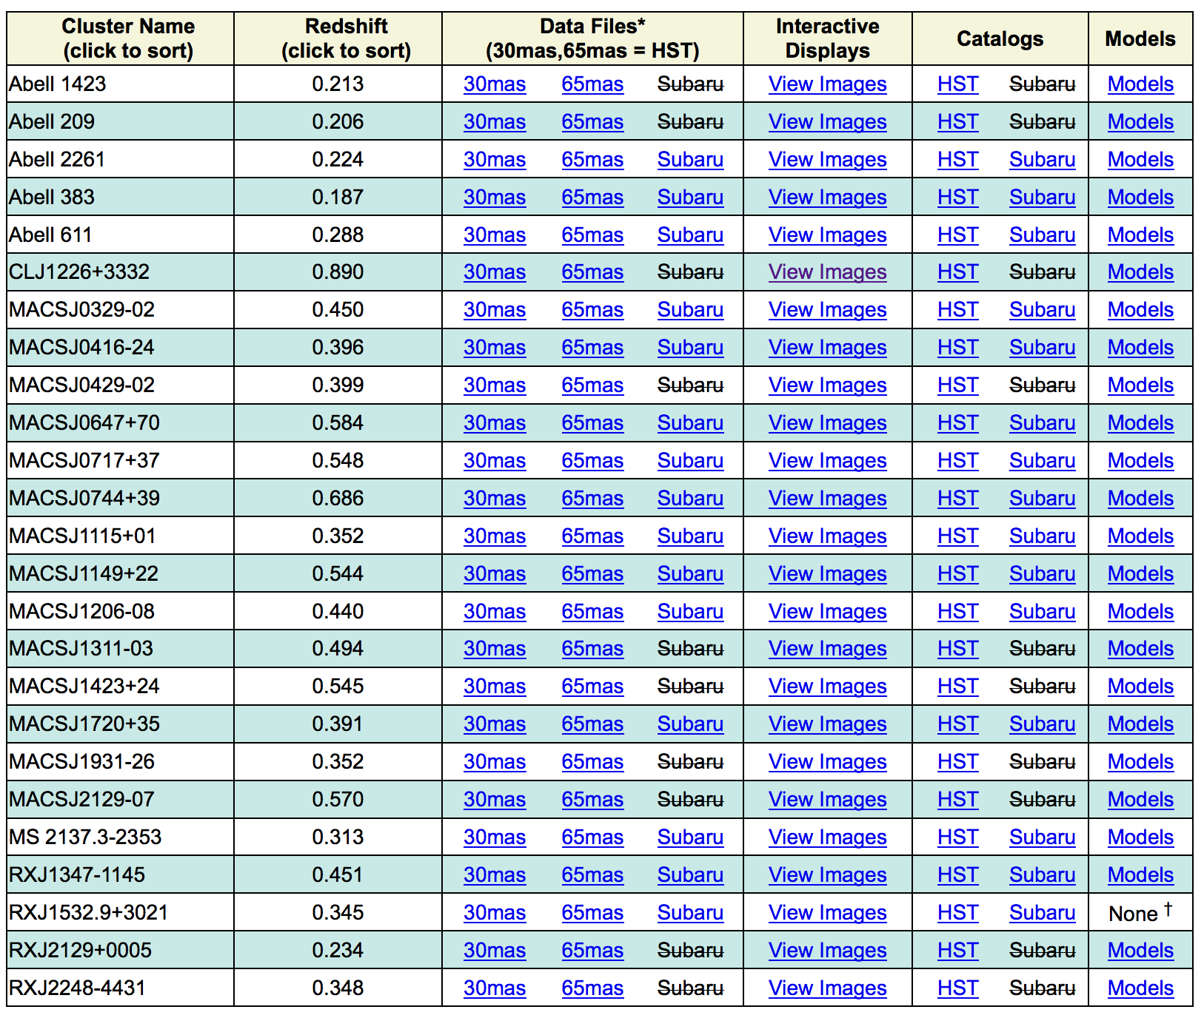
CLASH http://archive.stsci.edu/prepds/clash
All 25 clusters complete (15 HST bands each)
All HST mosaics delivered; Subaru images and catalogs also being delivered

Slide 10
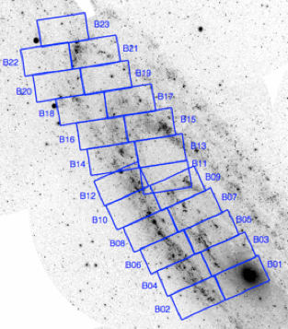
PHAT http://archive.stsci.edu/prepds/phat
F275W+F336W (WFC3/UVIS),
F475W+F814W (ACS/WFC),
F110W+F160W (WFC3/IR)
All 23 bricks complete and delivered / released
v2.0 photometry catalogs released

Slide 11
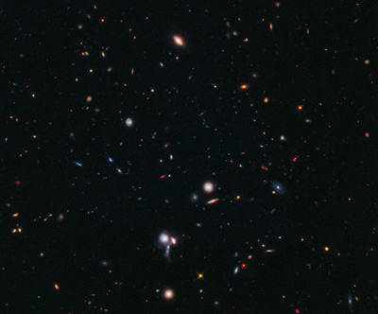
BoRG http://archive.stsci.edu/prepds/borg
ACS+WFC3 imaging of parallel fields in 4 filters: F606W, F098M, F125W, F160W
29 new fields added in April 2014
71 fields released in total
typical depth 1-3 orbits per field (depending on filter mix)

Slide 12
HLSP (Part 2 – non-HST-image HLSP)
Frontier Field Lens Models
GCAT
BCSCAT
COS IGN Survey
All-Sky GALEX UV Emission Maps
UV Linelist of White Dwarf G191-B2B
HST Moving Target Re-processed Images
Scott Fleming

Slide 13
Frontier Fields Lens Models
http://archive.stsci.edu/prepds/frontier/lensmodels/
Models from 5 independent teams released prior to FF observations – important results comparing FF data with the (pre-FF) models.
HLSP page includes Interactive Displays for model maps, lens tool calculator written by Dan Coe.
New models include first external team (GLAFIC) and first models that include data obs. during FF.

Slide 14
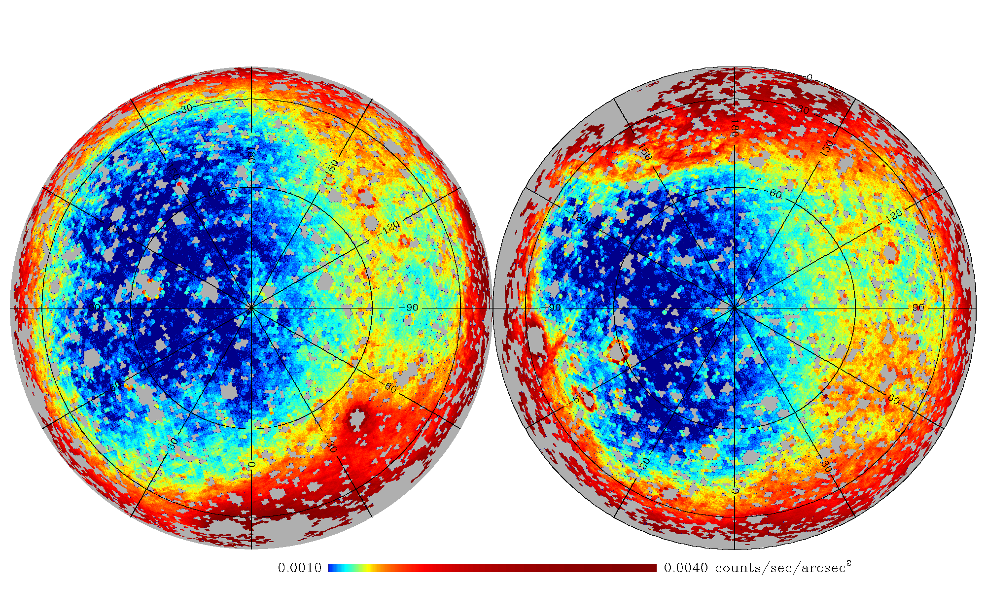
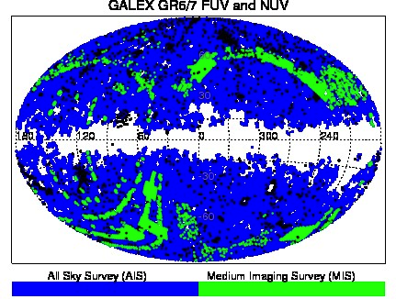
GALEX Unique Source Catalogs
http://archive.stsci.edu/prepds/{gcat, bcscat}
GCAT (Seibert et al.)
AIS, MIS -> GR6
GR7 in Kepler area
NUV-based catalog
S:N_NUV > 3
“best” (deepest) obs. for a source
BCSCAT (Bianchi, Conti, & Shiao, 2014 AdSpR, 53, 900
AIS, MIS -> GR7
Must have at least one obs. when FUV+NUV detectors on

Slide 15
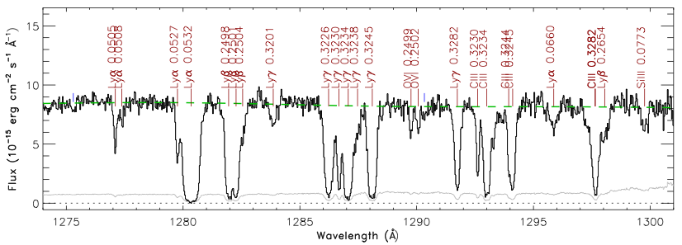
COS Survey of IGM
http://archive.stsci.edu/prepds/igm/
Coadd spectra of 75 bright AGN (Danforth et al.)
Spectral features identified semi-automatically
Galactic (MW) and intergalactic (redshifted) features from multiple species
>2,500 redshifted IGM systems at z < 0.723
Spectra, linelists, preview plots (above)

Slide 16
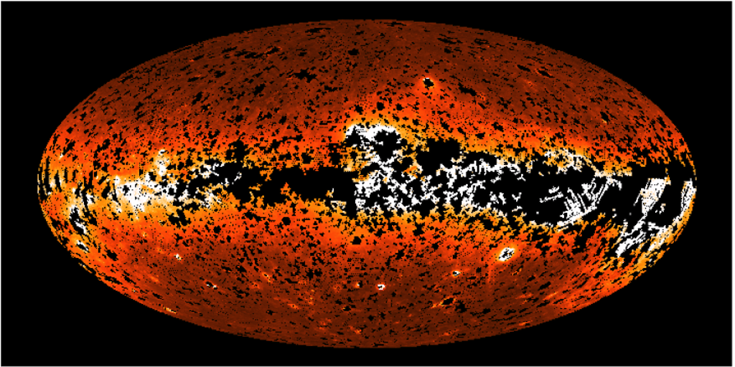
GALEX UV Emission Maps
http://archive.stsci.edu/prepds/uv-bkgd/
Maps of diffuse emission (GR7, J. Murthy)
Geocoronal and zodiacal components
2 arcminute resolution, includes 100 micron map
FITS projections, CasJobs tables, telemetry

Slide 17
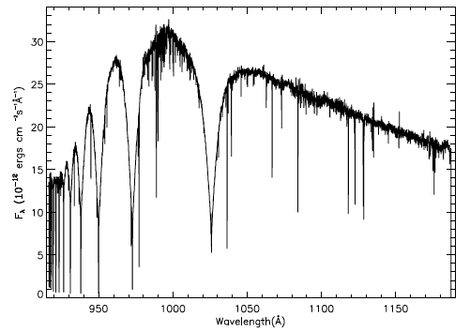
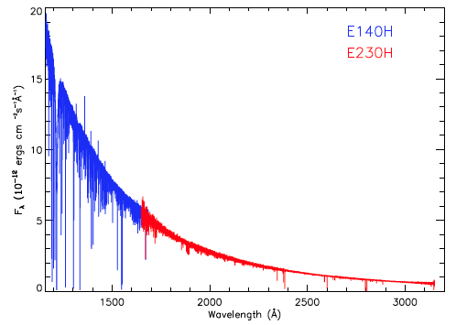
UV Linelist of a White Dwarf
http://archive.stsci.edu/prepds/wd-linelist/
Most complete linelist of a white dwarf to-date (Preval et al.)
Over 150 spectra from STIS and FUSE
Nearly 950 lines identified using latest spectral libraries
Individual spectra, coadded spectra, linelists

Slide 18
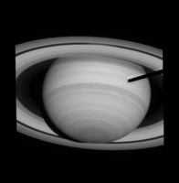
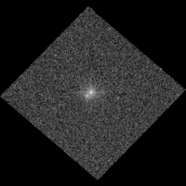
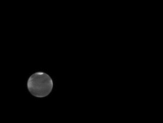
In Progress: HST Moving Target Re-processed Images
WFPC-2, WFC-3, and ACS re-processed with different CR rejection and drizzling, optimized for moving targets
Includes predicted ephemerides of known moving targets within an image
Includes a “MAST Classic” search interface

