Slide 1
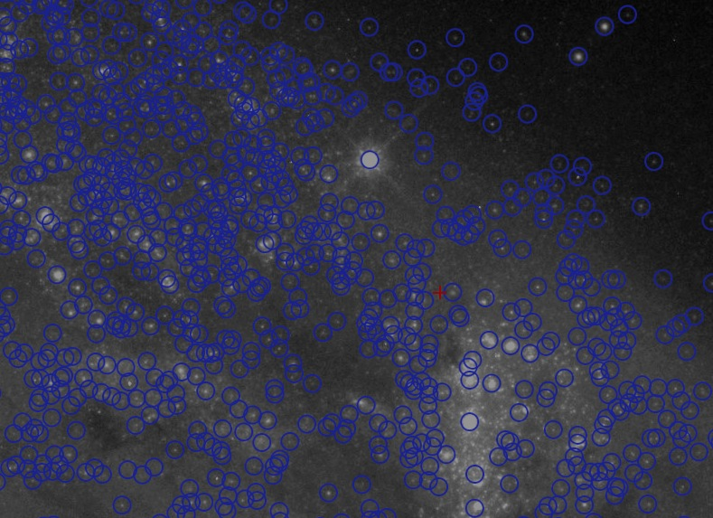
Hubble Legacy Archive and Hubble Source Catalog
Rick White & Brad Whitmore
Current teams:
HLA: Michael Dulude, Mark Kyprianou, Steve Lubow, Brian McLean, Lee Quick, Lou Strolger, Rick White
HSC: Tamás Budavári, Tom Donaldson, Steve Lubow, Lee Quick, Lou Strolger, Geoff Wallace, Rick White, Brad Whitmore

Slide 2
Hubble Legacy Archive (HLA) http://hla.stsci.edu
Goals:
Process HST data to produce higher-level, science-ready data products: combined images, mosaics, source catalogs
Based on software developed for data analysis (e.g., Multidrizzle) and research projects (e.g., Anton’s pipelines for GOODS, COSMOS, etc.)
Develop advanced web interfaces to the archive using next-generation browser technology
Primary future focus is on data product generation as MAST portal becomes the user interface
HLA user interface concepts (and some technology) adopted by portal and used for many other MAST services already
History: DR1 (2008 Feb 08) through DR8 (2014 Dec)
ST-ECF Grism
DR1
DR2
DR2.5
DR3
DR4
DR5
DR6
DR6.1
DR7
DR7.1
DR7.2
DR8
2008
2009
2010
2011
2012
2013
2014

Slide 3
Hubble Source Catalog (HSC) http://archive.stsci.edu/hst/hsc
Goal: Create master catalog of objects from HST images to enable database-driven research
Challenges:
Highly inhomogeneous sky coverage, hundreds of filters
Unreliable astrometry makes cross-matching hard
History:
Beta 0.1 (2012 June): ACS/WFPC2 HLA SExtractor source lists (Budavári & Lubow 2012 paper)
Beta 0.2 (2013 May): Improved source matching (using automated pre-offsets from 2MASS), improved tools (HLA source overlays, summary form, …)
Beta 0.3 (2014 March): Includes WFC3/UVIS and WFC3/IR HLA source lists, better source matching (fewer spurious sources)
Notes:
Input: thousands of HLA source lists

Slide 4
HLA Progress: Conversion to AstroDrizzle Pipeline
Better registration between images (e.g., correction of guide-star errors between orbits)
Improved geometric distortion corrections
Correction of Multidrizzle software bugs
New compute servers allow processing all WFC3 data in ~1 week
Before After
Notes:
Hst_calib – latest flats, DQ arrays (bad pixels, saturations, cosmic rays).
AstroDrizzle– improved geometric distortion correction, other Multidrizzle bugs
Drizzlepac– improved image transformation methods for better intra-exposure alignments.

Slide 5
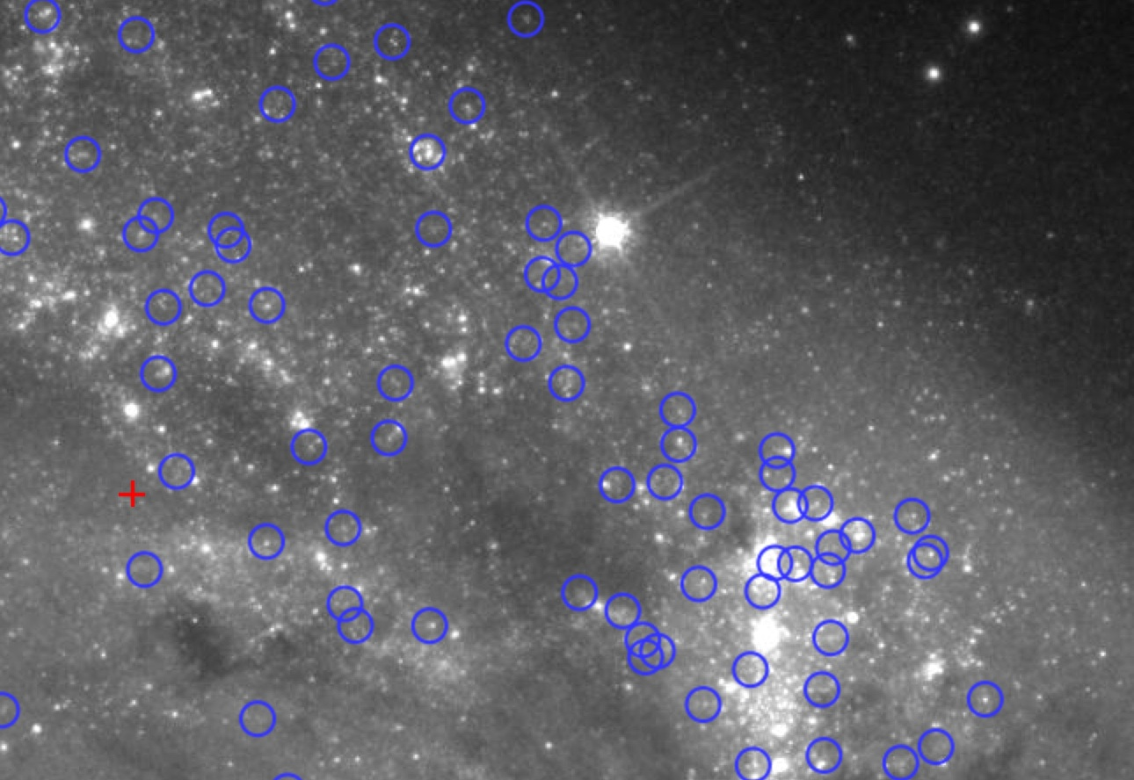
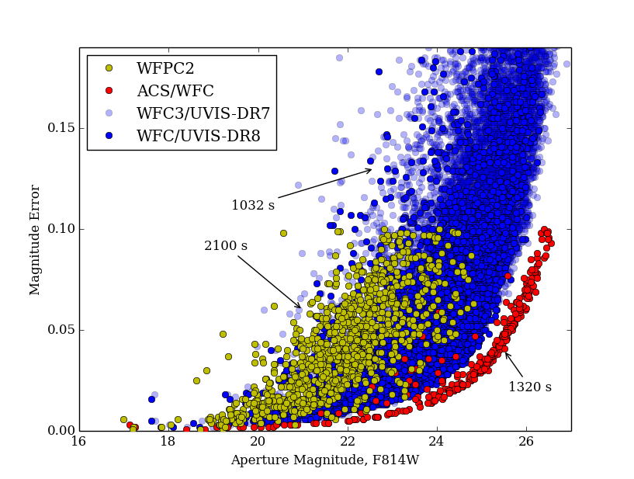
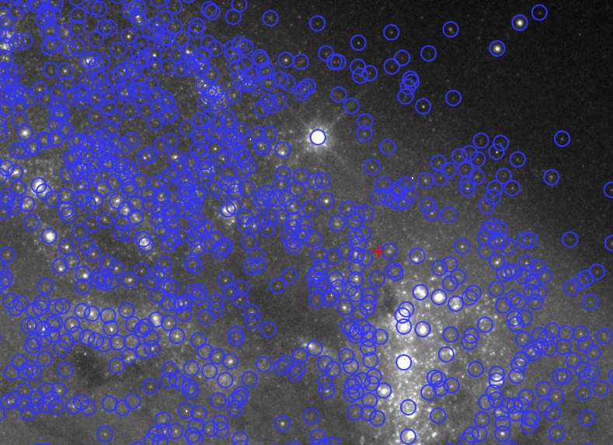
HLA Progress: Source Lists
The quality of WFC3 source lists represents a dramatic improvement in uniformity and depth compared to existing ACS and WFPC2 source lists.
The new (HLA DR8) WFC3 source lists are similar in quality to DR7, but reject more spurious sources
More than 2.5 times as many source lists with addition of new data
HSC Beta 0.3, ACS, N=992,
high background region in Antennae
HSC Version 1, WFC3, N~10,000

Slide 6
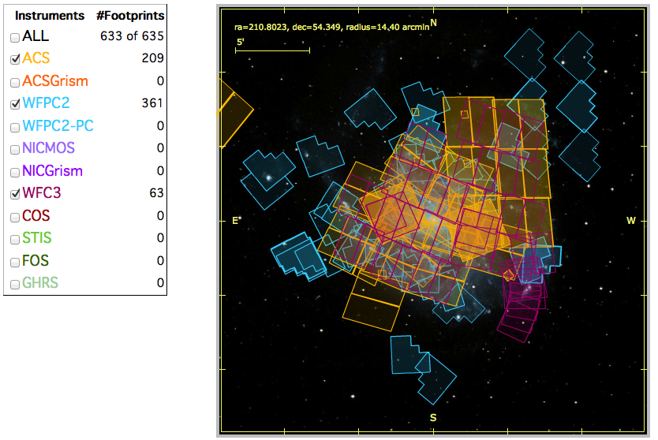
HSC Motivation: The Big Picture
Hubble footprint for M101
SDSS image and catalog
Example of potential for supporting Database Astronomy:
The Hubble Source Catalog:
Combines tens of thousands of HLA visit-based source lists into a master catalog.
Provides entry into the rapidly growing field of Database Astronomy.
Will be a fundamental reference for JWST users, and upcoming surveys (e.g., PanSTARRS, LSST).
HSC sources
Notes:
How much science would have come from SDSS if everyone had to make their own catalog.
Reminder on quality of higher spatial resolution HST data. Typically 10 – 100 times more sources in the same FOV as SDSS.

Slide 7
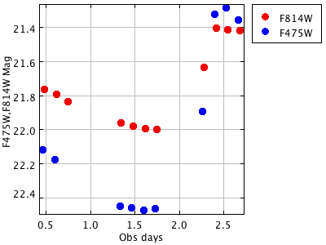
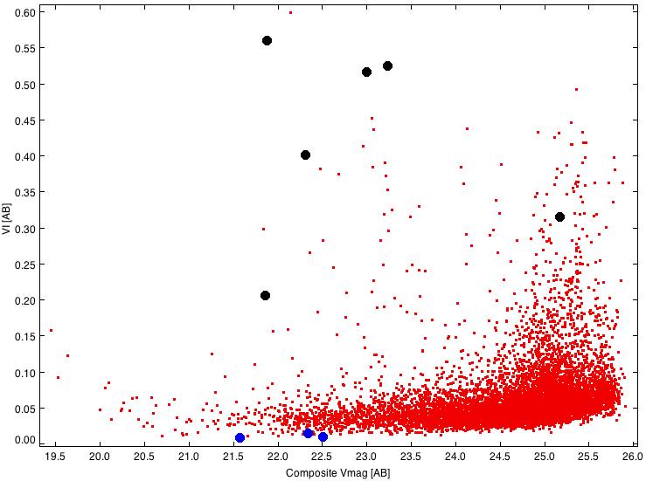
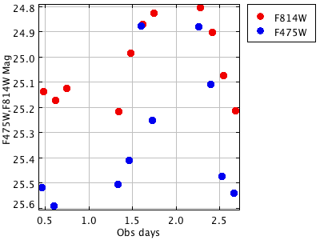
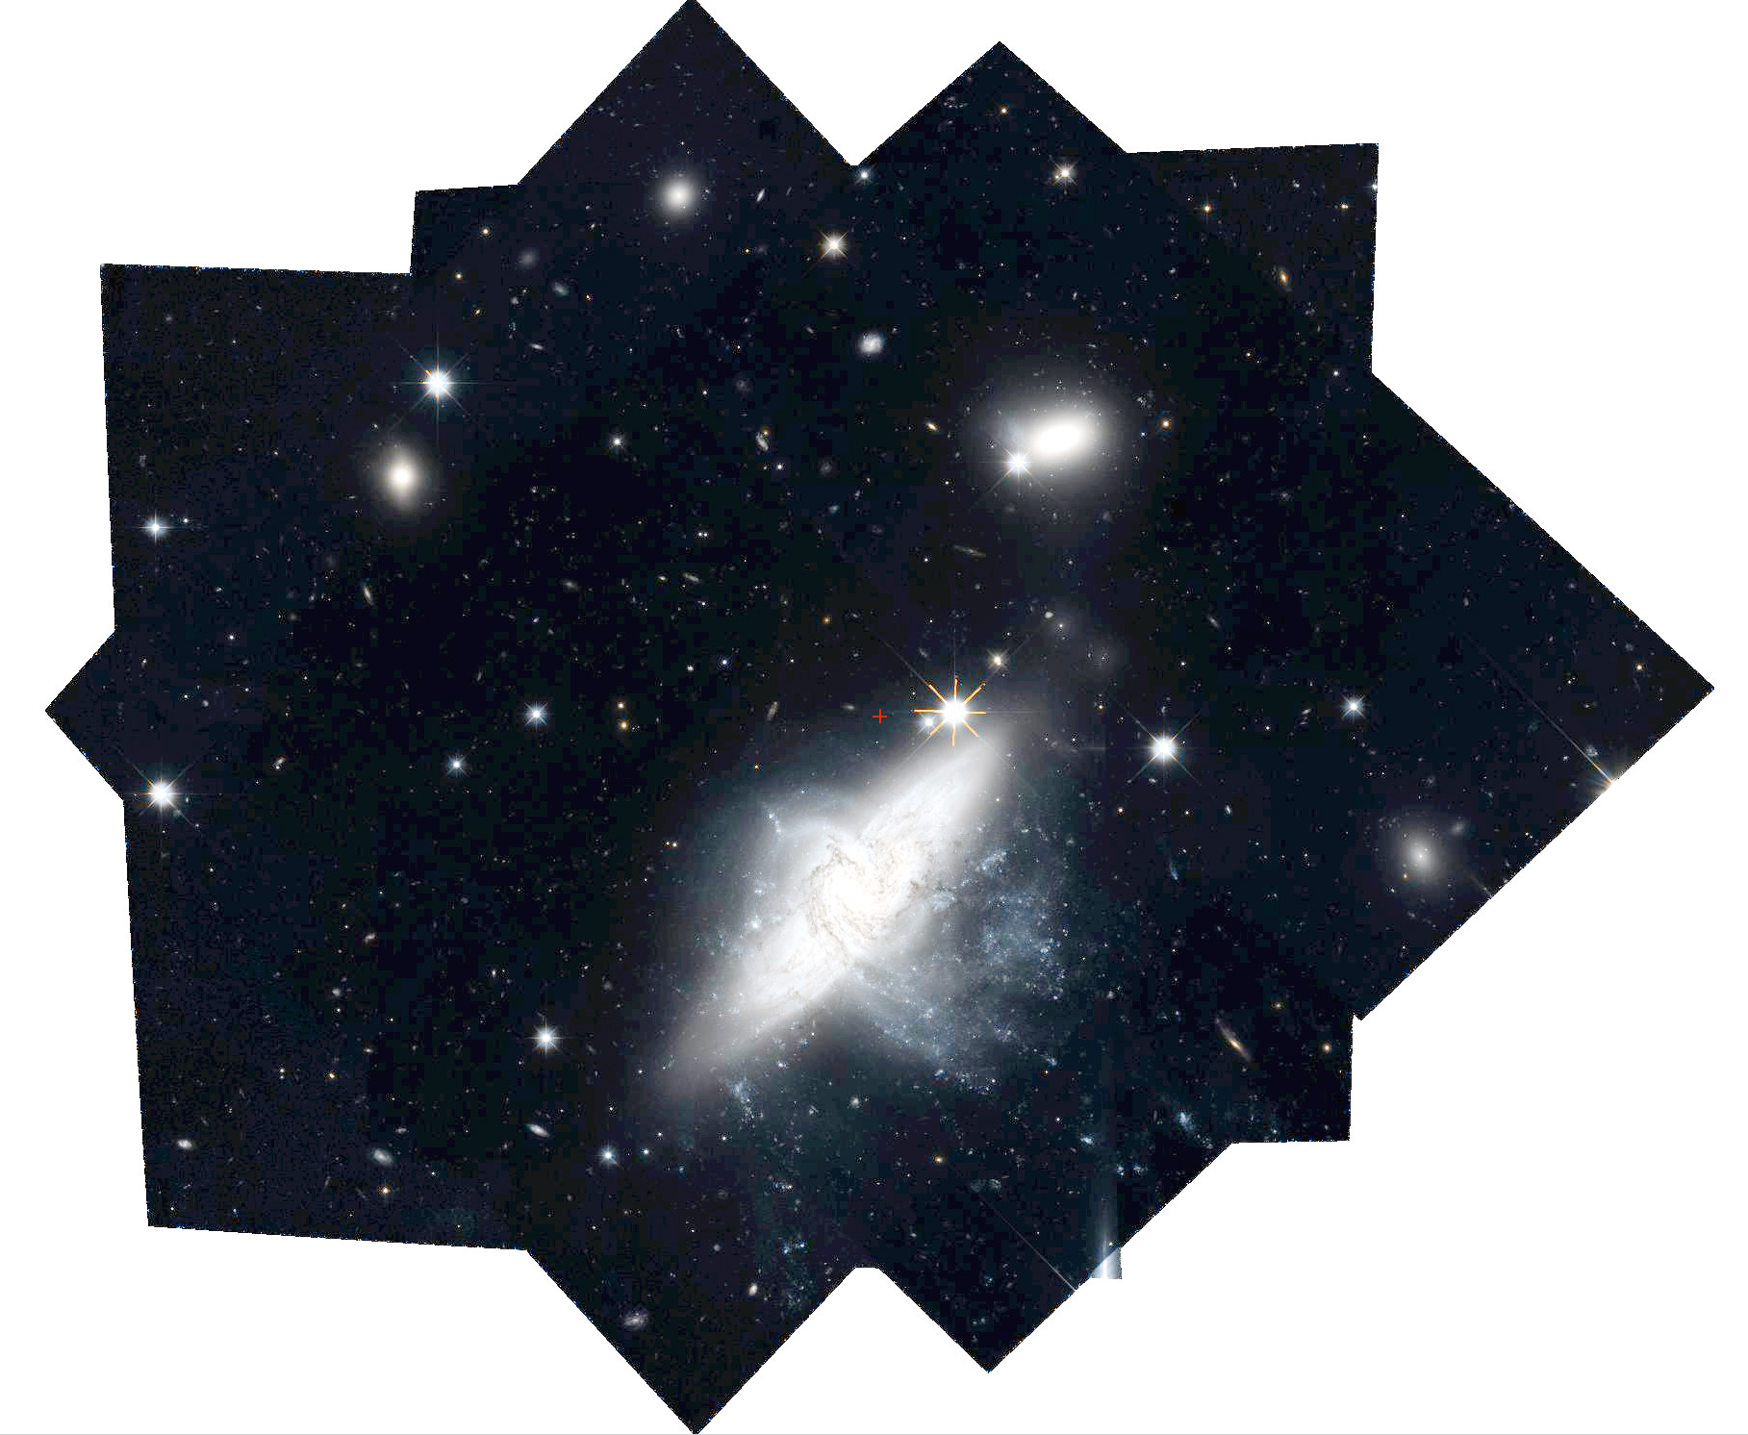
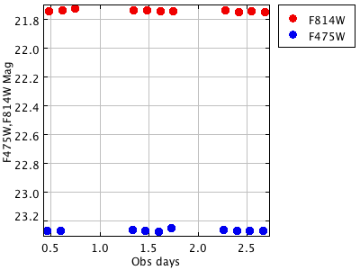
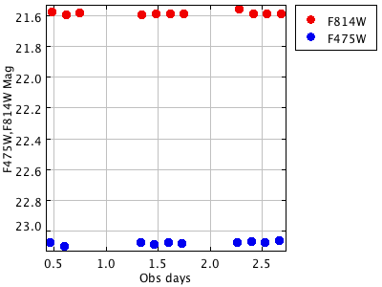
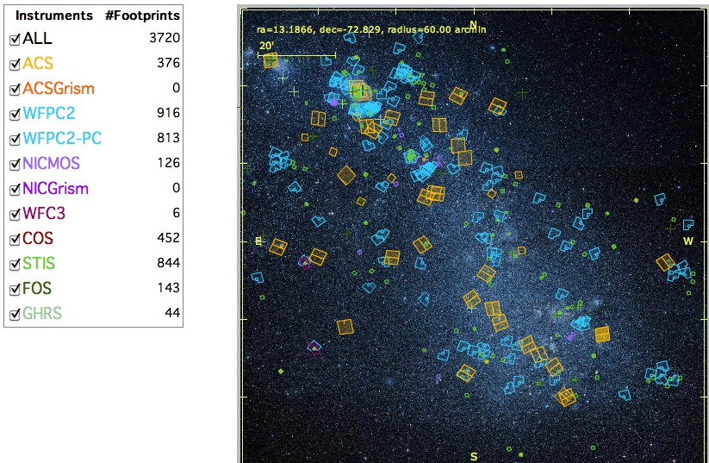
Three more reasons to build the HSC
2. Mosaics – Accurate spatial offsets between observations are needed to build the HSC. These can then be used to make mosaics.
1. Time-variable phenomena – The HSC supports time-variable studies over >20 year baseline.
HSC photometry of dwarf galaxy IC 1613
124 ACS images
29 separate visits
3. Very large datasets – Replicating what is available in the HSC in seconds would take most researchers weeks, months, or years to produce.
Hubble images of the SMC
Notes:
1 + 2 HSC will do BOTH mosaics and time-variable (visit based) reductions.
2. The HLA started making mosaics but found it too hard. Needed better relative offsets between images before could continue, i.e., the HSC
4. SDSS brought in a new era of “database astronomy”. The HSC will incorporate Hubble into this revolution.

Slide 8
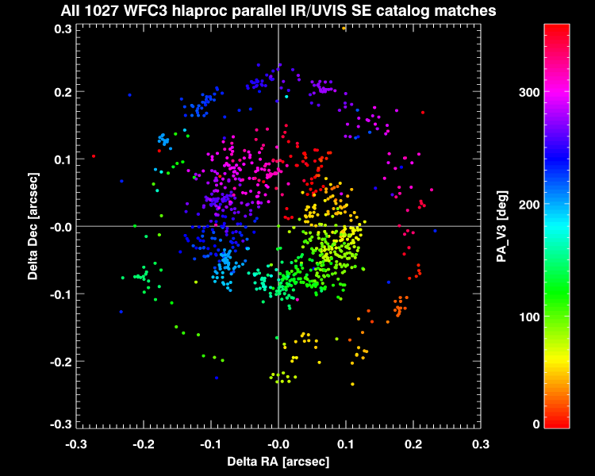
Aside: Comparison of WFC3/IR & WFC3/UVIS astrometry (within same visit, using same guide stars)
The circle centered on zero, with the PA_V3 correlation, indicates a shift between the IR and UVIS apertures
Notes:
Comparison of IR and UVIS “parallels” (within a single visit using same Guide Stars)
The circle centered on zero, with the PA_V3 correlation, indicates a shift between the IR and UVIS apertures

Slide 9
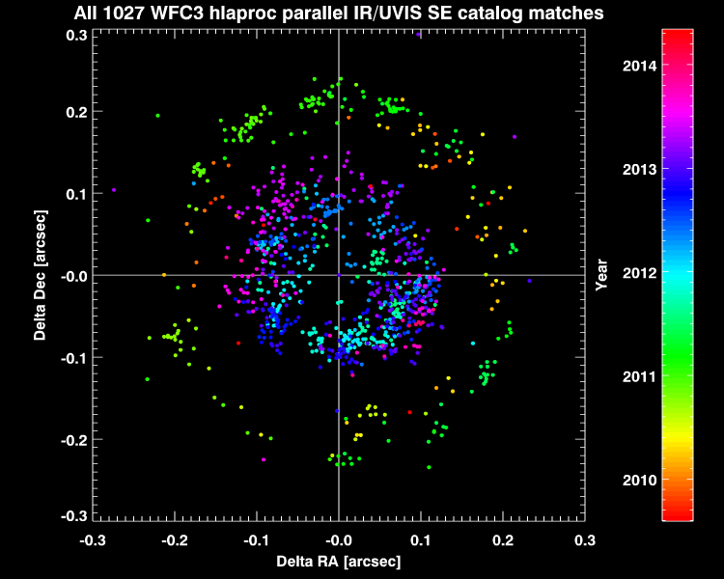
Aside: Comparison of WFC3/IR & WFC3/UVIS astrometry (within same visit, using same guide stars)
Changing the color coding to observation date shows that the thick radial distribution is a function of date
Notes:
Changing the color coding to observation date shows that the thick radial distribution is a function of date
The inner circle comes from later observations

Slide 10
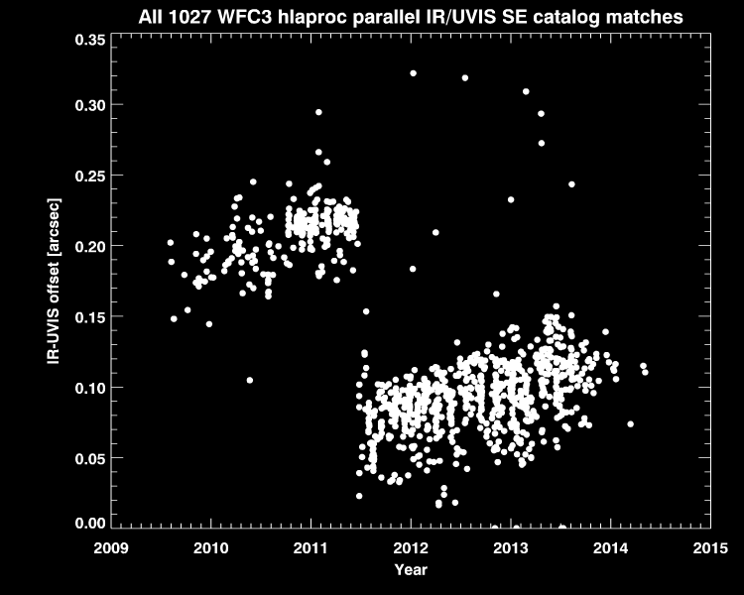
Aside: Comparison of WFC3/IR & WFC3/UVIS astrometry (within same visit, using same guide stars)
The HSC will be a tremendous source of information on a wide variety of calibration issues (e.g., zeropoint, focus, astrometric stability). Here we show one example: relative positions of science instruments over time.
These aperture offsets will dominate HST astrometry errors once the guide star positions are improved.
Notes:
Plotting the radial offset versus observation date makes the trend clear
There was an FGS SIAP update on June 2011 at the date of the jump
Around those dates there is a general drift between the apertures
The HSC will be a tremendous source of information on the relative positions of science instrument apertures over time
These aperture offsets will dominate HST astrometry errors once the guide star positions are improved

Slide 11
HLA & HSC Release Schedule
Dec 2014 – HLA DR8
New WFC3 images & catalogs processed using AstroDrizzle
Two additional years of data (twice HLA DR7)
Feb 2015 – HSC Version 1
New WFC3 catalogs from HLA DR8
Absolute astrometry from Pan-STARRS, 2MASS, SDSS
Discovery Portal Integration Phase 1 (plotting capabilities, new condensed summary form, preview cutouts, arithmetic operations on columns, cross-matching)
CasJobs for SQL–based queries
June 2015
New deeper ACS and WFPC2 catalogs (based on WFC3-type algorithms)
Additional astrometric reference catalogs (SkyMapper for south?)
PASP paper available
HSC Ready for Science!
Catalog and Portal described further in Cycle 23 Call for Proposals
Examples given in HST Primer and HLA/HSC/MAST sites
Presentations at AAS

