Slide 1
The Initiative
A proposed pilot project with AAS Journals

Slide 2
Scientists need to be able to get at the data that result in science
both to reproduce results and produce new results
“non-reproducible single occurrences are of no significance to science”
–Karl Popper, The Logic of Scientific Discovery, 1934

Slide 3
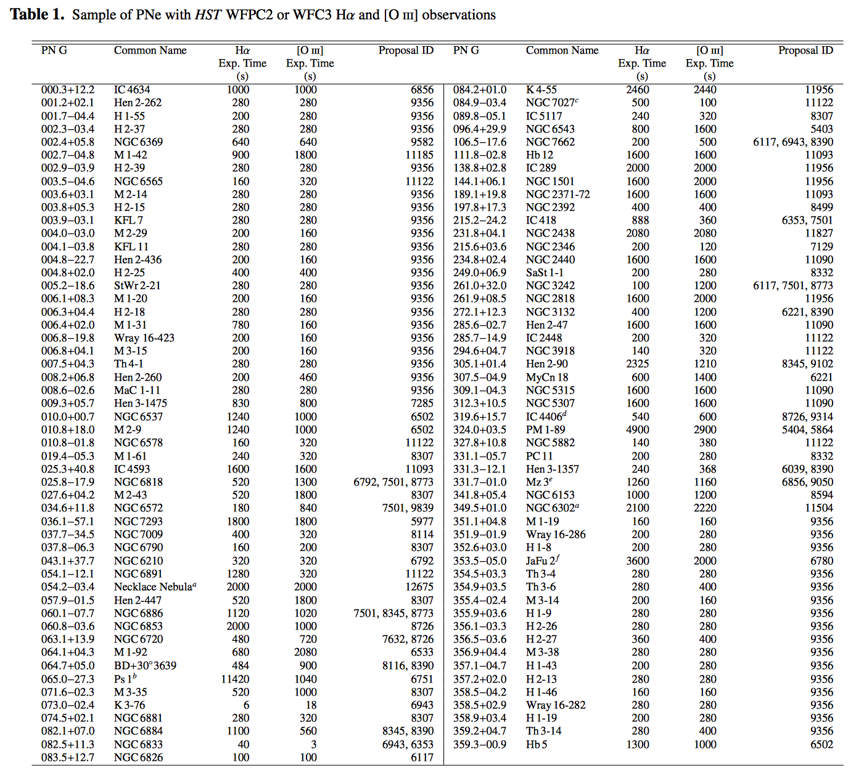
While it is possible to track down data from a paper,
it’s often unpleasantly hard
We searched MAST for HST WFPC2 or WFC3 coeval Hα and [O iii] images of PNe available by March 2013. This search yielded Hα and [O iii] images for 103 PNe obtained through the F656N and F502N filters, respectively
Guerrero+ 2013
We present a catalogue of photometric and structural properties of 228 nuclear star clusters (NSCs) in nearby late-type disc galaxies. These new measurements are derived from a homogeneous analysis of all suitable Wide Field Planetary Camera 2 (WFPC2) images in the Hubble Space Telescope (HST) archive.
Georgiev & Böker 2013

Slide 4
At Space Telescope there is 1 FTE spent trying to piece this all together; without the authors it’s hard!
It might be possible to track down some of the specific datasets for this paper,
but it would be very time consuming with possibly little payoff. I’m tagging as
impossible for now. -Sara

Slide 5
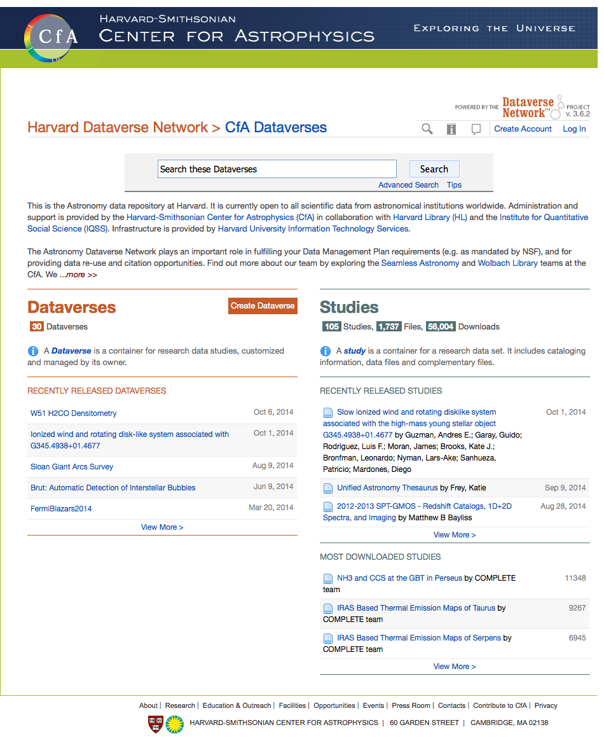
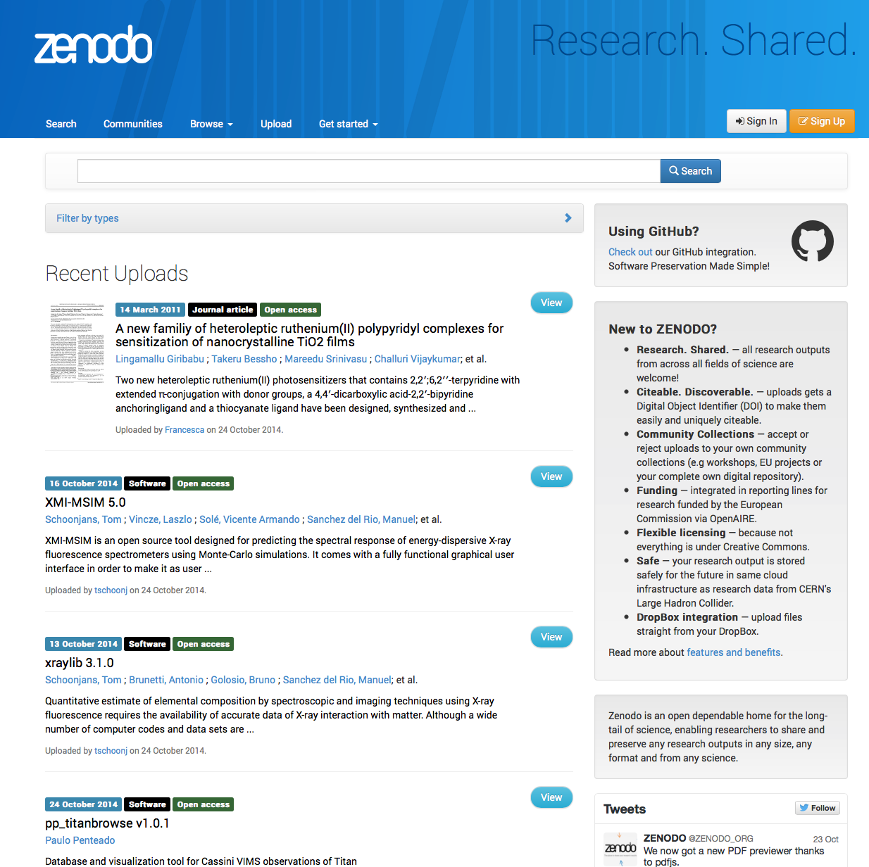
A “Solution” without MAST: DOIs for data
: a broadly used, permanent, citable, URL (Basically)
Harvard Dataverse
Zenodo

Slide 6
Places similar to STScI have DOI’ed their own content:
it works, but no one uses it!

Slide 7
The Problem: Without significant encouragement authors
won’t link data in their papers
We Astronomers
are
Lazy*
*[citation needed]

Slide 8
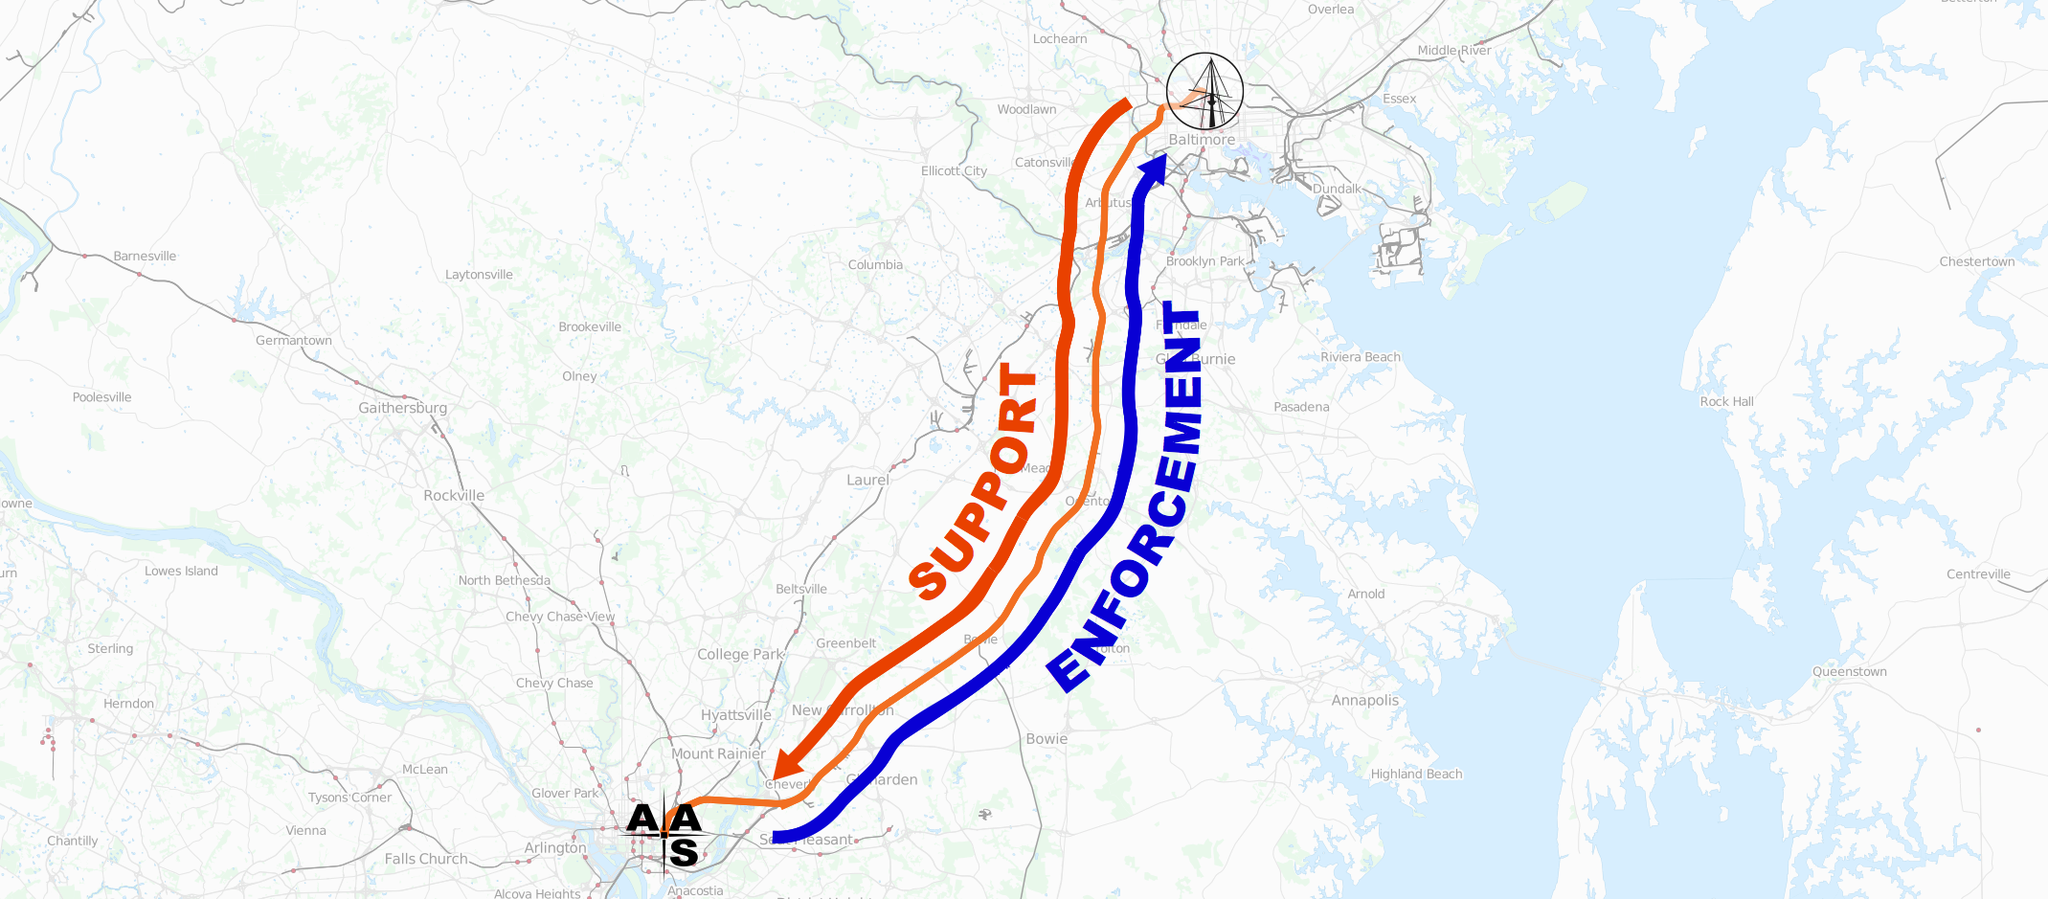
The Initiative
connecting the AAS Journals to MAST

Slide 9
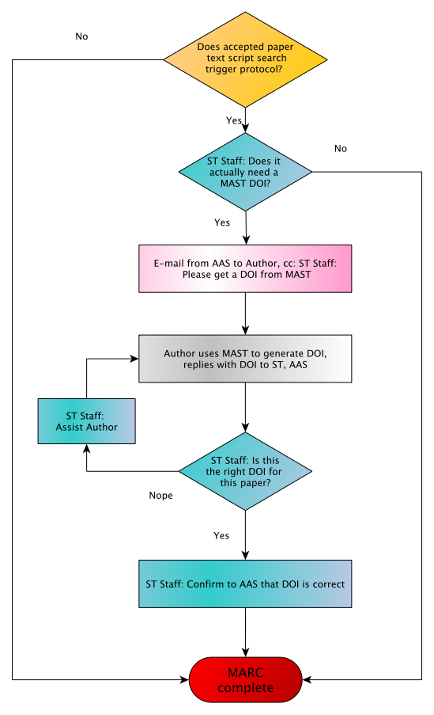
We can construct a simple (mock) workflow for
AAS Journals, STScI/MAST, and authors
Robot
ST MAST Staff
AAS Staff
Author

Slide 10
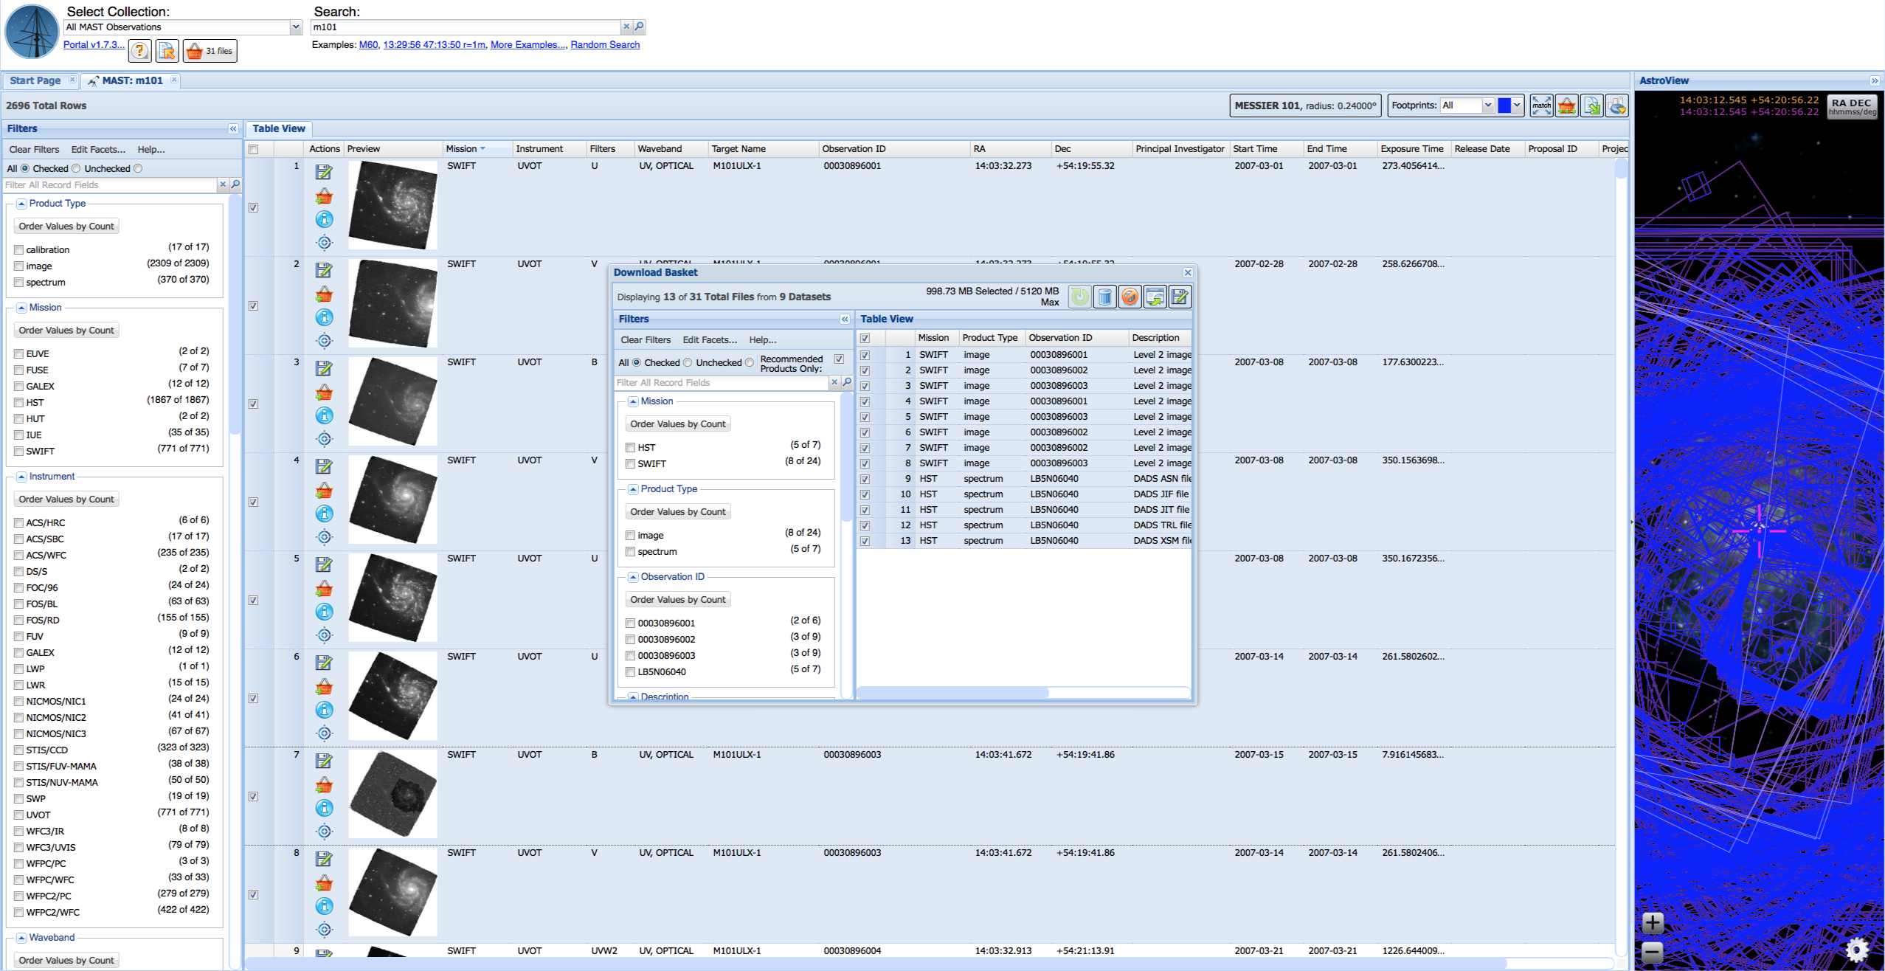
What might this look like for Authors at MAST?

Slide 11
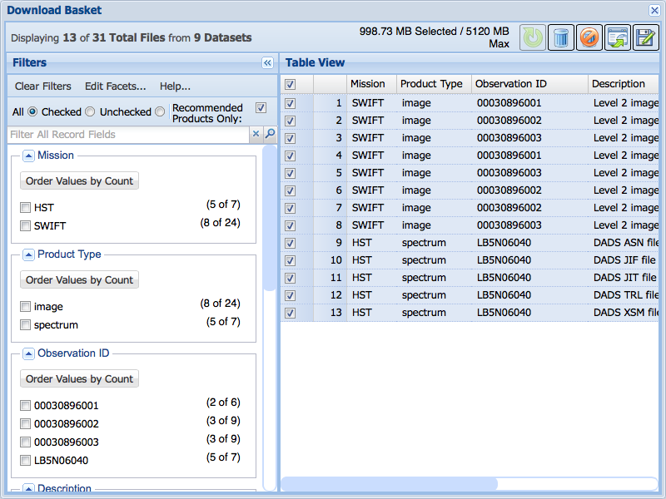

Slide 12
Questions for the MUG
Would the ability to make a permanent reference to an arbitrary collection of data be useful to you beyond the context of the journals?
Would being asked by ApJ/AJ to use MAST to make a link to your data be an undue burden?
Are there other DOI / data-linking features that could be useful to MAST users?

