Slide 1
Introduction and Highlights
Rick White
Karen Levay

Slide 2
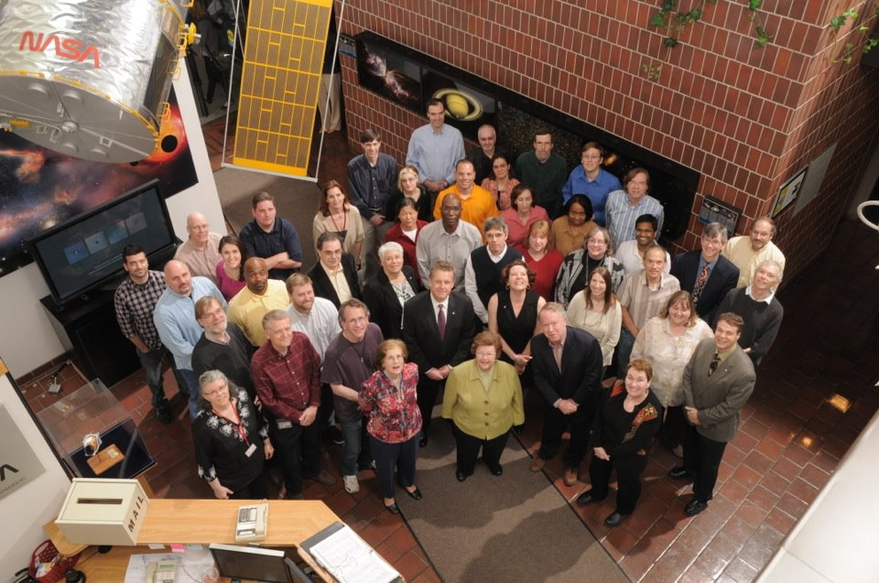
Barbara A. Mikulski Archive for Space Telescopes
MAST archive was renamed in honor of Maryland Senator Barbara A. Mikulski. Senator Mikulski recently became both the longest-serving woman member of the U.S. Congress and the longest-serving female senator. She has long been a strong and effective supporter of space science and of the missions in the MAST archive.

Slide 3
MAST Data & Growth
205.7 TB - Holdings Size as of Nov 1
3 TB / month – Average Ingest Rate per month
1,062,167 - Average # searches per month
16 TB – Average TB distributed per month

Slide 4
Distribution vs Holdings
Holdings as of Nov 1 2012
Distribution 2010 –2012

Slide 5
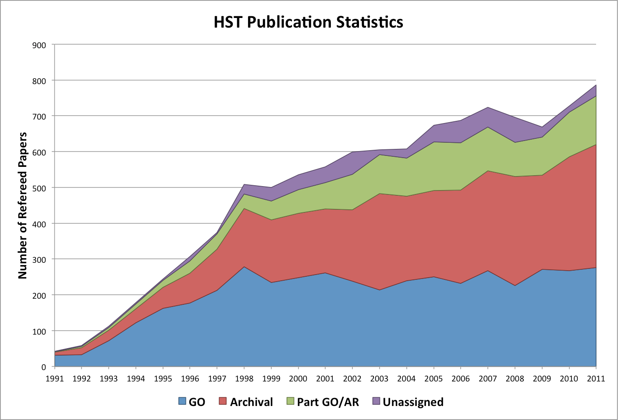
Publications
MAST continues to identify papers using data for most of the MAST missions. HST archival papers continue to be more than half of the annual total.

Slide 6
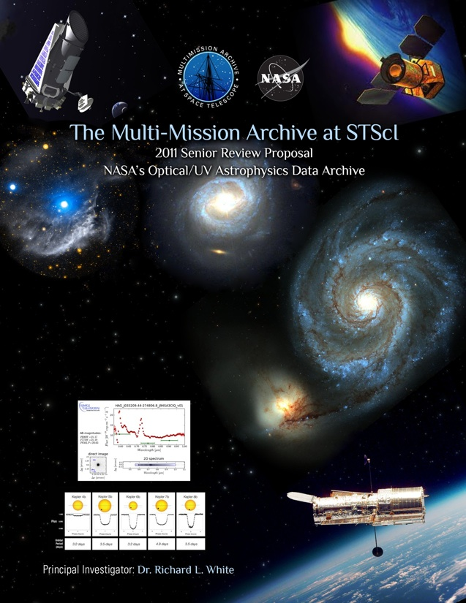
Archive Funding Sources
Missions
HST
JWST
Kepler
MAST
VAO (<2 FTEs)
MAST Proposal for 2011 NASA Data Archive Centers Senior Review
Notes:
Gretchen Greene will be discussing the VAO in her presentation this afternoon

Slide 7
Archive & MAST Staff
Archive Team Leads: Carl Johnson, Rick White, Gretchen Greene
Data Systems Branch – Mark Kyprianou
20 members
Development and testing of HST/JWST/Kepler processing pipelines, archival, distribution processes
Data Processing Archive Services Branch – Faith Abney
11 members
Operations for HST/JWST/Kepler pipelines and distribution
Archive Sciences Branch – Karen Levay
18 members
“MAST” archiving and distribution; Interface development for all Missions/Datasets; Bibliography support; VO work; HLSP Support
Hubble Legacy Archive – Lee Quick coordinator
Members from various areas in STScI (MAST, DSB, INS, Mission Office)
~ 10 people at various levels of effort
HLA pipeline, catalog & interface development

Slide 8
Staff Changes
Departures
Alberto Conti
Arrivals
Anton Koekemoer
Anastasia Alexov
Pending Retirement
Myron Smith
Pending Arrivals
Sahar Allam
Scott Fleming

Slide 9
Highlights with details later
HST updating infrastructure (M.Kyprianou & P.Greenfield)
Hubble Source Catalog (B.Whitmore)
JWST Data Management System (DMS) design and development underway (G.Greene)
Kepler DMC activities (D.Fraquelli)
Kepler “Colors Table (M.Smith)
MAST Activities
GALEX closeout & photon-list generation (M.Smith & B.Shiao)
HLA Project (L.Quick & S.Casertano)
Data Discovery Portal (T.Donaldson)
Common Archive Observation Model (B.McLean)
Spectral Classification Tool (M.Smith)
Many activities are aimed toward unification of MAST holdings and interfaces

Slide 10
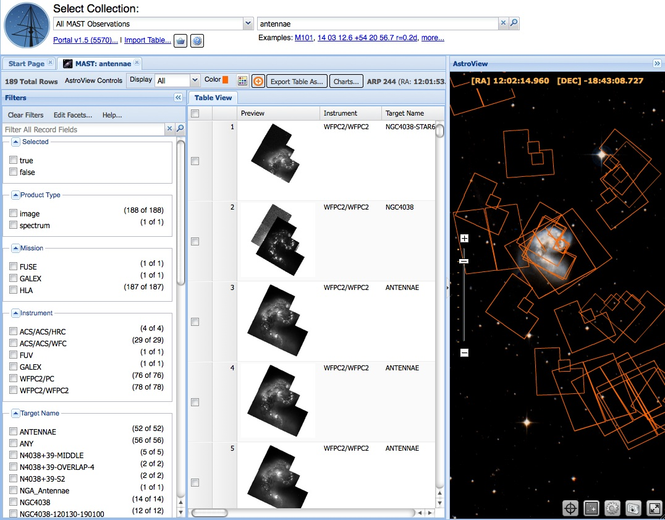
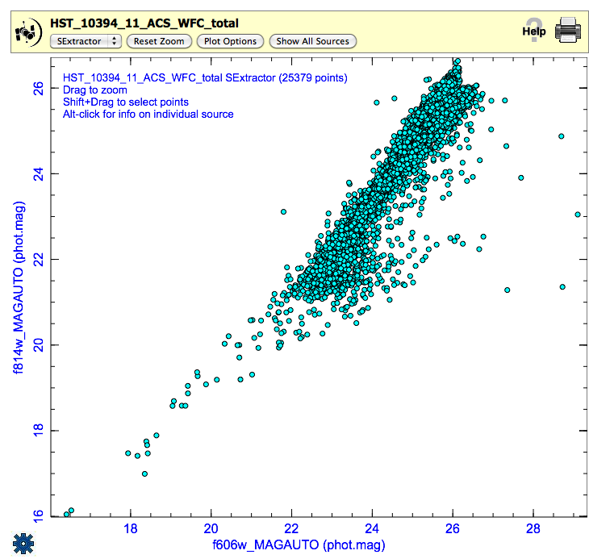
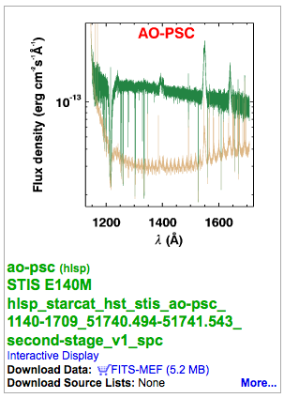
MAST Portal
HLA Catalog Plotting Tool
HLSP Spectrum in HLA DR7

Slide 11
Bibliography Project
Expanding HST by identifying data by dataset in addition to the program ID
HST search
Integrating into Data Discovery Portal
http://archive.stsci.edu/hst/bibliography
http://archive.stsci.edu/hst/bibliography/pubstat.html
http://archive.stsci.edu/bibliography/

Slide 12
Kepler
Fraquelli will discuss Kepler Data Management Center work
Kepler is archived in “DADS”.
New paradigm of large numbers of datasets/files requested at one time so DADS not as efficient for requests.
MAST creates tarfiles of data by category (e.g. all data in a quarter, all public Kepler Object of Interest (KOI) data)
All public data are online
Most distribution through tarfiles each approximately 44GB (compressed size) holding ~ 80 GB of data.
October 2012 record month: 38 TB Kepler (uncompressed size)
Total Kepler downloads since January: 228.7 TB (80 % of the total Kepler downloads)

Slide 13
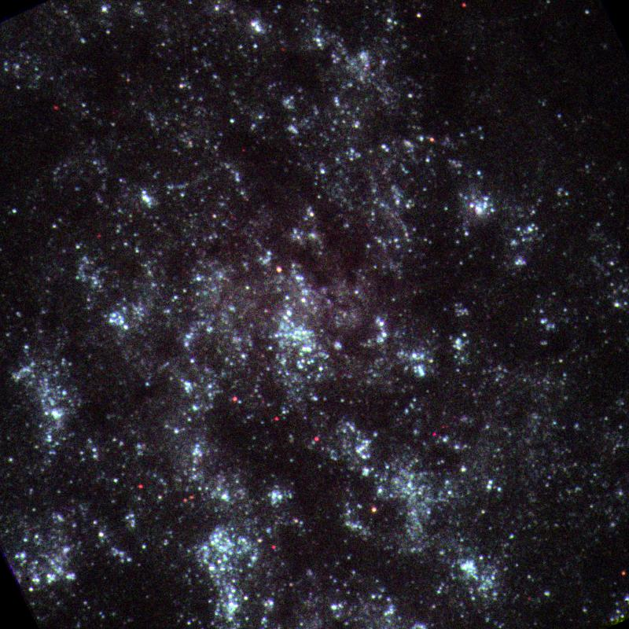
SWIFT UVOT
SWIFT UVOT data added October 2012
Data complementary to GALEX data
Worked with SWIFT UVOT team at Penn State
Data retrieved from HEASARC (the primary archive for all SWIFT data)
Swift UVOT ultraviolet image of M33 13x13 arcmin

Slide 14
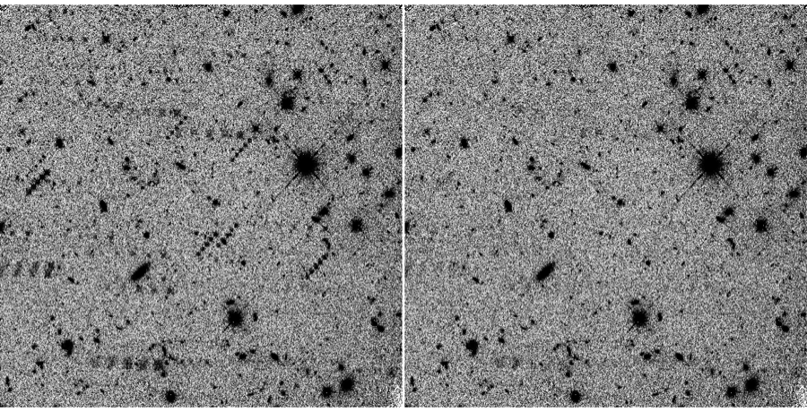
WFC3 Persistence
The STScI WFC3 persistence team used a model and the time-history of earlier exposures to generate estimates of the amount of persistence. For each exposure, they produce fits files that contain estimates for each pixel in each "flt" file and a persistence-subtracted "flt" file. MAST is hosting these data.
Before correction
After correction

Slide 15
HTML5/Canvas Spectral Plotter
Replaced customized plot tool

Slide 16
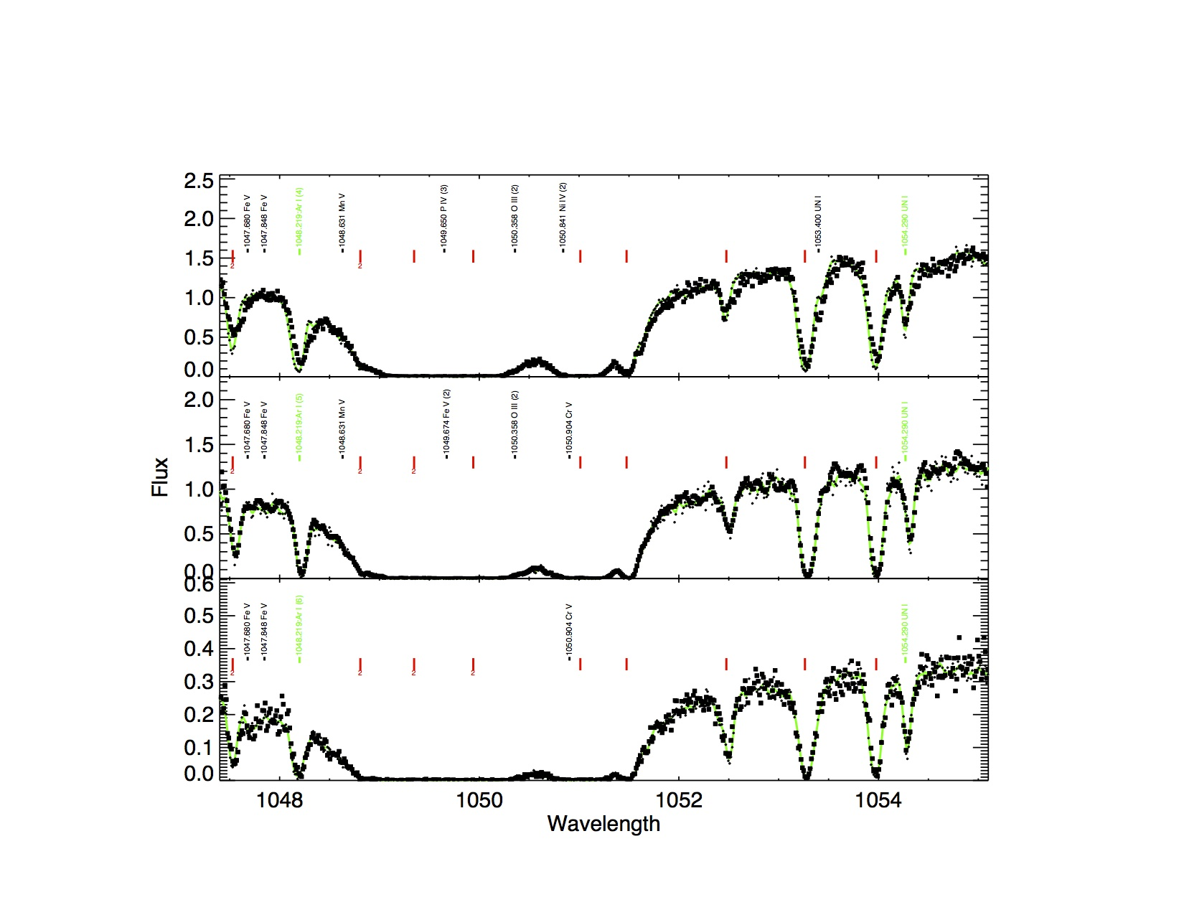
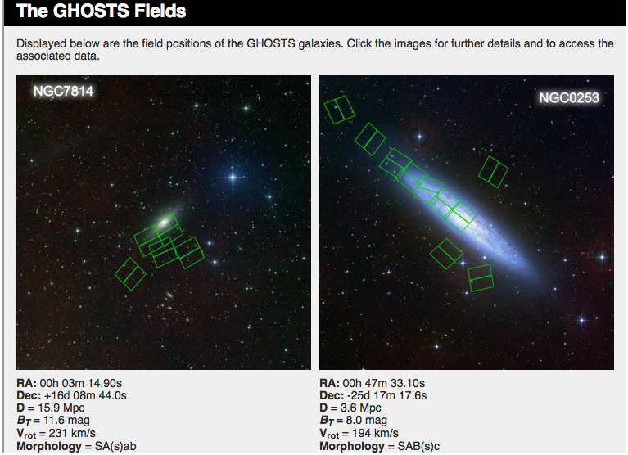
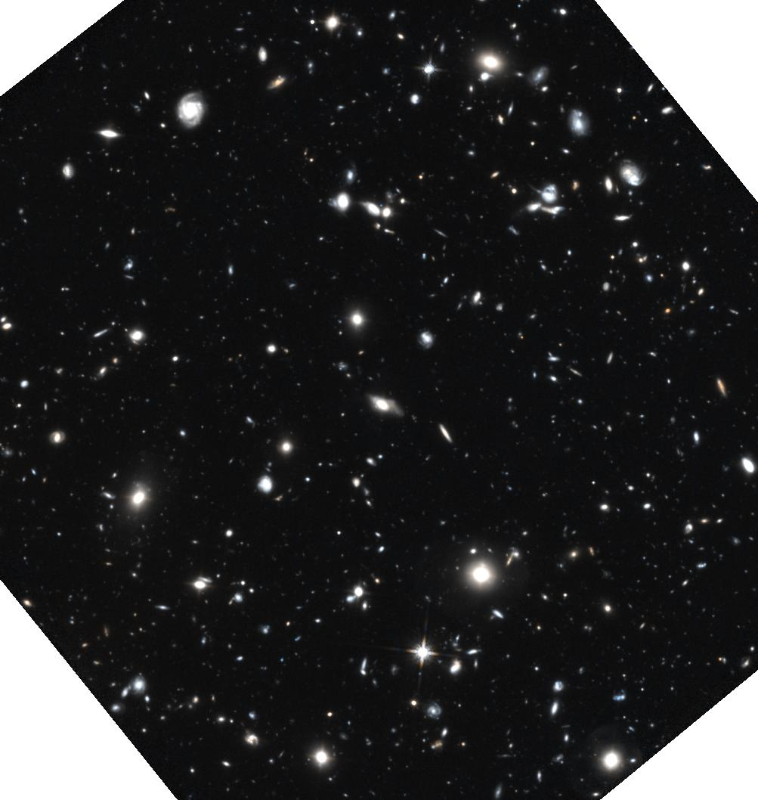
Community Contributed High Level Science Products (HLSP)
Detailed Far-UV Spectral Atlas of O Main Sequence Stars - Smith
The Galaxy Halos, Outer disks, Substructure, Thick disks and Star clusters (GHOSTS) – de Jong
The Hubble Ultra Deep Field 2012 (HUDF12) - Ellis

Slide 17
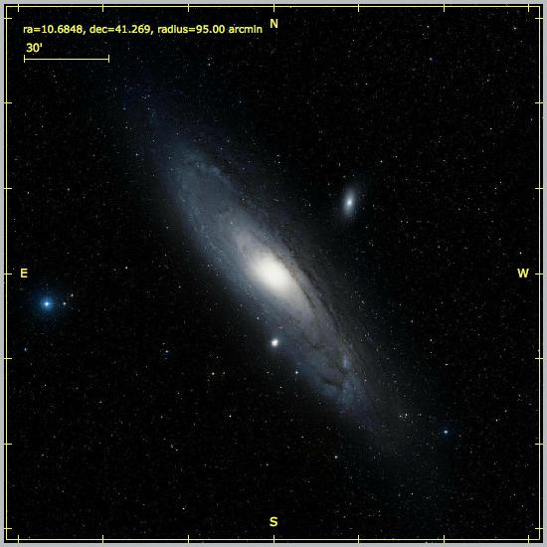
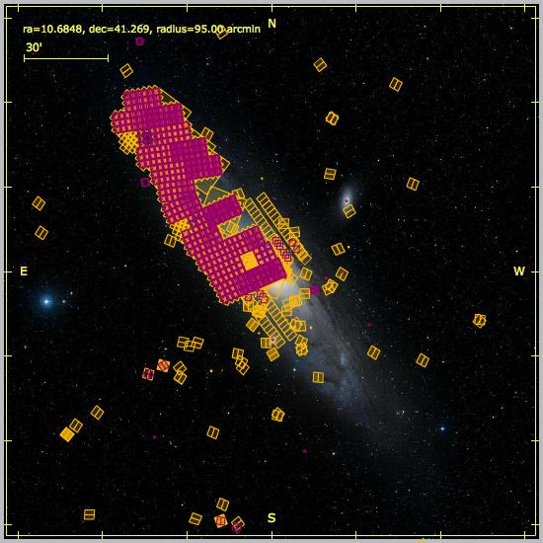
Multi-Cycle Treasury Programs
CANDELS (Faber/Ferguson)
649 GB of data
> 25 TB distributed to 907 IP addresses
Citizen Science Initiative
CLASH (Postman)
160 GB of data
> 781 GB distributed to 738 IP addresses
PHAT (Dalcanton)
252 GB of data
> 1.5 TB distributed to 269 IP addresses
Citizen Science Initiative

