Slide 1
Kepler Archive
Dorothy Fraquelli

Slide 2
Kepler involves a number of branches and personnel at STScI. No one at STScI works full time on Kepler. Some work is done under contract with the Kepler project (i.e., the DMC) while other work is done under the MAST contract.
Staffing for Kepler (2.1 FTE in FY 2012):
+ from ASB: Randy Thompson, Shui-AyTseng, Tim Kimball, Karen Levay and Myron Smith
+ from DPAS: Forrest Hamilton, Dorothy Fraquelli, Deborah Kenny, Faith Abney (lead) (Tracy Ellis, Tatjana Tomovic are backups for Hamilton)
+ from DSB: Christine Heller-Boyer
+ from ITSD: Tom Walker, Pat Taylor, David Unger
The archive holds light curves, target pixel files and FFIs for quarters 0 through 13.
+ All data are public, except for Q10-13 GO data.
+ Q14 data are expected to arrive at the archive in January 2013.
+ Q15 observations are in progress on the spacecraft.
Ancillary files, many added in 2012
+ Cotrending Basis Vectors
+ Focal Plane Characterization Models
+ Engineering files (long/short cadence collateral files, artifact removal pixel files, background pixel files and Reverse Clock files)
+ Spice Kernels (ephemeris)

Slide 3
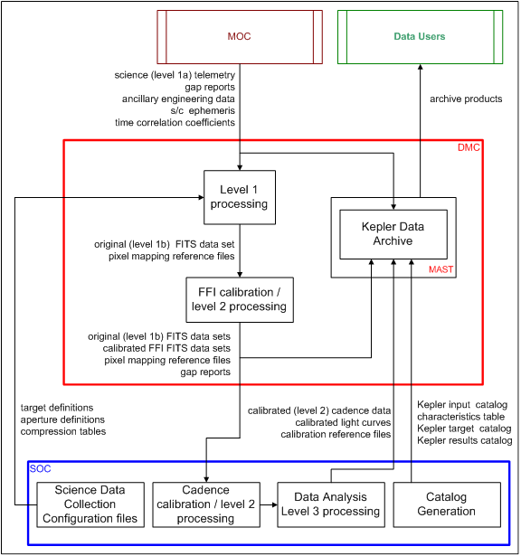
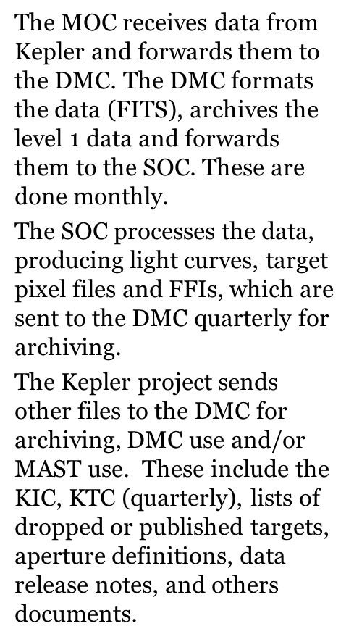

Slide 4
October 2012 Retrieval Statistics
748,896 searches
6,447,300 datasets retrieved
4,776 GB of data retrieved
386 unique users
Notes:
These are the monthly statistics for October 2012.

Slide 5
MAST provides the archive user interface for Kepler data, which consist of light curves, target pixel files, full frame images (FFI), a variety of support files and documentation.
+ Standard MAST search forms for Target Searches, Data Discovery, FFI and Engineering Data Searches and the Kepler Input Catalog (KIC).
> includes a plotter to preview public light curves
+ Direct download of CBV, Focal Plane Characteristics and Spice Kernel (ephemeris) files.
MAST also provides a number of value added interfaces and services.
+ Target search has additional magnitudes/colors from cross matches to GALEX, UKIRT project (IRT), USNOb catalog, Isaac Newton Telescope Survey (KIS), Everett KPNO Survey (UBV) and SDSS/DR9. (see next presentation)
+ Display and direct download of FFIs
+ Direct download of target pixel files and tar files containing light curves based on investigation id, and public data by quarter.
+ Several VO services
+ Casjobs (direct query of the database) and more ….
MAST will house the Kepler archive after end of mission.

Slide 6
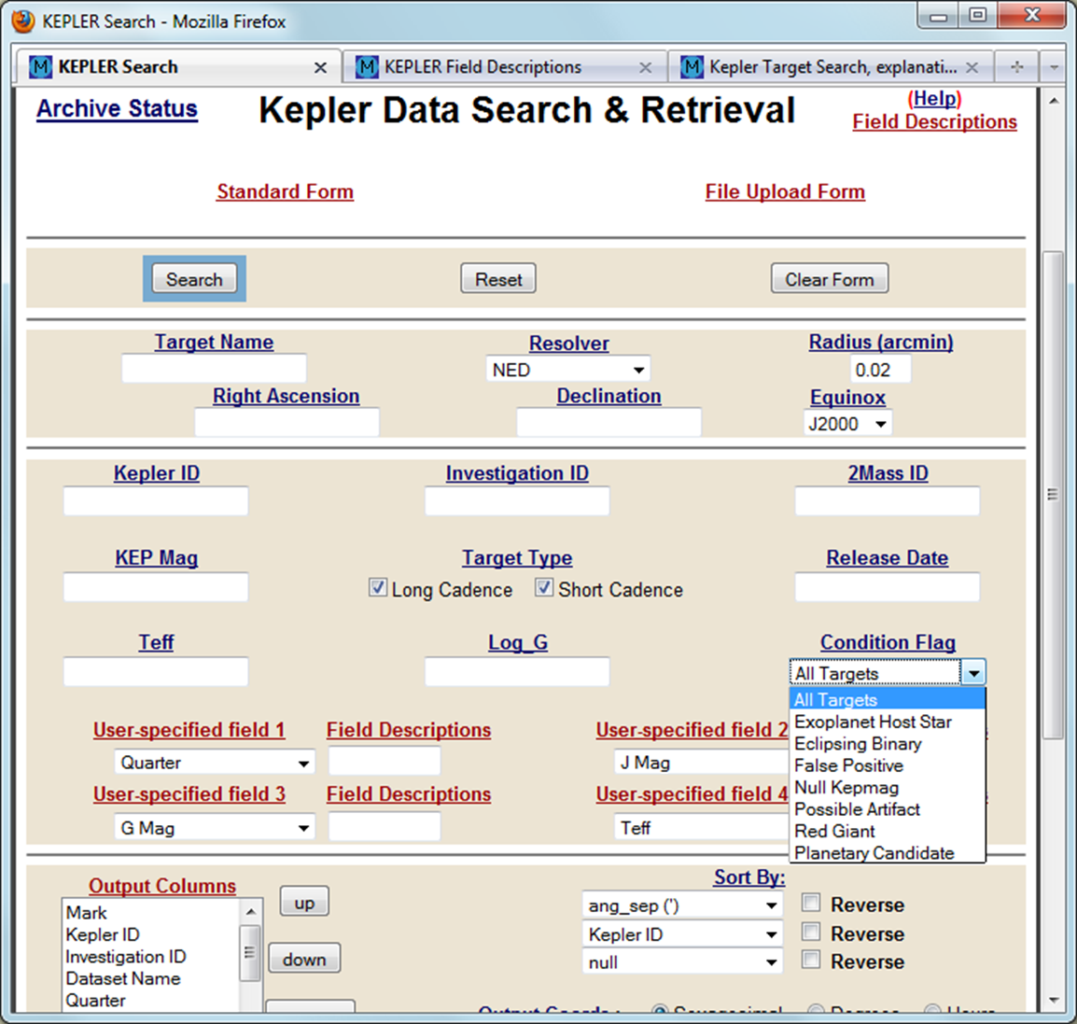

Slide 7
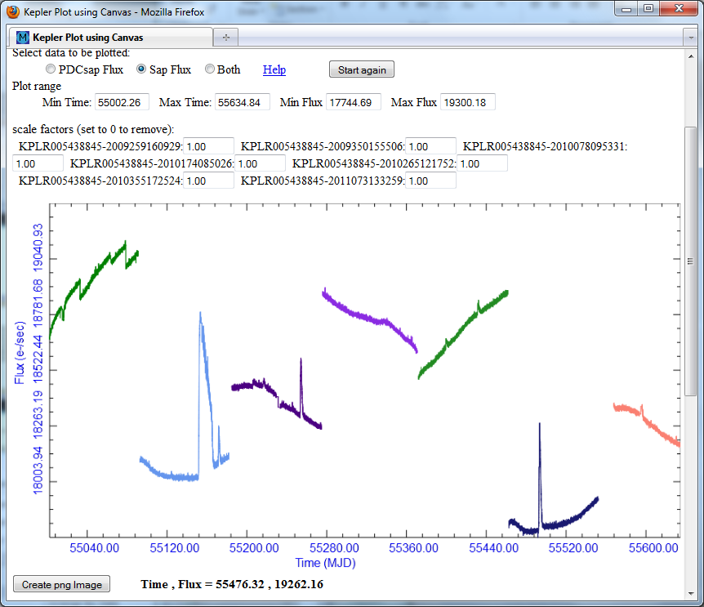

Slide 8
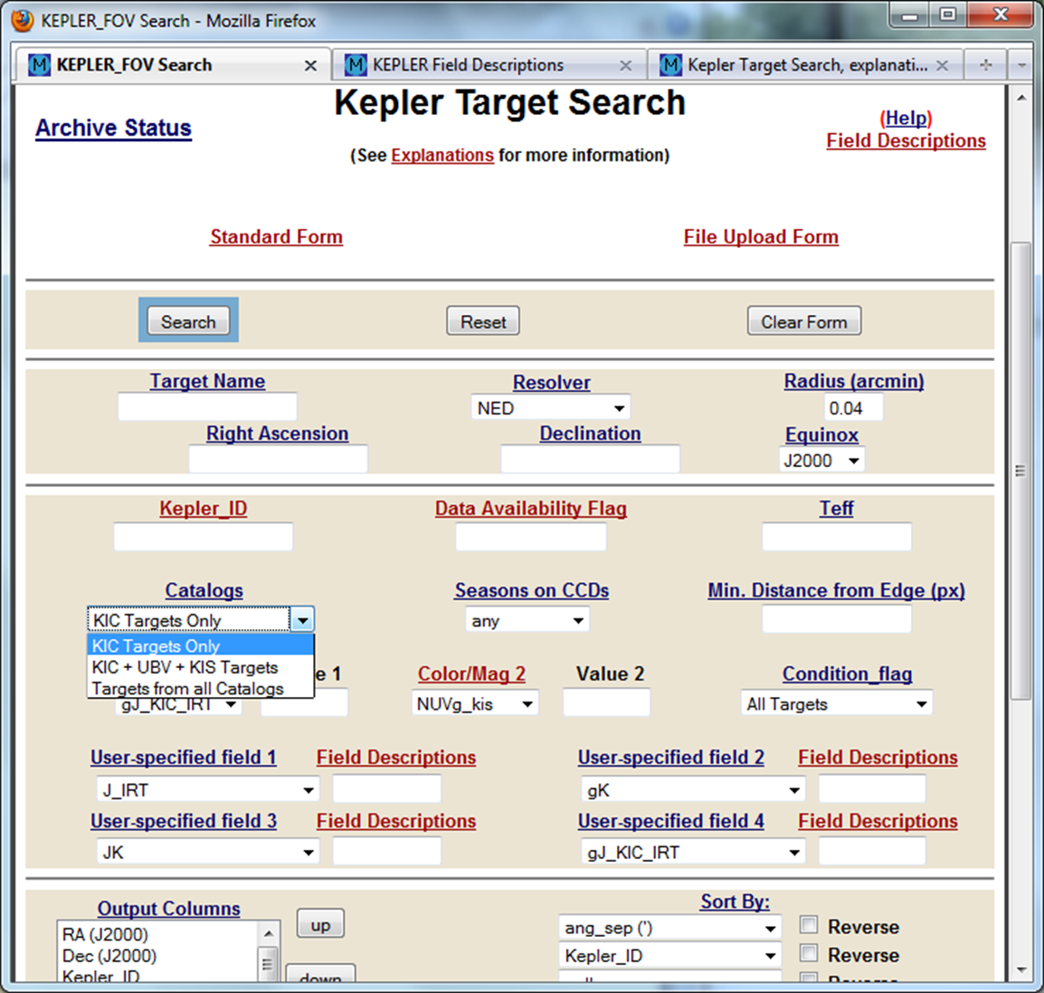

Slide 9
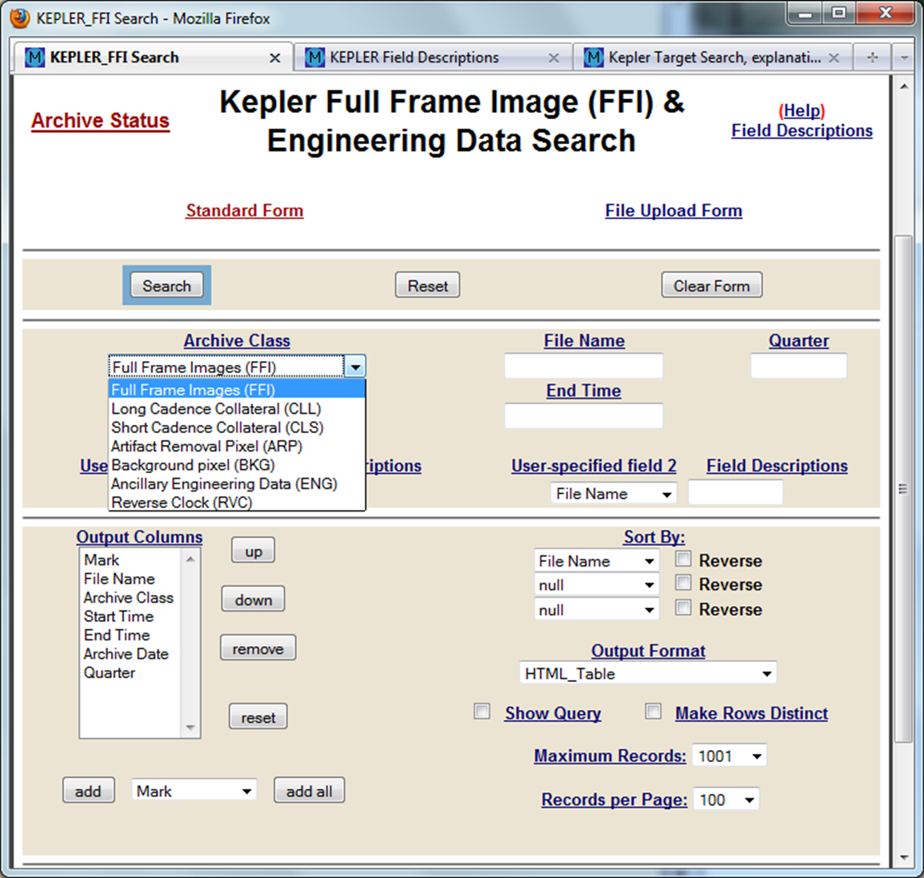

Slide 10
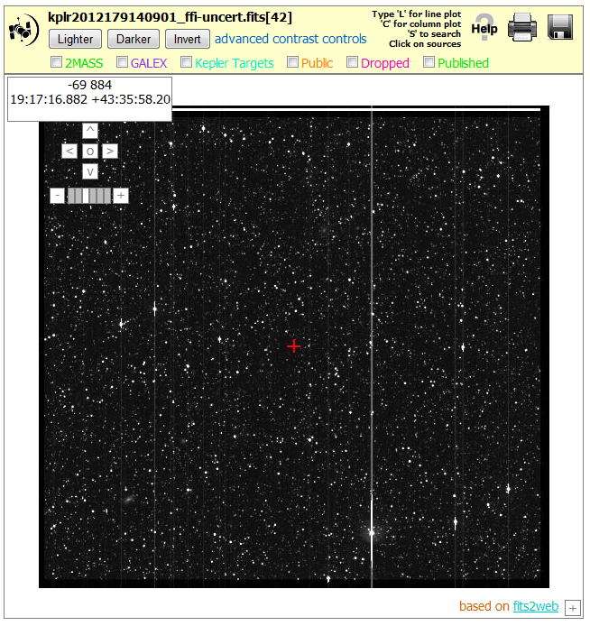

Slide 11
In the past year the archive has received:
Updated light curves for Q0-Q8 (improved software)
Q10-Q13 light curves, target pixel files and FFIs
Co-trending Bias Vectors (CBV)
Updated list of released Kepler Planetary Candidates (KOI)
Data Release Notes and updated documentation
ABC files (artifact, background and collateral files)

Slide 12
In progress or expected from 2011-2012
Additional High Level Science Products - none delivered
Kepler Colors Table - operational, more colors coming
Interfaces for the SPICE Kernels (aka ephemeris), Ancillary Engineering Data and Reverse Clock data - done
Pixel Response Function files and a CBV-like interface for retrieval
- done
Support for Kepler Senior Review Proposal - done
Another CT - done
Operations is moving from Solaris/SyBase to linux/sqlserver; expect to see improved performance. - done, performance improved by factor of 2
Continued receipt of monthly and quarterly data transmissions, and quarterly KTCs - done
Transfer of target pixel files to the KASC group - done

Slide 13
In progress or expected
Kepler Colors Table - plan to add more colors as available
Updated Q0-Q13 light curves to fix a Barycentric Time/leap second issue (March – May 2013).
Coordinate with NexSci for delivery of Confirmed Planet information
Continued receipt of monthly and quarterly data transmissions, and quarterly KTCs
Transfer of target pixel files to the KASC group
Additional High Level Science Products
Discussion Point
Adding Kepler light curves to the MAST Portal
+ treat as a catalog or as an observation log?
> observation log results in more rows than the Portal can handle

Slide 14
Kepler Legacy Archive
We expect to be involved in the planning of the Kepler Legacy Archive.

Slide 15
Kepler Acronyms
ASB – Archive Sciences Branch
CBV – Co-trending Basis Vectors
CT – Characteristics Table
DPAS – Data Processing and Services
DSB – Data Software Branch
DMC – Data Management Center located at STScI
KASC – Kepler Asteroseismic Science Consortium
FFI – Full Frame Image
IRT – UK IR Telescope survey – J
KIC - Kepler Input Catalog
KIS – Kepler Isaac Newton Telescope survey – U, g, r, I, H-alpha
KTC - Kepler Target Catalog
MOC - Mission Operations Center located at LASP in Boulder
Q# - quarter, as in Q1 is Quarter 1
RVC – Reverse Clock Cadence
SOC – Science Operations Center located at NASA Ames
TPF – Target Pixel File
UBV – Everett et al survey – U, B, V

