Slide 1
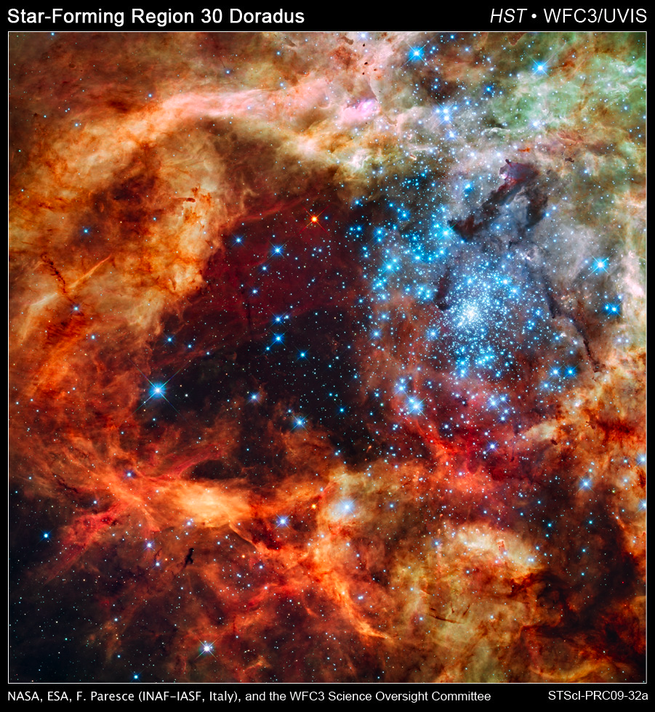
Optimizing Science - an Ongoing Process
Brad Whitmore
HSTPG Presentation, April 27, 2000
The Hubble Source Catalog: Plans and Progress
Brad Whitmore
(with Stefano Casertano, Anton Koekemoer, Steve Lubow, Rick White)
Mug Meeting, Nov. 26, 2012
1. Motivation
2. Progress
3. Community Input
4. Timeline

Slide 2
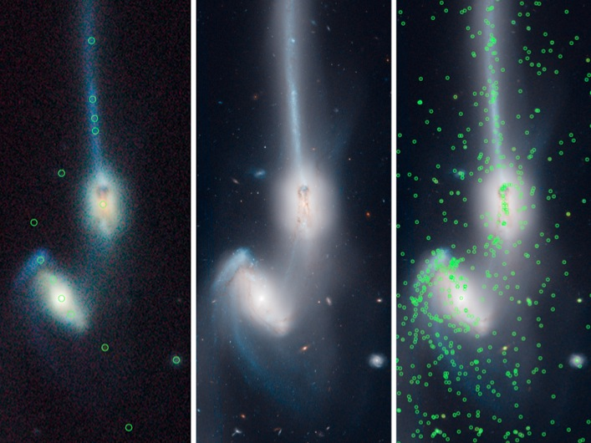
HST Source Catalog
Easily accessible catalogs of objects are a mainstay of astronomy.
Example: The SDSS source catalog is a primary catalyst for SDSS science productivity.
HST Source Catalog
  Increases the scientific return of the archive for decades to come
  Fundamental reference for JWST science
  Complements upcoming surveys (PanSTARRS, LSST)
SDSS + source catalog
HST ACS/WFC
HST + source catalog
HST: ~10⁶ observations, ~10⁸- 10⁹ objects to catalog

Slide 3
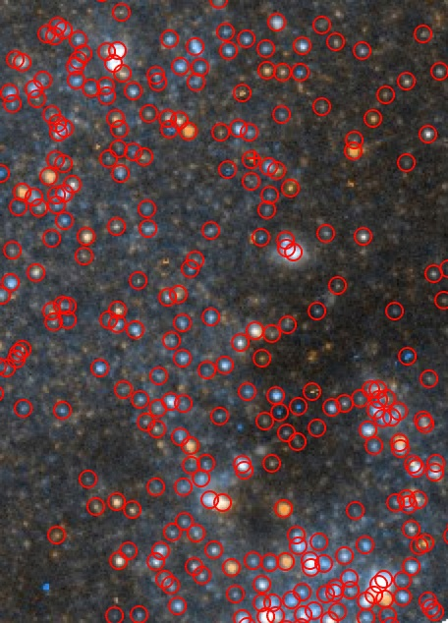
Basic Approach
General-use source lists are already generated in the HLA for single-visit imaging observations.
  DAOPHOT (point and point-like objects)
  SExtractor (extended, point, and point-like objects)
These single-visit source lists will be combined, keeping track of the time domain.
In addition, it will be necessary to develop a system that automatically updates the HSC regularly as new data enter the archive.
DAOPHOT source list for part of
10918_22_ACS/WFC F814W/F555W_M101-F2 image

Slide 4
Goals and Requirements
The overarching goal of the Hubble Source Catalog (HSC) project is to optimize science from HST by developing a single catalog containing the majority of all sources ever observed by Hubble.
The baseline goals are to:
B1) - Provide a general, easily accessible, time-resolved catalog of "all" 10 sigma sources observed by HST, using the ACS, WFC3 and WFPC2.
B2) – Cross-reference with a basic list of existing catalogs (e.g., SDSS, 2MASS, Spitzer, GALAX, Chandra, existing Hubble HLSP, ...) as well as HST spectroscopic datasets that may be relevant.
B3) - Develop tools for easy access and quick-look analysis. These would include a relational database search capability, and a quick-look, time-resolved phenomena tool.
Notes:
e.g., All Sc galaxies within 10 Mpc.
It is important to note that the HSC will not eliminate the need for astronomers to make more detailed catalogs optimized to address their own specific science goals in many cases.
The HSC is designed to be a general-use catalog sufficient for many, but not all users.
However, we note that even in the cases where a researcher makes their own specialty catalog, the HSC will still be a useful cross-reference and normalization resource.

Slide 5
How will people use the HSC ?
  What HST data exist for my particular target ? (100 %)
  Do a sanity check on my own catalog (80 % ?)
  Make use of existing cross matches with other catalogs (HST HLSP, SDSS, Chandra, Spitzer, spectral extractions, … (50 % ?)
  Use it to do my science (10 – 50 % ?)

Slide 6
Caveats:
It is important to note that the HSC will not eliminate the need for astronomers to make more detailed catalogs optimized to address their own specific science goals in many cases.
The HSC is designed to be a general-use catalog sufficient for many, but not all users.
We are in an early stage (Beta-1) of the project. The HSC has a number of known shortcomings that are being addressed for a Beta-2 release planned for January, and a Version 1 release in May.

Slide 7
HST Cross-Matching Catalog Project
Lubow (STScI) & Budavari (JHU)
A Jump Start
Goals:
  Cross-match HLA source lists of 30 million source detections into searchable HST object catalog
  Improve astrometry
NASA AISRP grant started over 2 years ago, expired in June 2012
In June, finished work on an initial catalog system that covers ACS/WFC and WFPC2, and submitted paper.

Slide 8
Results
Check on astrometric accuracy
Check on reliability of ACS matches
matched pairs
With astrometric correction
# sets of matches
# pairs
Without correction
random pairs
sigma per match (mas)
Fractional difference in flux between pairs of sources
~3 % have time span > 1 year
Most are multi-wavelength
detections & nondetections
7 x 10^5 sets of matches
Cumulative # sets of matches
# sets of matches
Coverage > 1 year
detections only
Time span of match (days)
# filters in match
Lubow & Budavari

Slide 9
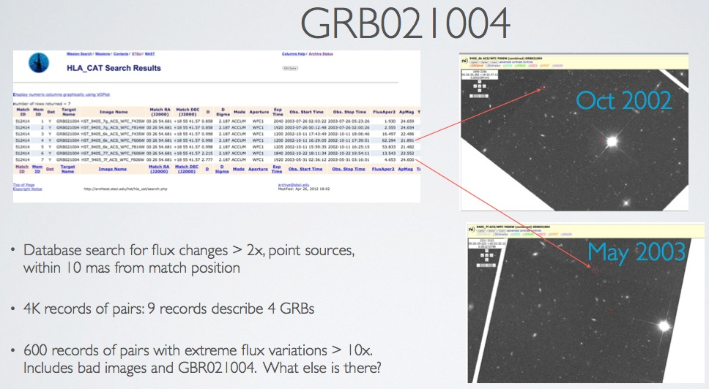
Some Early Comparisons

Slide 10
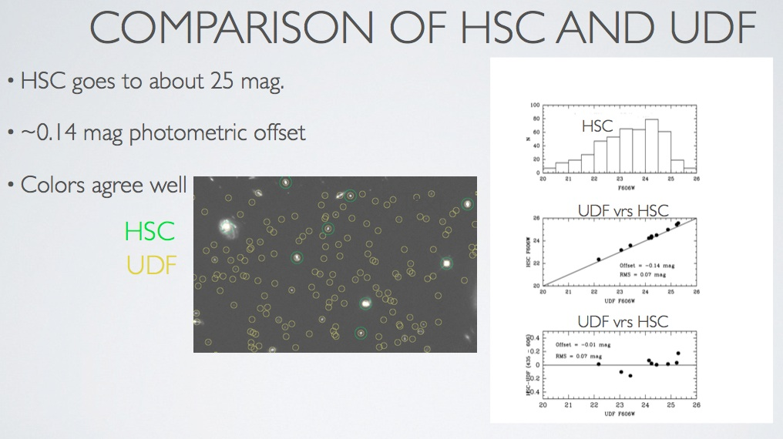
Some Early Comparisons

Slide 11
Community Interactions:
Use Case Category Definitions
1. Time variability (e.g., SN, GRBs, light echos, proper motion, transients)
2. Astrometry (absolute astrometry, identification of "blind" sources such as ULXs)
3. Photometry (e.g., CMDs, color-color, photo-Z's, ...)
4. Morphology (of individual objects rather than ensemble - e.g., clumpy galaxies, star vs cluster, …)
5. Structure determination (use ensemble of objects - e.g., Milky Way components, streams, galaxy clusters, …)
6. Very large datasets (e.g., all LMC observations)
7. Cross-matching catalogs (e.g., with user-supplied catalog , multiwavelength catalogs, ...)
Spectroscopic cross-matching (e.g., with ACS and NICMOS grism extractions)
Notes:
Apologies for number of words in the next several viewgraphs. Won’t read them all – just highlight some of the main points.

Slide 12
Community Involvement
Four working groups will be formed to help guide the development of the HSC and insure that people using a variety of different analysis tools can use the catalog and tools effectively.
  Point and Nearly-point source photometry (e.g., color-magnitude diagrams in globular clusters and in the field, compact clusters in external galaxies) [Potential members: Tom Brown, Jay Anderson, Peter Stetson, Abi Saha, Julianne Dalcanton, Brad Whitmore, Nate Bastian, Soeren Larsen, ...]
  Extended object photometry and morphology (e.g., faint galaxies in survey fields, photometric redshifts) [Potential members: Harry Ferguson, Anton Koekemoer, Mark Dickinson, ... ]
  Multi wavelength (and spectroscopic) cross matches (e.g., ULIRGs, gamma-ray bursts, x-ray counterparts) [Potential members: Tamas Budavai, Lee Armus, Bob Hanisch, Knox Long, ... ]
  Time-resolved phenomena (e.g., Cepheids, supernova, variable stars, …) [Potential members: Stefano Casertano, Adam Riess, Nathan Smith, … ]

Slide 13
Early MAST Survey Results
“Would you be interested in serving on a HSC Working Group to help guide the development of this new initiative?”
- 31 yes (out of 232 respondents)
Any other feedback/suggestions on how this catalog might be useful for your research?
  “ This is a great first stab at this (and a long time coming). There are a lot of limitations in the catalog at present (e.g., no flags for suspected cosmic rays, only wide-band filters, assessment of variability/light curve) that need to be sorted out and expanded upon to make the catalog more useful to a broader audience/community.”
  “ Include cross matching of catalog sources with source catalogs from other missions/surveys, and conditional matching (e.g., 'find me all HSC sources detected in X-ray and mid-IR and that were observed with HST in at least two bands/filters or grism’).”
  “ I think the catalog will be more useful with the highest possible precision in the absolute coordinates of sources.”
✔

Slide 14
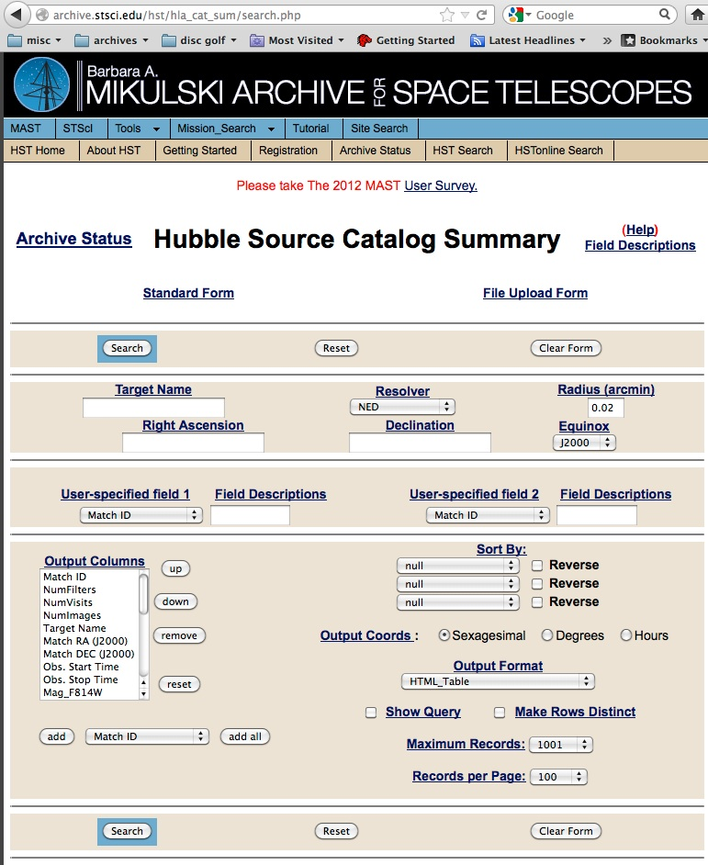
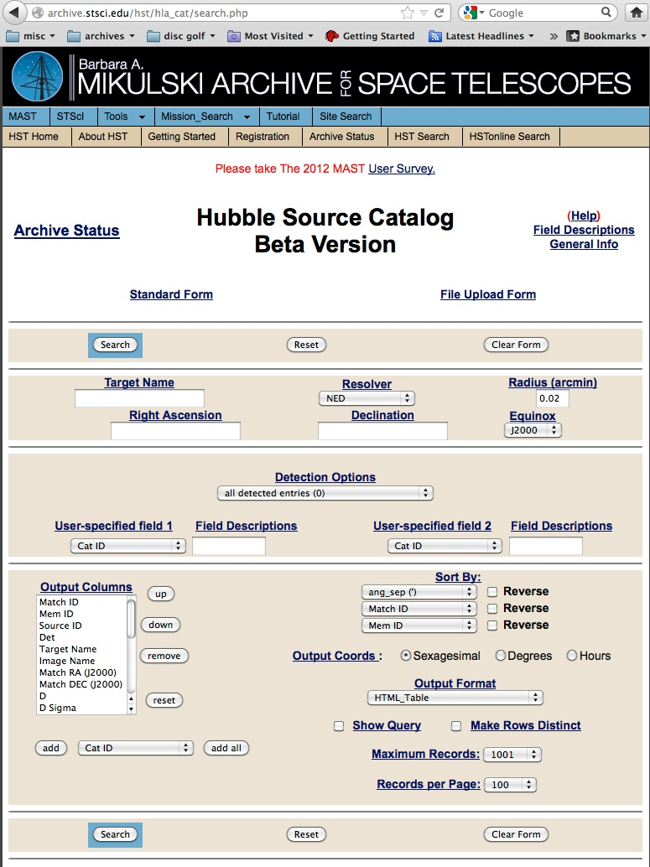
Current HSC Web Form
http://archive.stsci.edu/hst/hla_cat/
Overlay only available in hla/dev at present
One row per object
One row per observation

Slide 15
HSC Timeline
June 2012 – Beta-1 version released (Lubow + Budavari paper posted)
  Includes ACS and WFPC2 based on HLA SExtractor source lists
  Only detailed / time-resolved version of form available
October 2012 – Questionnaire sent. Early results encouraging
January 2013 – Beta-2 version of catalog
  Includes ACS and WFPC2 based on HLA SExtractor source lists
  Include “summary” form (early version made available in version 1.5)
  Improved source filtering and matching
May 2013 – Version 1 of HSC released
  Includes ACS, WFPC2, WFC3
  Preliminary cross-matching (e.g., SDSS)
  Improved tools (over plots, correlation plotting, …)
Future – SQL CASJobs, value-added catalogs, workshops, PASP …

Slide 16
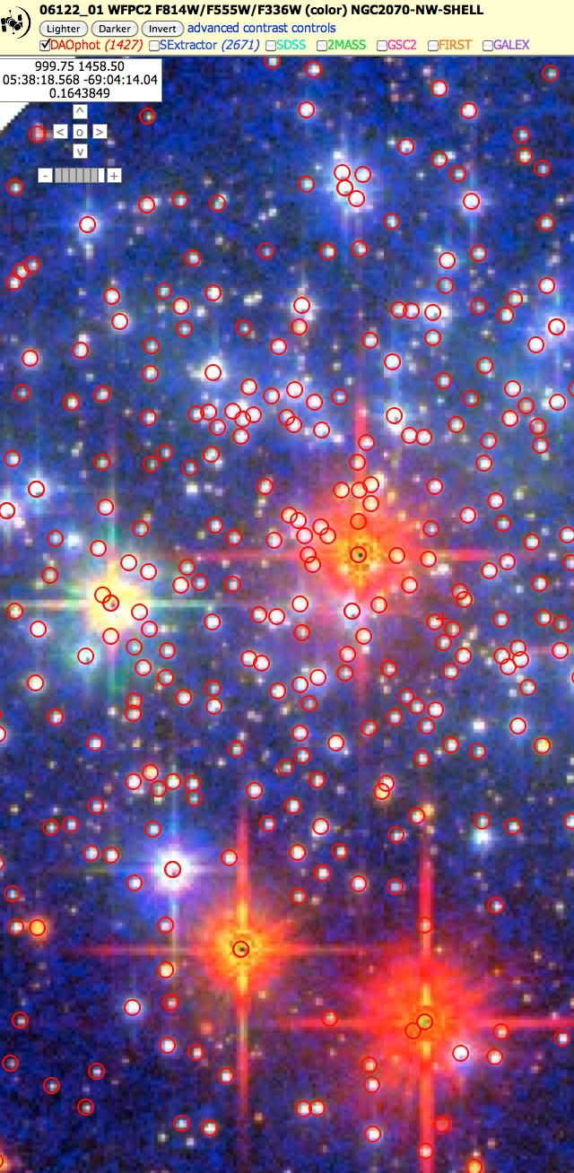
Summary
An early Beta version of the HSC has been online since June.
We are using it, in conjunction with several use cases, to test the quality of the HSC and to set detailed requirements.
An aggressive timeline has been established, including strong involvement with the community.
The HSC will add a valuable new dimension to the information available to Hubble users for decades to come, and provides a bridge to future missions both in space (e.g., JWST), and on the ground (e.g., LSST).

