Slide 1
Hubble Legacy Archive
Lee Quick
November 26, 2012

Slide 2
HLA news in the last year
DR6 Release (2012 January 5)
DR7 Release (2012 November 2)
New interface features and capabilities
New data and revamped pipelines
Staff ~ 4 FTEs
Rick White | Stefano Casertano
Niall Gaffney | Lee Quick
Michael Wolfe | Steve Lubow
Mark Kyprianou | Brian McLean
Rachel Anderson | Kevin Lindsay

Slide 3
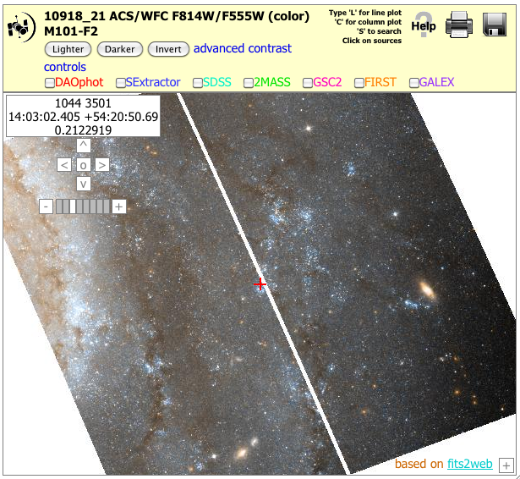
New interface capabilities
Interactive display enhancements including JPEG save option
Inventory and images view include select all button
HLA Simple Image Access Protocol server compliant with VO standards
Scatter plotting tool plots properties of HLA source lists

Slide 4
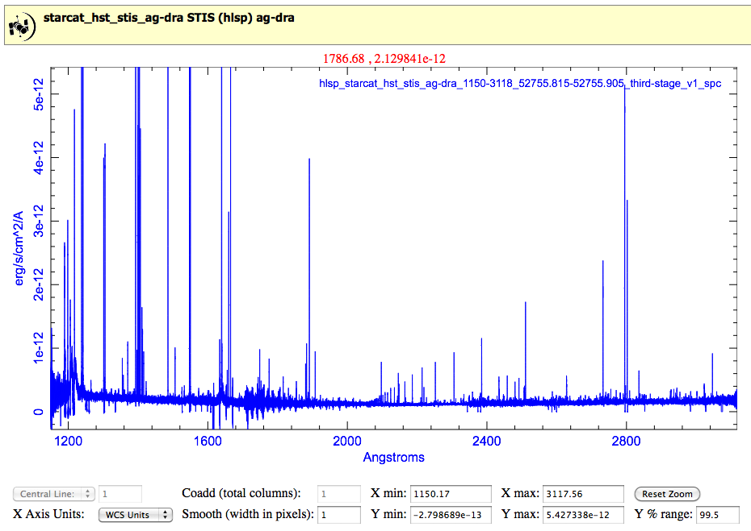
New interface capabilities, cont.
Ability to support Spectral HSLP
586 spectra from the StarCAT project
New line plotting tool – HTML5/Canvas
Interactive display accepts spectra

Slide 5
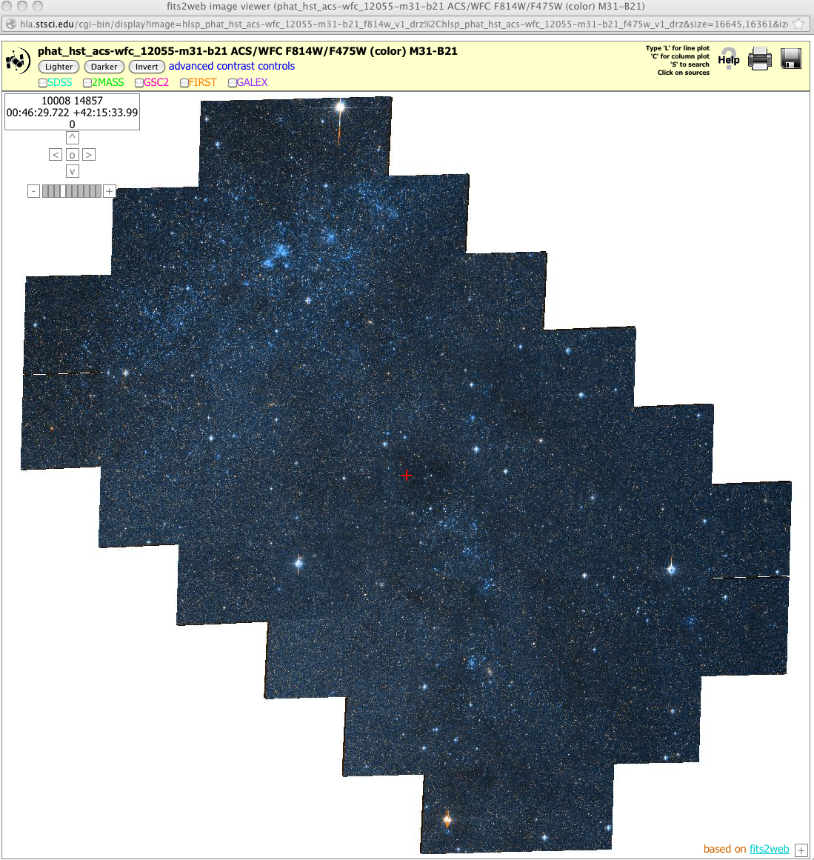
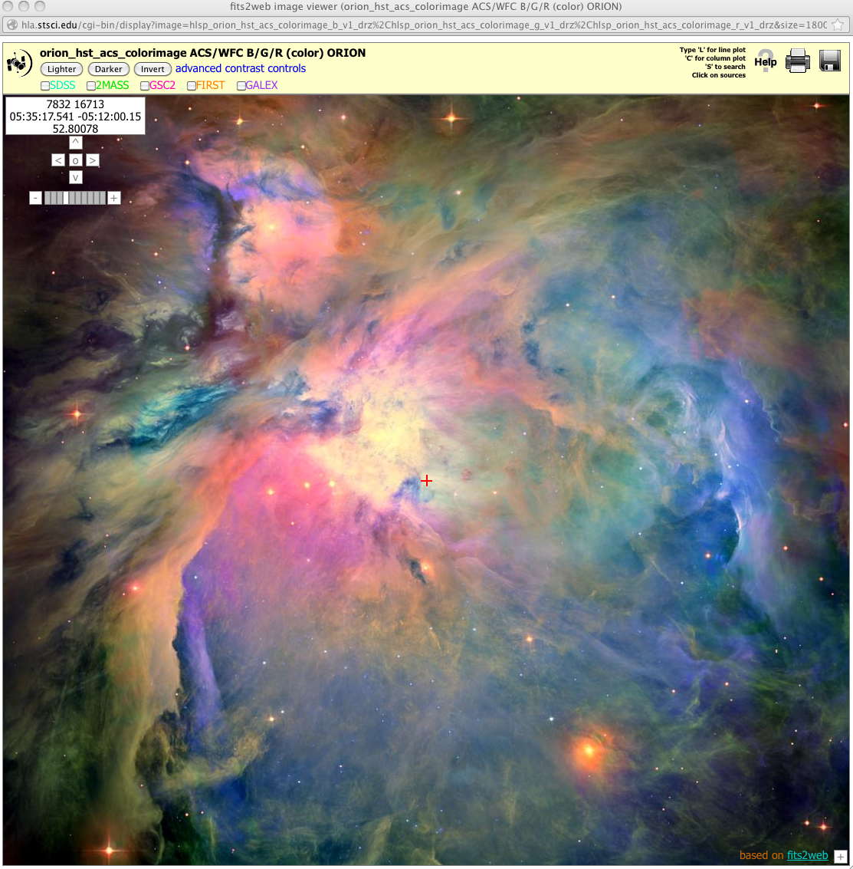
New Data
Additional ACS (updated to release date 2-16-2011), WPFC2 and NICMOS data
New High Level Science Products
CANDELS (Cosmic Assembly Near-IR Deep Extragalactic Legacy Survey)
CLASH (Cluster Lensing And Supernova survey with Hubble)
PHAT (The Panchromatic Hubble Andromeda Treasury)
HIPPIES (Hubble Infrared Pure Parallel Imaging Extragalactic Survey)
HUD09 (Hubble Ultra Deep field 2009)
ORION (The HST survey of the Orion Nebula Cluster
BORG (Brightness of Reionizing Galaxies Survey
GHOSTS (ACS Nearby Galaxy Survey)
StarCAT (HST STIS Echelle Spectral Catalog of Star)

Slide 6
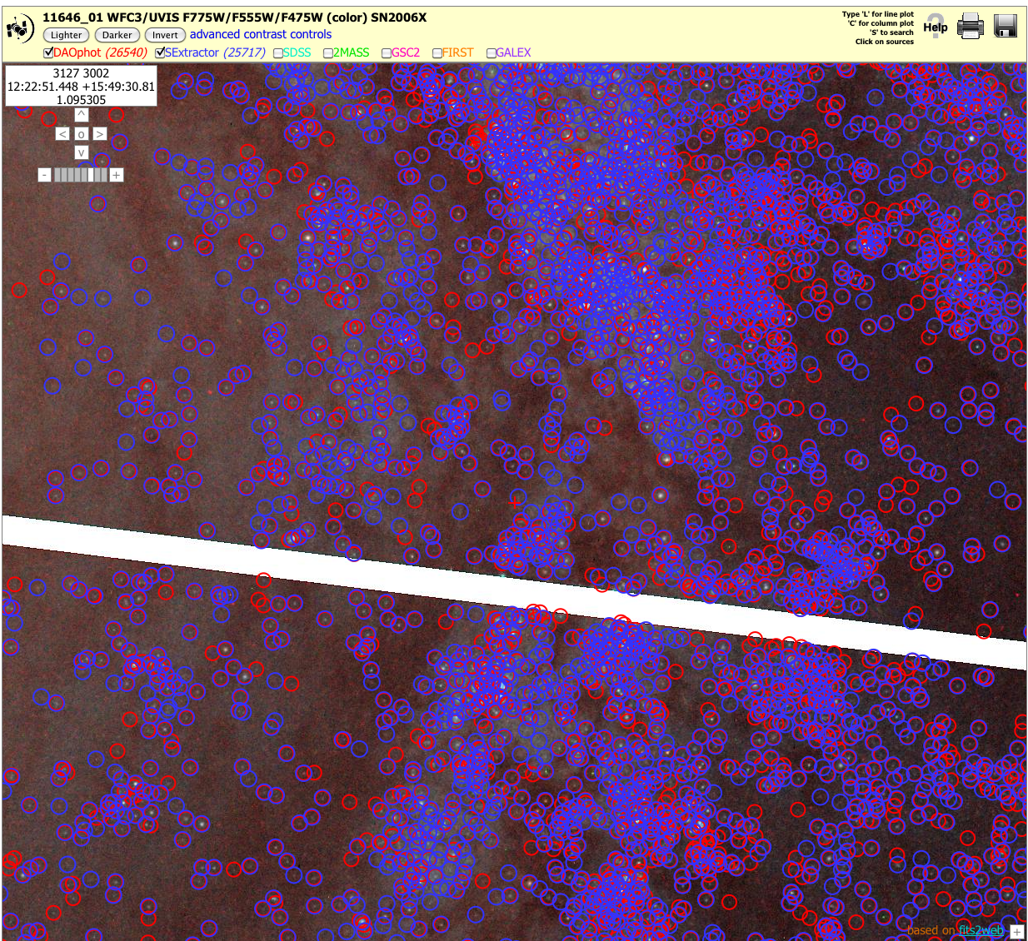
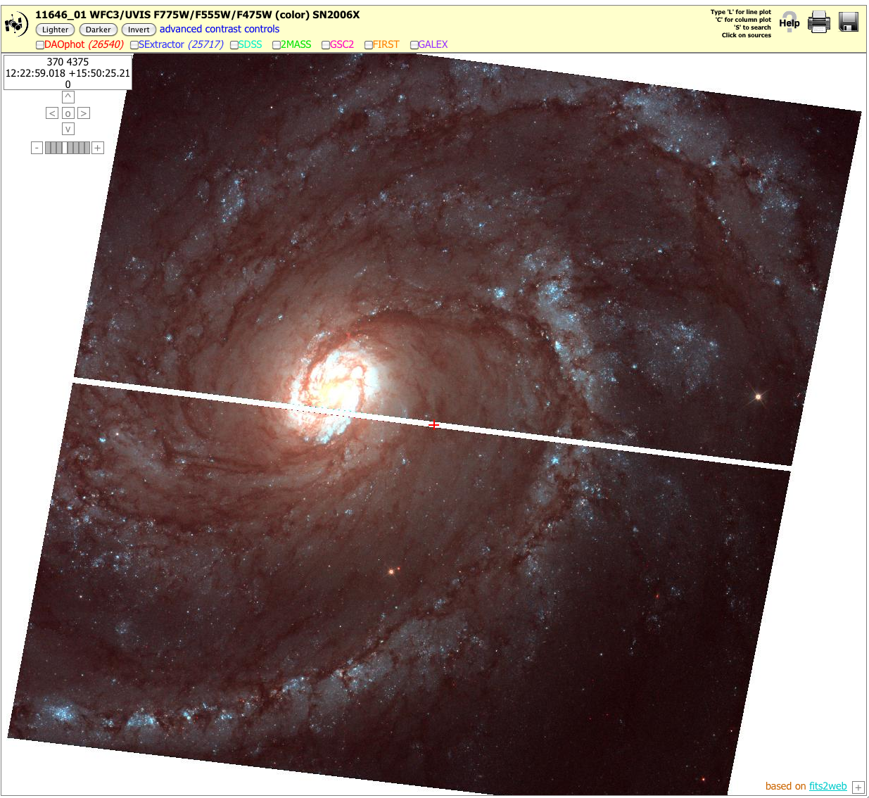
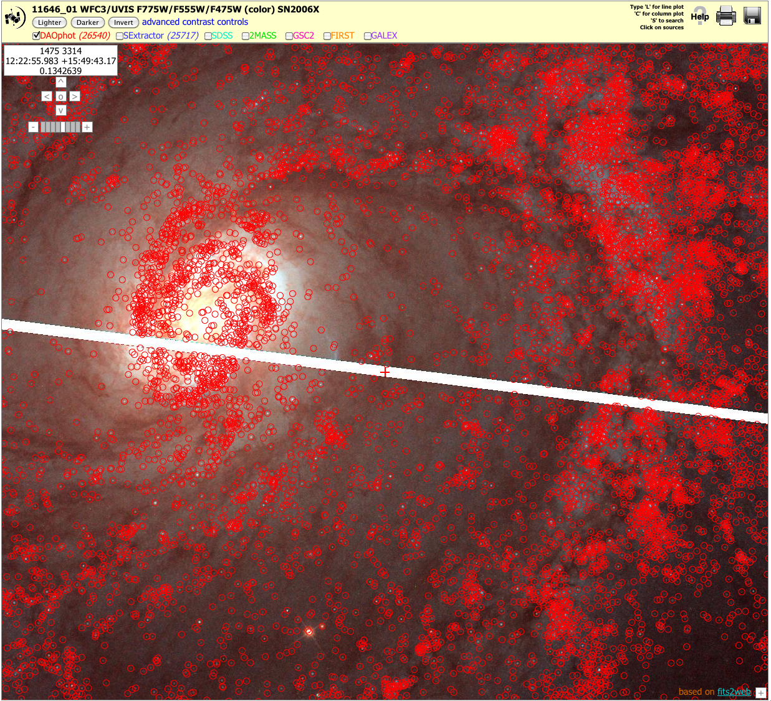
New Data
WFC3 image data: includes ~62% of data from observations that have a release date up to 11-30-2011
WFC3 source lists
DAOphot -5,201
Source Extractor -7,019
New (internal) review interface for
approving data

Slide 7
WFC3 Processing Pipeline
Based on existing HLA pipelines (ACS, NICMOS) with structural changes
Integrates data processing, source list generation
Modular design - steps are broken into separate programming units
Removes STSDAS dependencies as much as possible
Isolate instrument dependencies into small modules
Designed to be extensible to mosaic generation
Some algorithmic changes
New alignment module performs very well on crowded fields
Sky equalization included
More rigorous handling of header information
WFC3 images include two additional extensions (extensions 1-3 remain unchanged)
Extension 4 - Exposure Time layer records the effective exposure time for each pixel
Extension 5 – Table that includes information on all contributing images
Notes:
New alignment module performs very well on crowded fields
Not sensitive to cosmic rays, image defects
Critical for high-quality mosaics
Performance uneven on sparse fields - major source of data quality issues
Sky equalization included
Removes need to subtract sky
Better sky match if extended sources are present
More rigorous handling of header information
Much inherited information is not applicable to combined images
Relevant image-dependent parameters stored in tabular form

Slide 8
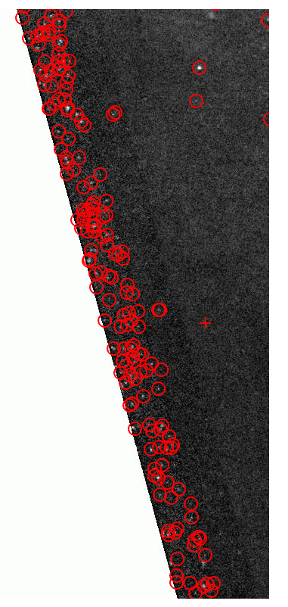
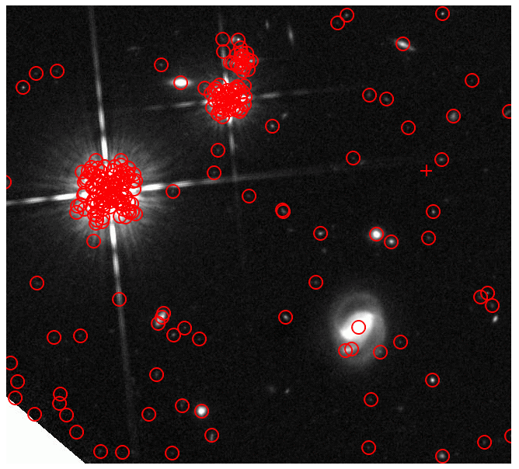
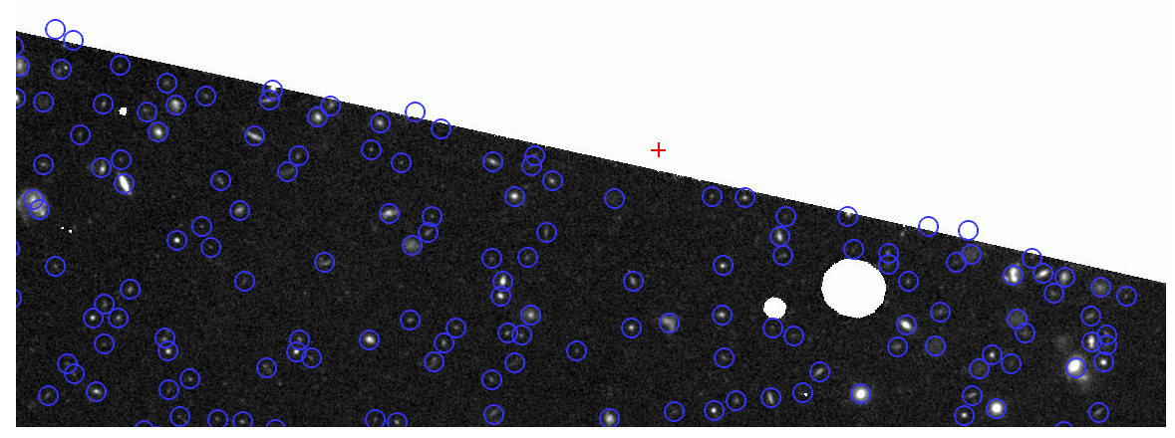
WFC3 Source list generation
Similar to ACS source lists
Total light image
Algorithm modified because sky background was not subtracted from WFC3 images
Spatial Filters
Gaussian kernel for sparse images
Mexican hat kernel for crowded images
Problems
DAOphot - number of spurious detections associated with bright stars constitute nearly half of the total source counts
SExtractor - detections of spurious sources near edge of valid data.
DAOphot - UVIS the edge region is affected by cosmic ray events

Slide 9
Work in progress
WFC3 imaging pipeline
Inclusion of Astrodrizzle
Refactoring and adding Astrodrizzle functions
WFC3 source lists flagging
Concentration index
Saturated sources
Detection swarms around bright stars
Diffraction spike detections
Nexp filtered detections, i.e. Lingering spurious edge detections

Slide 10
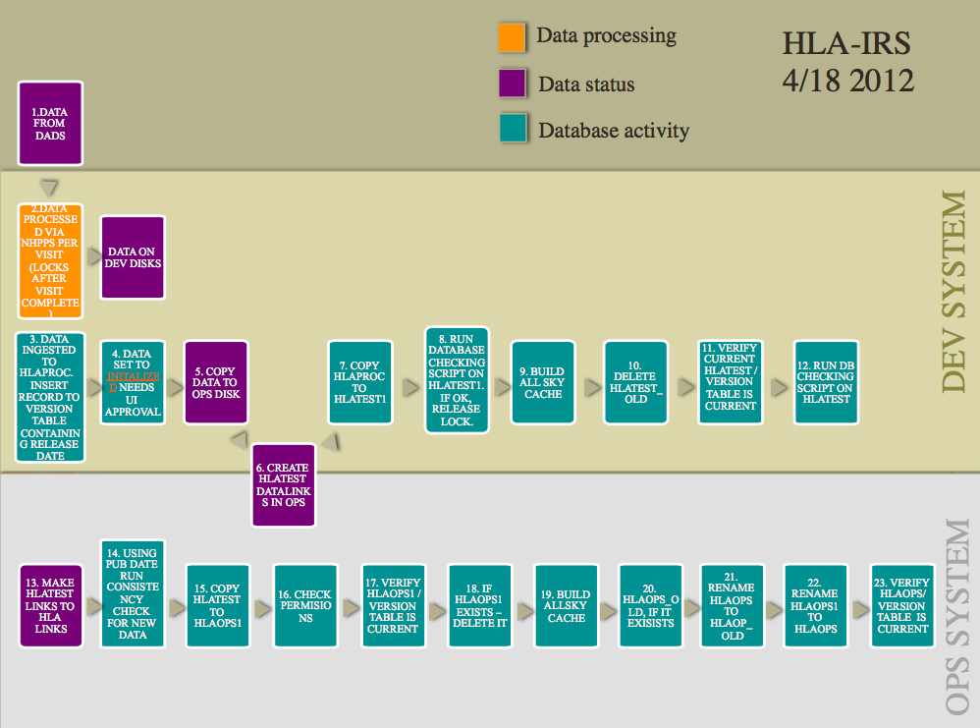
Work in progress
IRS – Incremental Release System
Database development almost complete
Design data delivery infrastructure

Slide 11
HLA stats

Slide 12
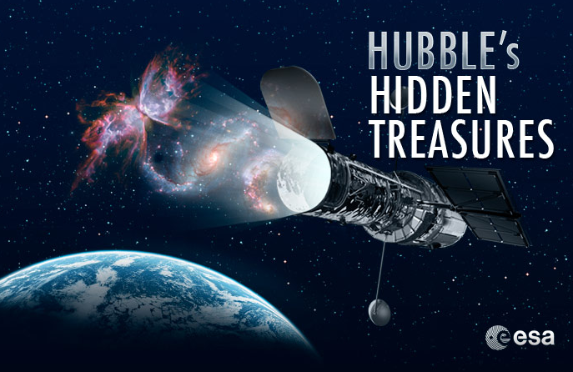
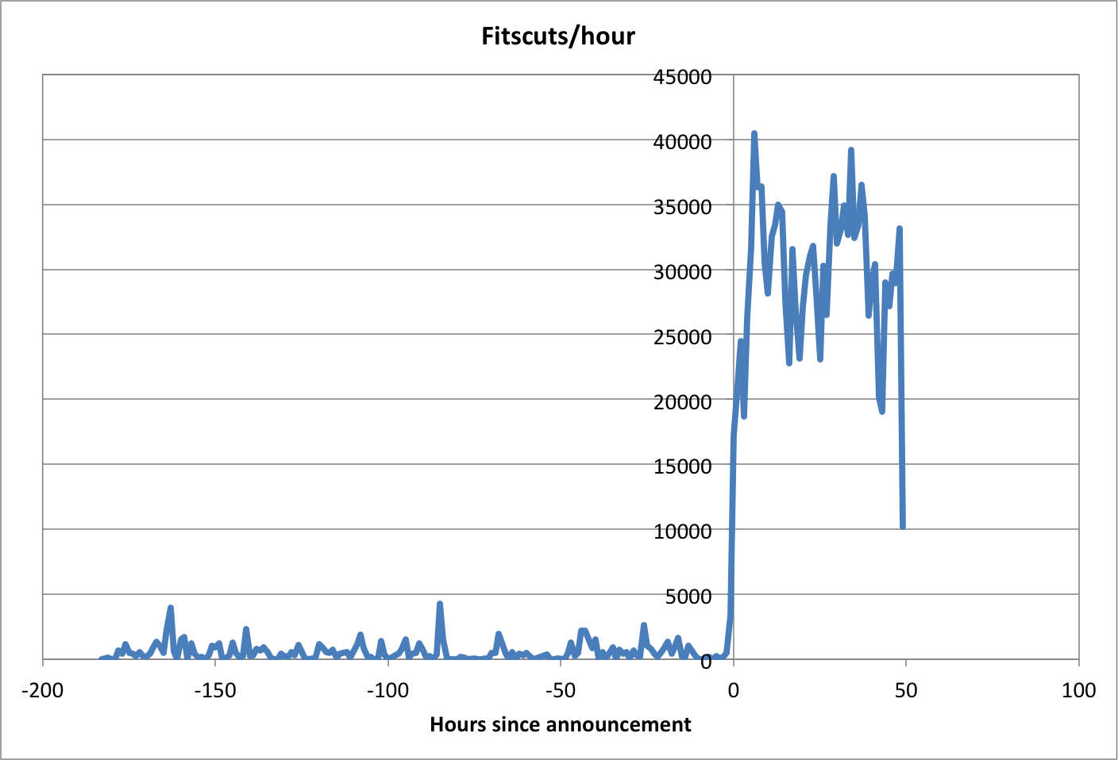
HLA stats cont.
Google Analytics
~150 hits > 4,328 hits (factor of 28)
FITSCUT
~600/hour > 41,000/hour (a factor of 68)

Slide 13
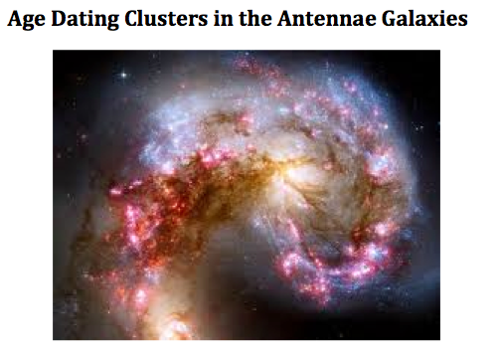
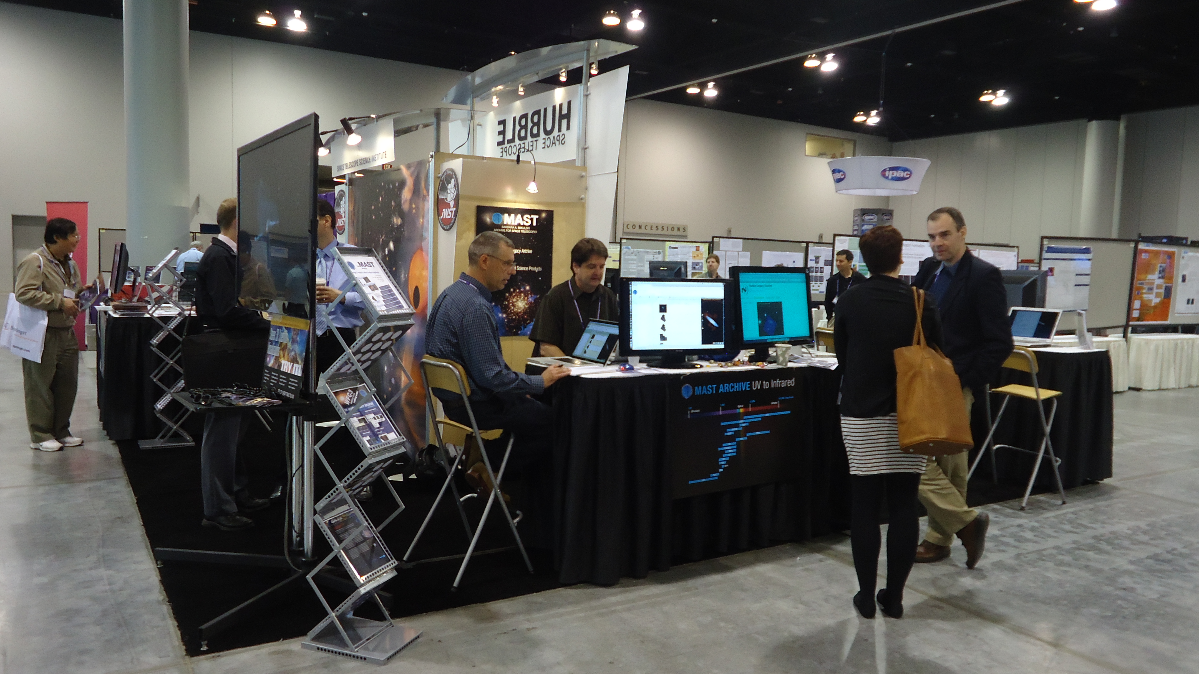
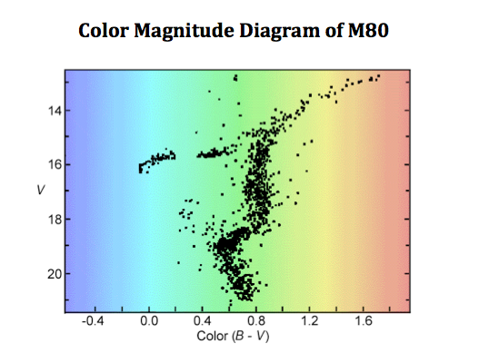
Outreach and Education
AAS Summer/Winter Sessions
ADASS – November 2011
STScI Citizen Engagement Jamboree
STScI Spectroscopy Workshop
Educational materials now available

Slide 14
Future HLA
Current and future baseline product generation
Process all public WFC3 data
Extend new WFC3 pipeline and data formats to other imaging instruments (WFPC2, ACS, NICMOS)
Develop robust mosaic pipeline
Produce mosaics for more pointings, instruments
Incorporate source lists and produce uniform metadata for HLSP
Enhance presence of spectral data in HLA
Include more existing products
Encourage teams to provide HLSP whenever possible
Foster development of spectral pipeline
Consider feasibility of WFC3 grism analysis tools
Develop tools to combine moving-target images

Slide 15
Future HLA cont.
Other products and features
Produce all-sky HST catalog (see Whitmore talk)
Develop tools to investigate time-domain data
Search for solar system targets
Expand capabilities of image display
Further enhance plotting tool capabilities
Continue educational and outreach endeavors
Integrate HLA interface into MAST portal
Ultimately portal will incorporate all HLA interface capabilities
Common look-and-feel for seamless navigation
Identify HLA services and functions to incorporate

