Slide 1
MAST Data Discovery Portal
Tom Donaldson
Tony Rogers

Slide 2
Agenda
Review Objectives
Current status
Work Completed Since Release
Work in Progress
Future Work

Slide 3
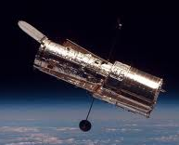
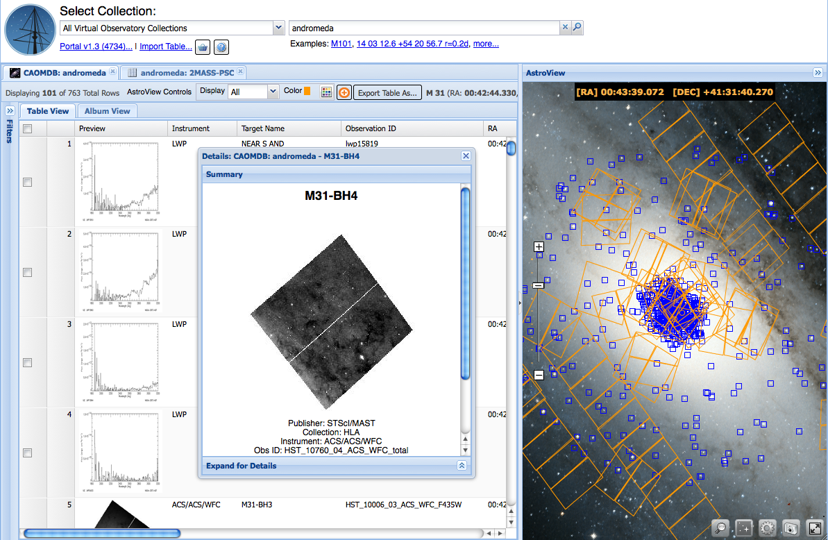
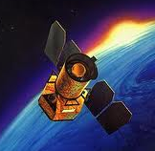
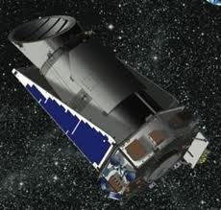
Objectives
Unify MAST missions with a common discovery interface.
Provide instant access to Virtual Observatory collections.
Build a framework for astronomy data interchange.

Slide 4
Current Status
Originally released in Fall 2013
Replaced MAST cross-mission search
Supported JWST DMS Build 2 testing
Usage is small but growing (up to a few thousand unique searches per month)
Should increase with additional query parameters
Used for searching JWST SID archive.
Also operational as VAO Data Discovery Tool
Server supports gPhoton python client
http://archive.stsci.edu/prepds/gphoton/

Slide 5
Work Completed Since Release
>100 tickets for software changes
Bug fixes and usability improvements
Press release data display and test bed
Upgraded core JavaScript library
Enhanced usage logging
Enhanced import/export
Performance enhancements
>30 tickets for CAOM improvements
New data made available for several missions
Corrections to some metadata values

Slide 6
Work In Progress
Hubble Source Catalog support
Search, filter, overlay in AstroView, scatter plots, cross-match with other catalogs
Display image cutouts for each extraction
Create new columns
HST image display in AstroView

Slide 7
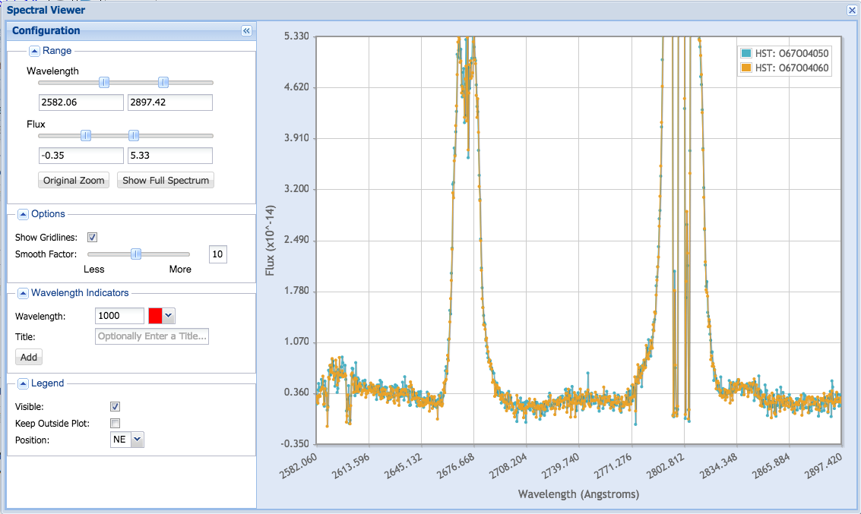
Work In Progress (2)
Interactive Spectral Viewer

Slide 8
Work In Progress (3)
View previews as cutouts. Example at:
03:32:42.290 -27:47:46.17 r=0
Full Previews
Cutouts around position

Slide 9
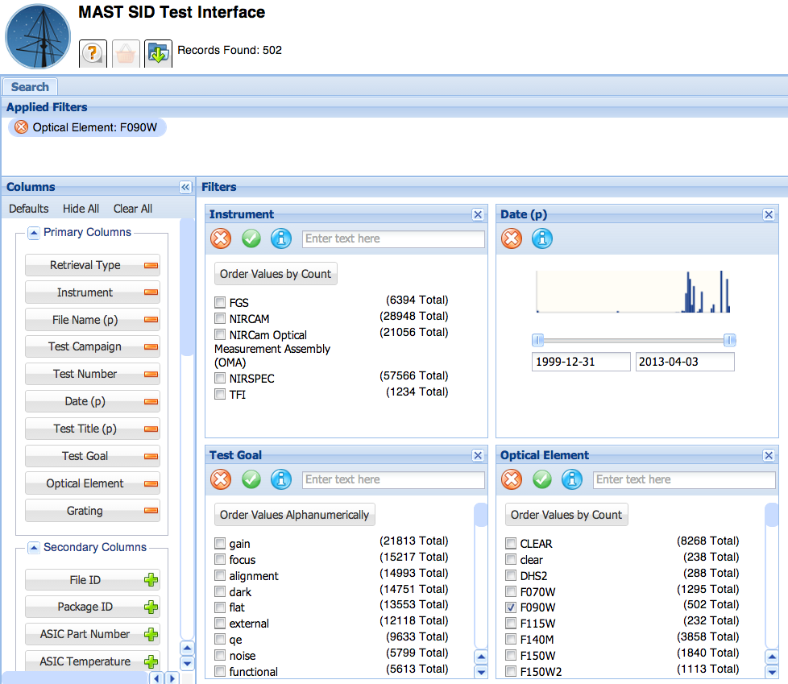
Work In Progress (4)
Parameterized query interface
Search by Instrument, Program ID, etc.

Slide 10
Work In Progress (5)
Work with a designer to improve usability, look and feel.
Integrate with STScI SSO infrastructure
JWST Requirements Analysis

Slide 11
Future Work
Data Retrieval
Load remaining MAST observations into CAOM
Search and cross-match against all MAST catalogs
Mission-Specific query interface
Support referencing MAST datasets via DOIs (Digital Object Identifiers)
Data Avalanche
Dealing with large result sets
Summary data views
Data Visualization
Integrated FITS viewer
Generalized image services
AstroView: More Surveys

Slide 12
Future Work (2)
Single Sign On
Retain user preferences, search and download histories
Restrict access to proprietary data
Virtual Observatory
New search engine
Study indexing to speed VO searches
Contribute to data discovery standards definition
Other
Ongoing JWST Implementation
Manage UI Complexity
Mobile access

