Slide 1
Introduction and Highlights
Rick White
Karen Levay

Slide 2
MAST Data & Growth
278 TB - Holdings Size as of Nov 1 2013
3 TB – Average Ingest Rate per month
19 TB – Average data distribution rate per month
1,500,000 - Average # searches per month

Slide 3
Distribution vs Holdings
Holdings as of Nov 1 2013
Distribution 2011 –2013

Slide 4
Publications
MAST continues to identify papers using data for most of the MAST missions. HST archival papers continue to be more than half of the annual total.

Slide 5
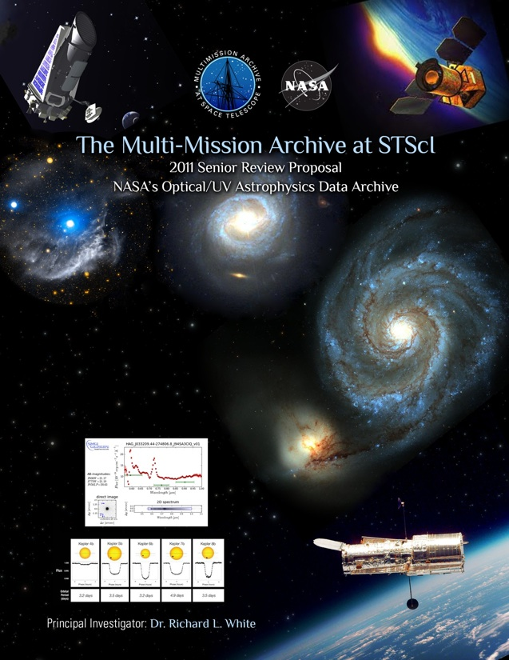
Archive Funding Sources
Missions
HST
JWST
Kepler
MAST
VAO (<2 FTEs)
MAST Proposal for 2011 NASA Data Archive Centers Senior Review
Notes:
Gretchen Greene will be discussing the VAO in her presentation this afternoon

Slide 6
Archive & MAST Staff
Archive Team Leads: Carl Johnson, Rick White, Gretchen Greene, Alessandra Aloisi
Data Systems Branch – Mark Kyprianou
20 members
Development and testing of HST/JWST/Kepler processing pipelines, archive, distribution processes
Data Processing Archive Services Branch – Faith Abney
11 members
Operations for HST/JWST/Kepler pipelines and distribution
Archive Sciences Branch – Karen Levay
18 members
“MAST” archiving and distribution; Interface development for all Missions/Datasets; Bibliography support; VO work; HLSP Support
Hubble Legacy Archive – Lee Quick coordinator
Members from various areas in STScI (MAST, DSB, INS, Mission Office)
~ 10 people at various levels of effort
HLA pipeline, catalog & interface development

Slide 7
Staff Changes
Departures
Steve Handy
Myron Smith (retirement)
Niall Gaffney
Francesco Pierfederici
Arrivals
Scott Fleming – Archive Scientist
Sahar Allam – Archive Scientist
Lou Strolger – HLA
Jacob Matuskey – S/W
Transfer
Anastasia Alexov (ASB -> DSB)
Alessandra Aloisi – New Deputy Division Head – primary focus on Archive and Science Software work

Slide 8
Highlights with details later
Hubble Legacy Archive and Hubble Source Catalog (White/Whitmore)
Kepler status and variability statistics project (Fleming/Fraquelli)
GALEX photon-list (Fleming/Shiao/Thompson)
Data Discovery Portal (Rogers)
Outcome from Spectral Legacy Working Group (Aloisi)
High-Level Science Products – new guidelines and current projects (Koekemoer/Fleming)
Related to MUG recommendation: Improving HST astrometry
Related to MUG recommendation: Improving tools & products for spectra

Slide 9
Topics Covered in Supplementary Slides
HST Upgrade Project Status (Condor/OWL, new calibration file system, processed data cache)
HST Instruments/Operations Highlights
JWST Data Management Systems
JWST Data Flow Diagram
JWST Functional Architecture
Ask if you’d like to see any of this material discussed.

Slide 10
WFC3 Persistence
MAST still maintains cache of WFC3 persistence corrected flats in a separate cache.
MAST communicated the MUG recommendation that the WFC3 persistence corrections be incorporated into the standard pipeline.
The instrument team was reluctant to include this correction in the standard pipeline as they feel the correction not finalized, but will reconsider the issue in 2014 time frame. Incorporation of the persistence correction may be more possible once the archive is in the online-cache mode and updates can be included when the data are reprocessed.

Slide 11
Common Archive Observation Model
Common Archive Observation Model
Meta-data population for most MAST missions now complete in current version of CAOM
(HST and HLA, GALEX, IUE, FUSE, EUVE, BEFS, TUES, WUPPE, HUT, SWIFT, KEPLER)
This is version being used by the Data Discovery Portal.
CAOM 2 is nearing completion and the meta data will be moved in the next couple of months.
Continuing active collaboration with CADC. ESAC, ESO and IPAC also considering adoption of CAOM.
Population of new/reprocessed HST data will be part of the HST processing pipeline
Related to MUG recommendation: Cultivate CAOM use by other archives

Slide 12
Communicating to Users
Two blog entries in AstroBetter (programmatic access and High-Level Science Products)
Regular updates on Facebook and Twitter
RSS feed “What’s New”
STScI Newsletter
Survey suggestion for more Archive Newsletters – but evidence is that they are not read.

Slide 13
High Level Science Products
Talk later about updated guidelines with discussion about HLSP in general (Koekemoer/Fleming)
New datasets include:
Frontier Fields
Hubble Heritage: Comet ISON, Horsehead
ACS Globular Cluster Survey additions
Hubble eXtreme Deep Field (XDF)
Brightest of Reionizing Galaxies (BoRG) additions
Orion Nebula Cluster Treasury Program
UDF12
Many CANDELS/CLASH/PHAT updates (next slide)
> 10 teams have had initial contact about providing HLSP
Related to MUG recommendation: Establish metadata requirements for HLSP

Slide 14
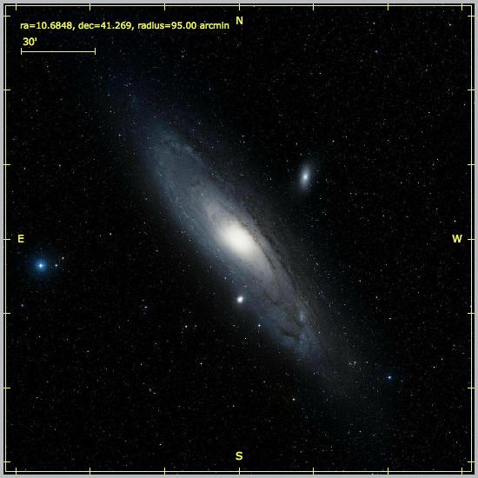
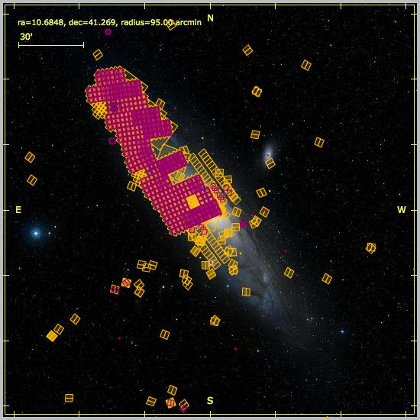
Multi-Cycle Treasury Programs
CANDELS (Faber/Ferguson)
2.6 TB of data
> 40 TB distributed to > 1400 IP addresses
CLASH (Postman)
343.6 of data
> 2.6 TB distributed to > 1100 IP addresses
PHAT (Dalcanton)
>1 TB of data
> 5 TB distributed to >540 IP addresses

Slide 15
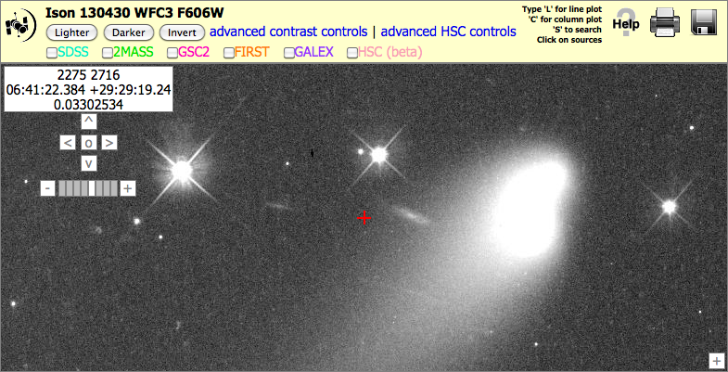
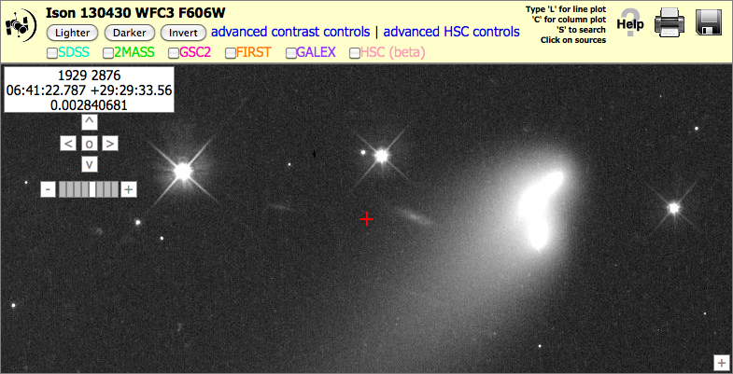
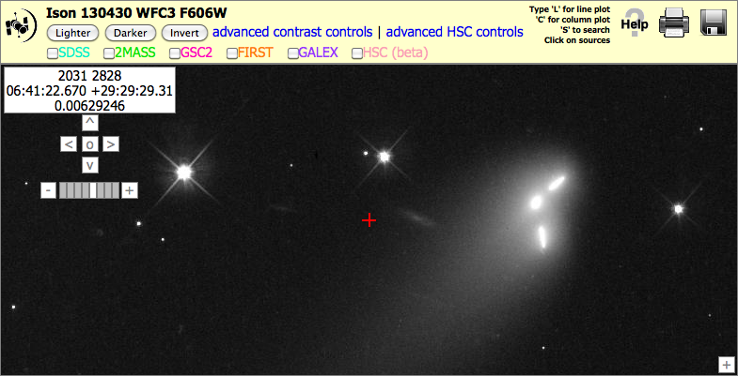
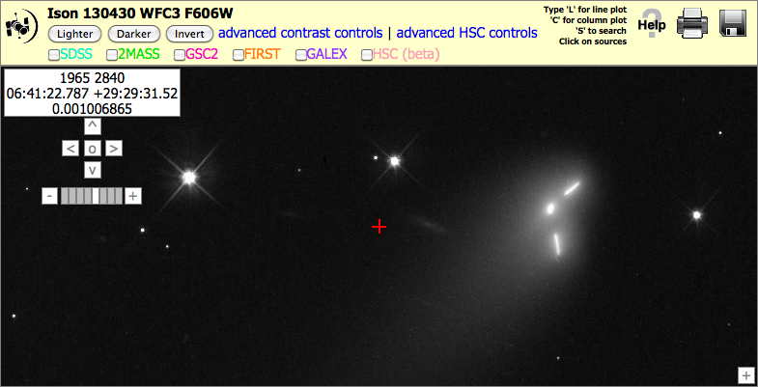
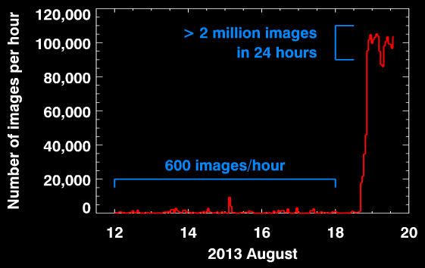
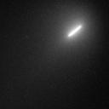
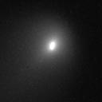
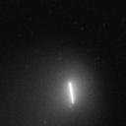
MAST Gone Viral! Comet C/2012 S1 (ISON)
What happened?
Blog post: comet is a spaceship!
Image is sum of 3 blurred exposures of the moving comet
Exposure #1
Exposure #2
Exposure #3
Notes:
Tim Kimball figured out how to modify the Apache webserver so that it could handle this huge load without impacting other archive users.

Slide 16
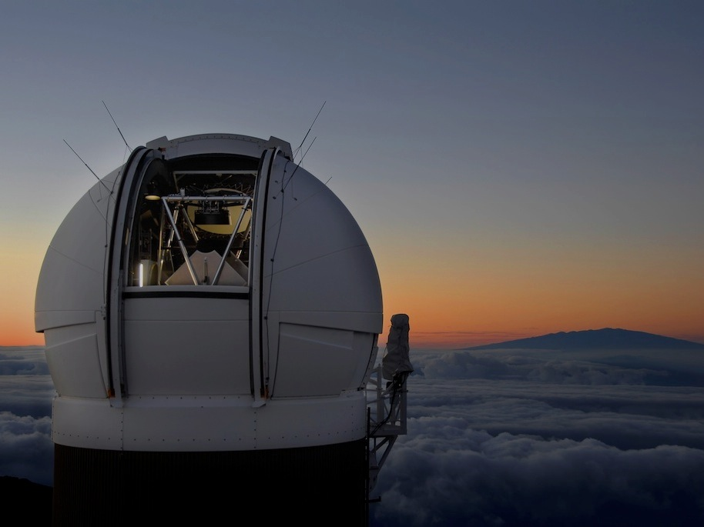
Pan-STARRS
STScI will host the public archive for PS1
100 TB database
2 PB images
This is a science project, not funded by MAST
But MAST will benefit from data + experience (already planning PS1 use to improve HST astrometry)
Will use MAST tools but new hardware
Current schedule: opens April 2015

Slide 17
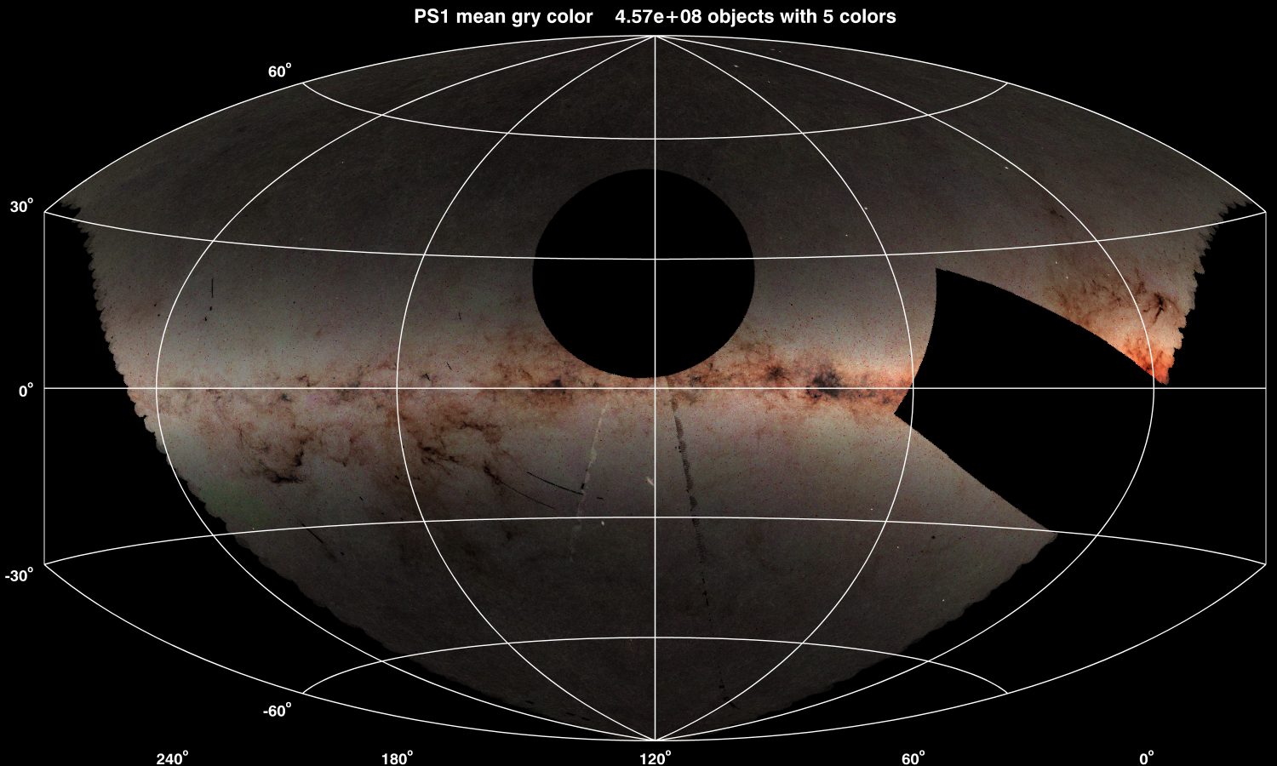
Pan-STARRS 3PI g/r/y mean colors 4.57x10⁸ objects
Notes:
Includes objects detected in all 5 grizy bands
Color comes from mean gry
Brightness comes from object counts
Note the clearly visible artifacts (PRs exist for those)

Slide 18
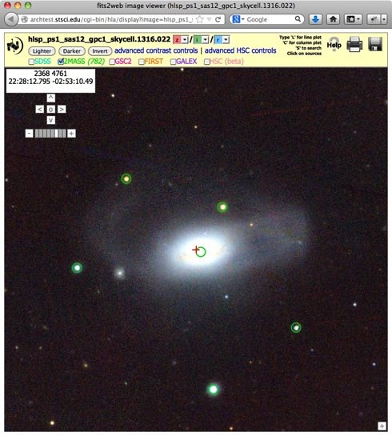
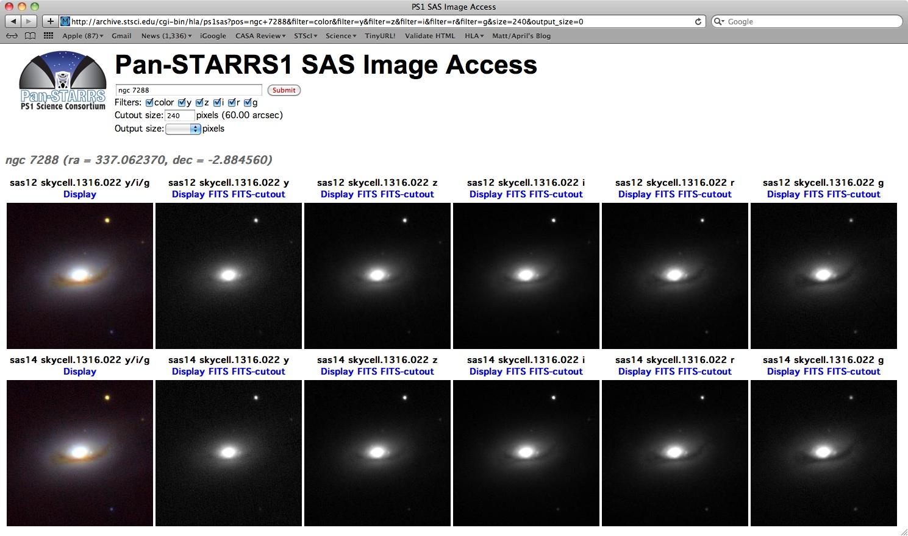
Sample PS1 image using HLA tools
Notes:
Demo positions:
ngc 7288
ngc 7222
334.073 0.4 (in md09, nice little cluster – choose z I r)
333 +5 (1024 pixel, shows bad region with stacking changes)

Slide 19
Future
SWIFT UVOT updates monthly
XMM OM data same as at HEASARC for the products we are serving.
Literature links are on-going. The data gathered from this project will be used in some future projects (see Aloisi)
Investigating the JHU SciDrive (VO Space)
Big Data – LSST representative on JWST SDR Review Board
Pan-STARRS
Related to MUG recommendation: SWIFT and XMM data should be the same as at HEASARC

Slide 20
MUG meeting changes
Fewer/shorter presentations
Longer meeting
Including some responses to MUG recommendations and suggestions in talks
Related to MUG recommendations: Improving the MUG meeting

Slide 21
Extra slides

Slide 22
Supplementary Material
HST Upgrade Project Status
HST Instruments/Operations Highlights
JWST Data Management System (DMS)
JWST Data Flow Diagram
JWST Functional Architecture

Slide 23
HST Upgrade Project Status
Project goals – modernize, improve flexibility.
Replace reference file system (replace CDB with CRDS)
Replace old OPUS pipeline infrastructure with Condor/OWL
Replace OTFR with online cache that is updated as needed
Goal to complete upgrade project and be operational Spring 2014
Improved implementation of reference files to be implemented into parallel operations in Dec 2013
Replacing OPUS with Condor/OWL workflow manager – Initial implementation in Ops for CRDS. - Dec 2013
HST instrument pipelines will be in Condor along with most of the support/ancillary pipelines.
Upgrade of Storage Broker – now flexible and able to handle different types of mount points e.g. online cache – completed September 2013
Full online cache population and reprocessing/repopulation in development. Static instruments will also be in cache. Timing is still TBD, but by Spring 2013
Operational workflow will include CAOM population and preview creation

Slide 24
HST Instruments / Operations Highlights
Astrodrizzle and CALWFC3 updates – Dec 2012 and Jan 2013
March 2013 – All WFC3 data reprocessed – March 2013
April 2013 – All ACS data reprocessed – April 2013
New calibration routines, COS updates – April 2013
More COS updates – May 2013
COS reprocessing started – June 2013. Recreating CCI/CSUM files so processing data manually in chronological order with team inspection every few weeks.
FOC and GHRS header-data fixed and re-ingested – Oct 2013

Slide 25
JWST Data Management Systems (DMS)
Design and development work underway.
Third System Design Review (SDR) later this week. Second DMS build was Oct 1.
Calibration and pipeline development underway. Definition of data products and associations started recently. Database design underway, starting with file tracking.
HST upgrade project taking advantage of JWST design decisions and HST provides operational experience for JWST.

Slide 26
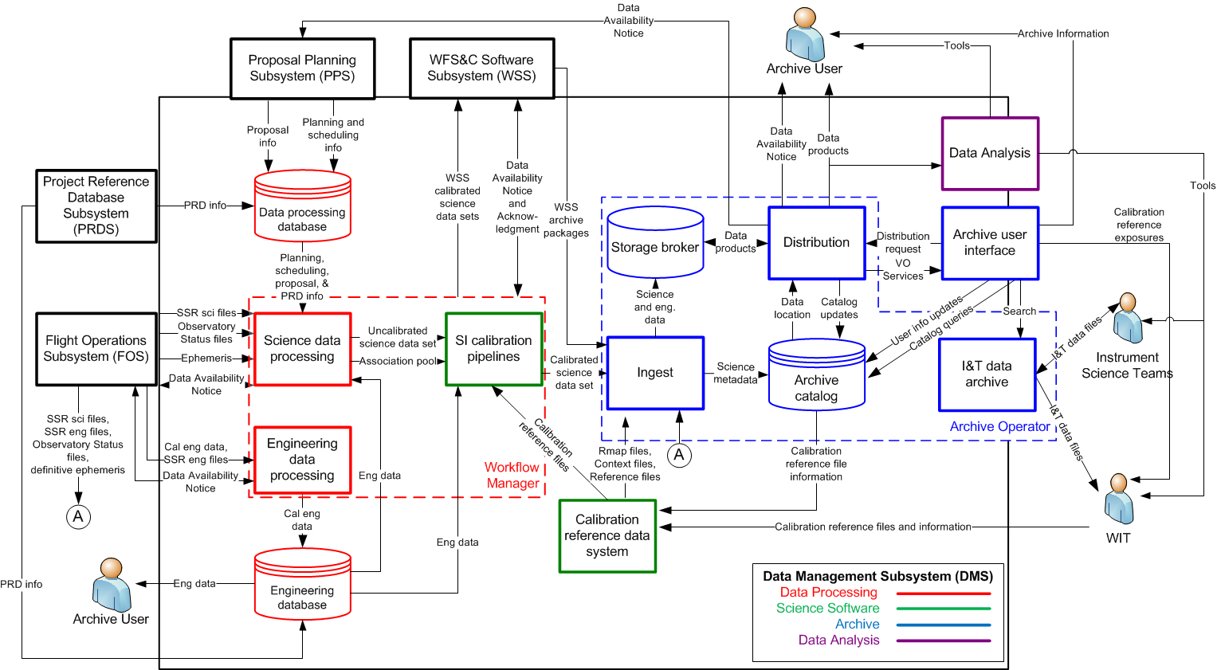
JWST Data Flow Diagram

Slide 27
JWST Functional Architecture

