Slide 1
MAST Data Discovery Portal
The new website for accessing MAST data
Tom Donaldson

Slide 2
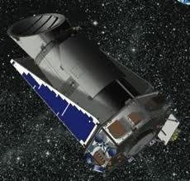
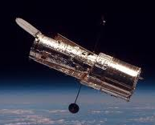
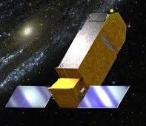
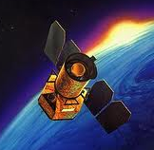
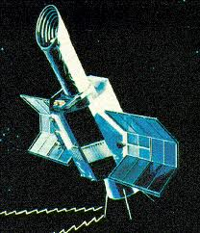
Consolidate all MAST data holdings
Single UI built on the success of HLA and GalexView

Slide 3
Collaborate With VAO
Access Virtual Observatory for Multi-Wavelength Search and Discovery

Slide 4
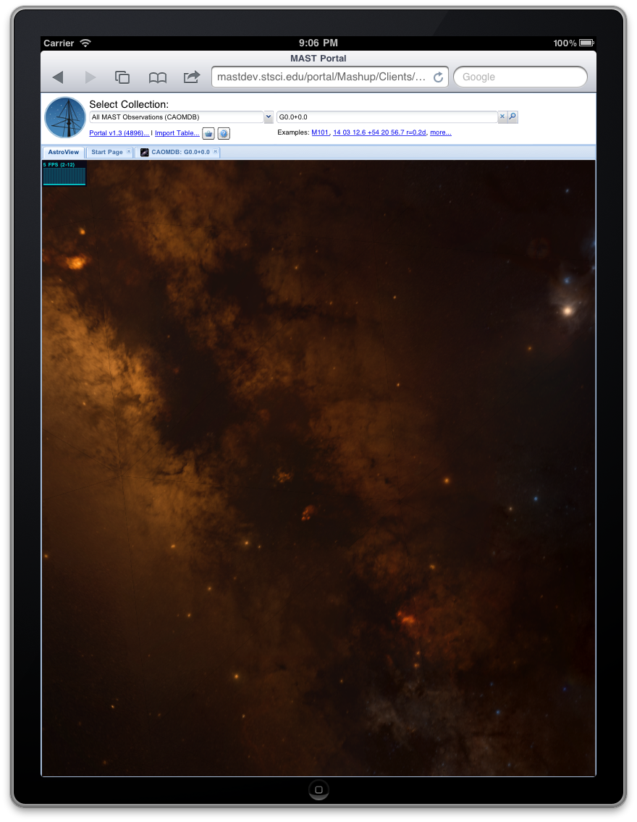
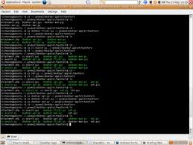
Flexible and Extensible Infrastructure
Single server can support multiple clients, while accessing local and remote resources
MAST Portal
External Web Site
Mobile Apps
APT
Aladin
Scripts
Mashup Server
Local Resources
Remote Resources

Slide 5
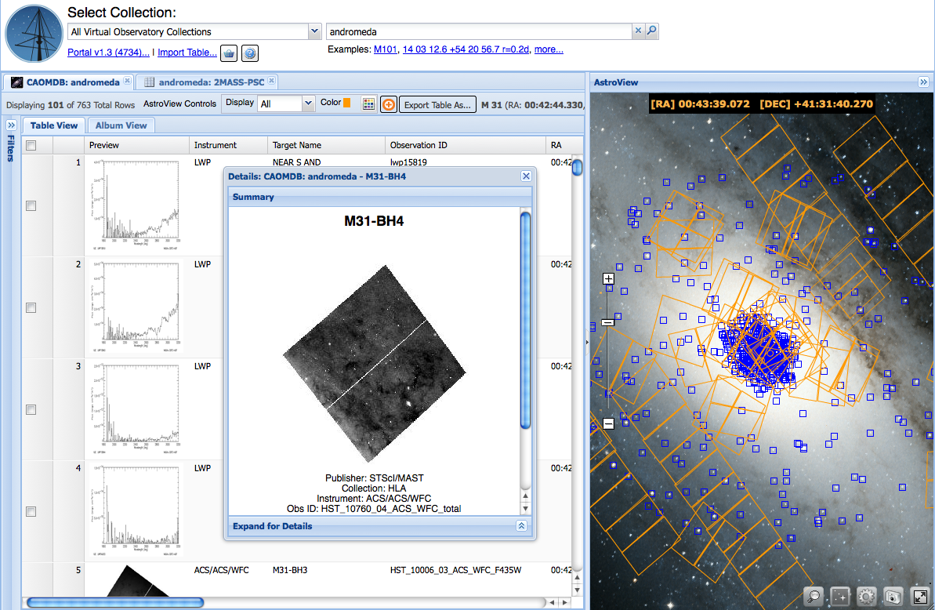
Demo: http://mast.stsci.edu/explore

Slide 6
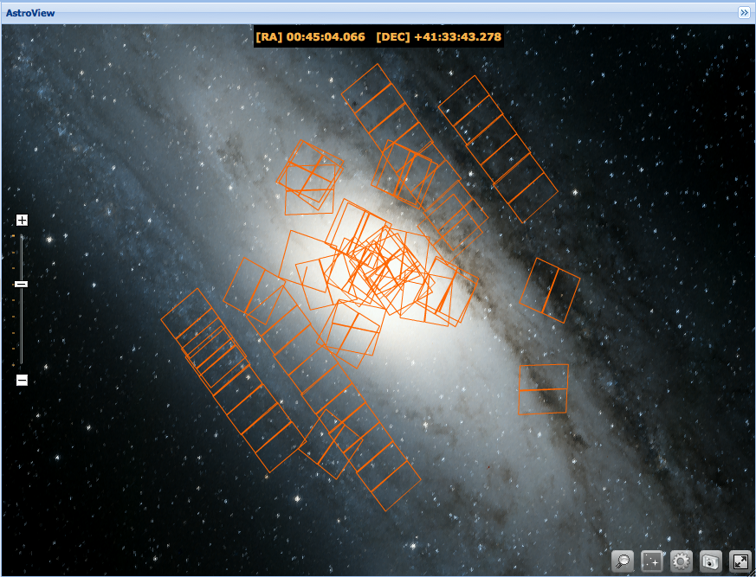
All-Sky Visualization

Slide 7
Displays for Images, Catalogs, Spectra

Slide 8
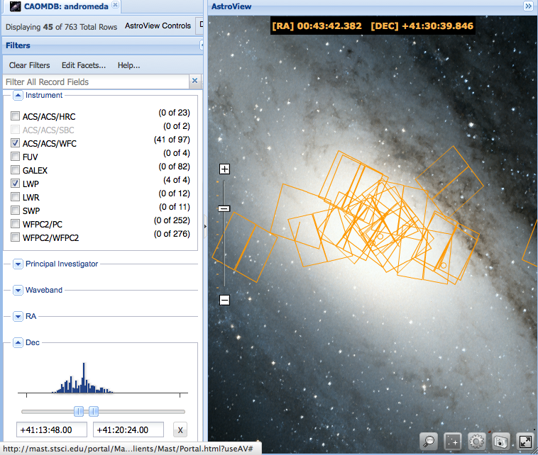
Filters for Narrowing Results

Slide 9
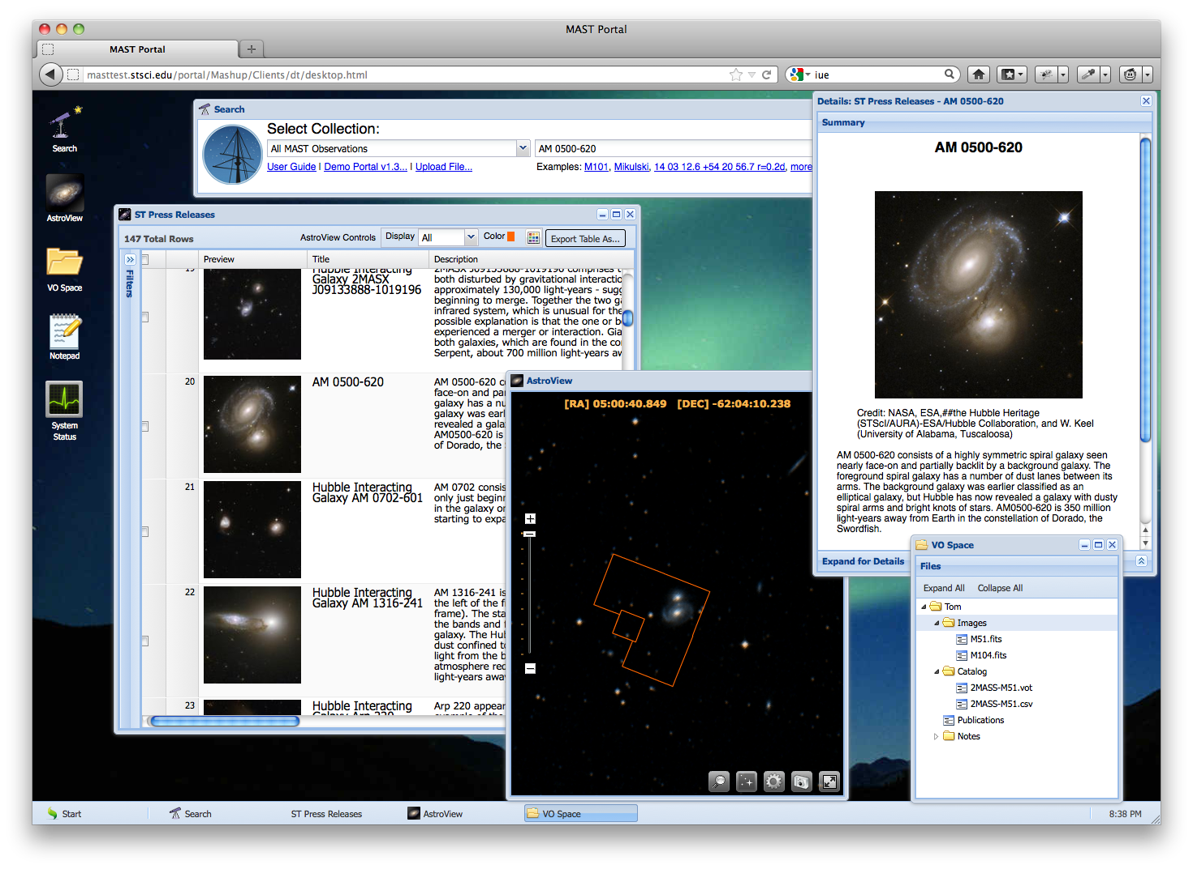
Astronomer’s Desktop

Slide 10
Future Plans
Incrementally Replace MAST Web Pages
Cross Mission Search
GalexView
HLA
Mission Specific Search Tools
StarView: Form-based Query Builder for HST
JWST SID Archive: Instrument Test Data for JWST
Custom Keyword Search
Other
Citizen Science
Mobile Interface
Single Sign On Support
Astronomer’s Desktop

Slide 11
Feedback
We plan to work closely with archive users to make this tool as useful as possible.
If interested in sharing ideas on features or trying out the interface as it evolves, please contact us:
Tom Donaldson (tdonaldson@stsci.edu)
Tony Rogers (rogers@stsci.edu)
Geoff Wallace (gwallace@stsci.edu)
Karen Levay (klevay@stsci.edu)
Other Contributors:
Bernie Shiao
Brian McClean
Theresa Dower
Dean Hinshaw

