Slide 1
HST Data Processing
Operations and Engineering Division
Data Systems Branch
Mark Kyprianou

Slide 2
Highlights - Infrastructure
Deployed database clustering technologies to DADS/OPUS systems
Internal and Public databases
Improve uptime, reliability and performance
Updated/added new web servers
3 independent environments:
Dev, Test and OPS
Allows for isolation in the software life cycle

Slide 3
Highlights - Instruments
Science data processing enhancements
Astrodrizzle (ACS and WFC3)
CALACS w/CTE
COS reprocessing/cataloging enhancements
CALCOS with no IRAF
STIS flight software problem with time tag data
STIS Reprocessing to create valid CCI files for post-SM4 data

Slide 4
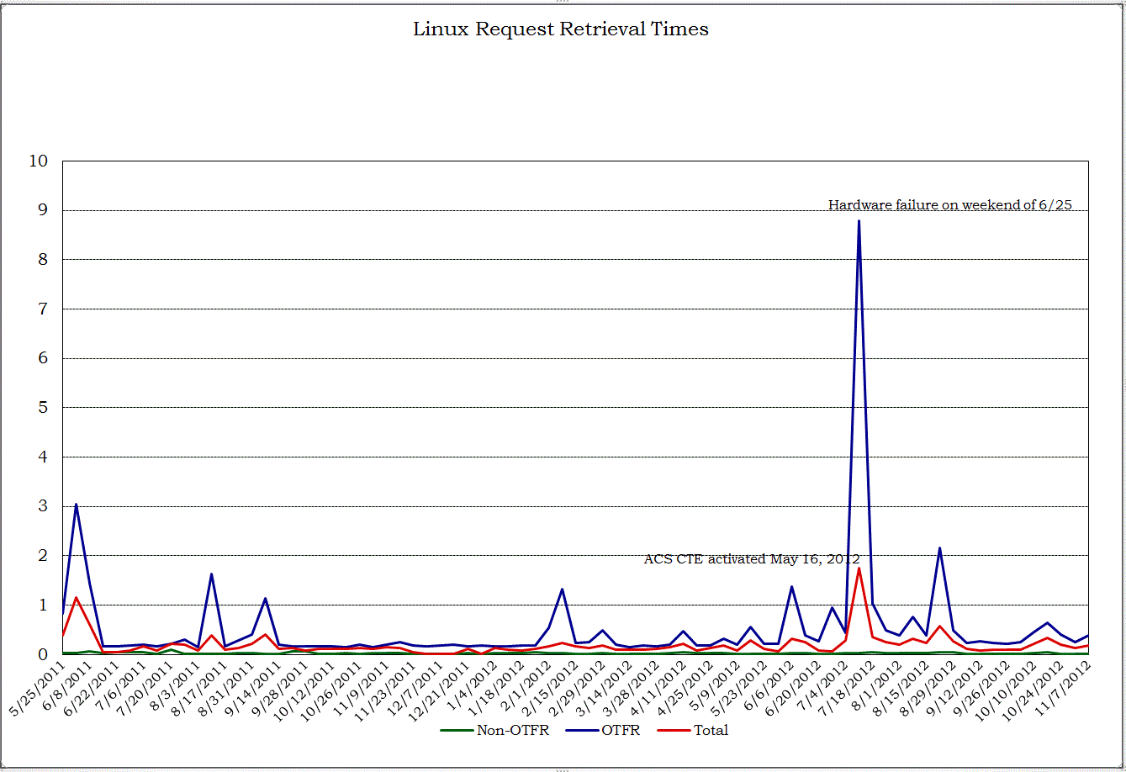
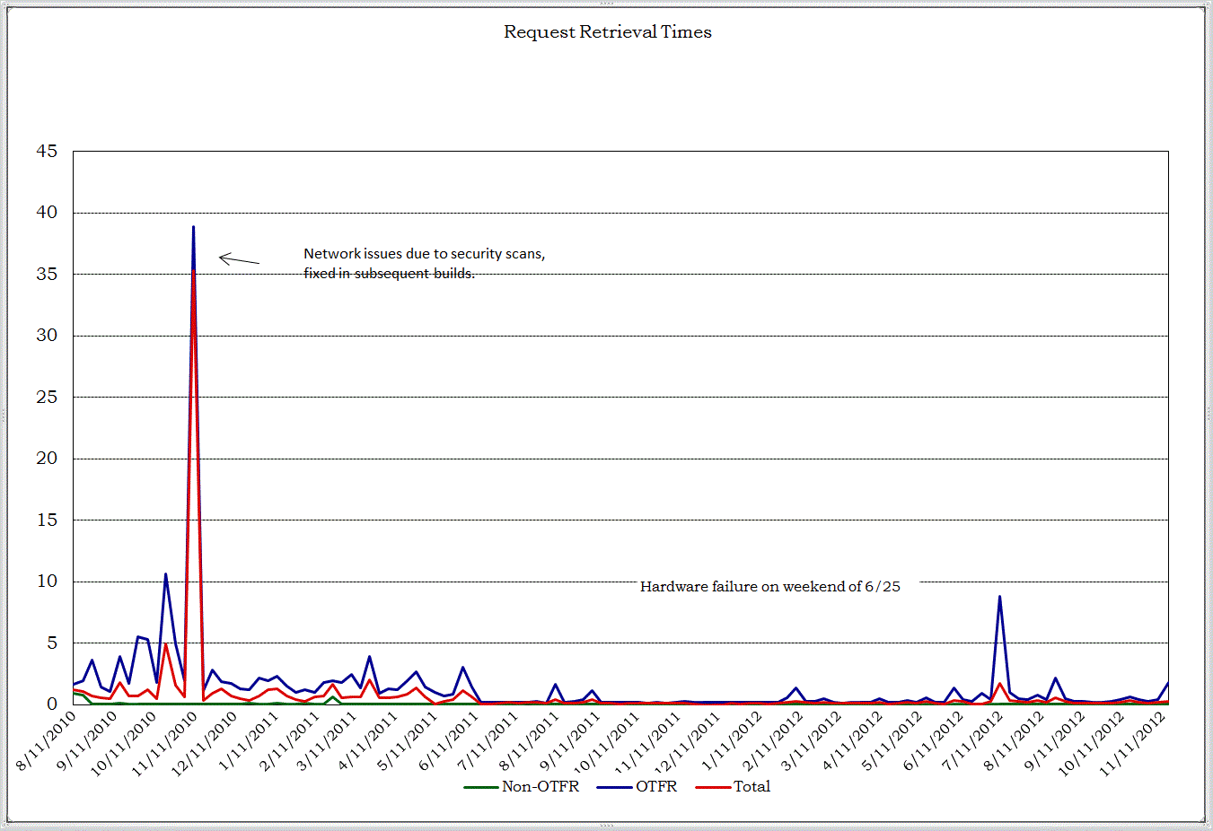
Retrieval Times

Slide 5
Future Development

Slide 6
Future Development
Infrastructure
Red Hat OS upgrade for DADS/OPUS servers
Purchased NAS storage (EMC Isilon)
Very scalable for Big Data
Blades support
High IOPS
CPU processing
Storage

Slide 7
Future Development
Instrument Data Processing enhancements
Keywords
Algorithmic enhancements
Reprocessing planned for ACS, WFC3 and COS
Iraf Free: WFC3 and STIS
In test

Slide 8
HST Upgrade Projects

Slide 9
HST Upgrade Projects
Background Automated Reprocessing (BAR)
Integrated reprocessing
Online cache
Workflow Manager (WFM)
Technology refresh for work flow processing
Calibration Reference Data System (CRDS)
Driven by analysis of current systems targeting JWST
HST Mission Office elected to adopt these enhancements

Slide 10
Background Automated Reprocessing (BAR)
Handle reprocessing activities in an integrated fashion
Use prioritization scheme to control processing sequence
Provide online access to files
Enhance tiered file storage sub-system
Store data to provide direct access
Rework file handling to be mission independent

Slide 11
Work Flow Manager (WFM)
Upgrade workflow processing
OPUS technology refresh is over due
Limited functionality for expansion (cloud computing, additional compute resources)
Condor: Open source, high-throughput computing software framework has been selected
Allows to access compute resources on different levels/rules

Slide 12
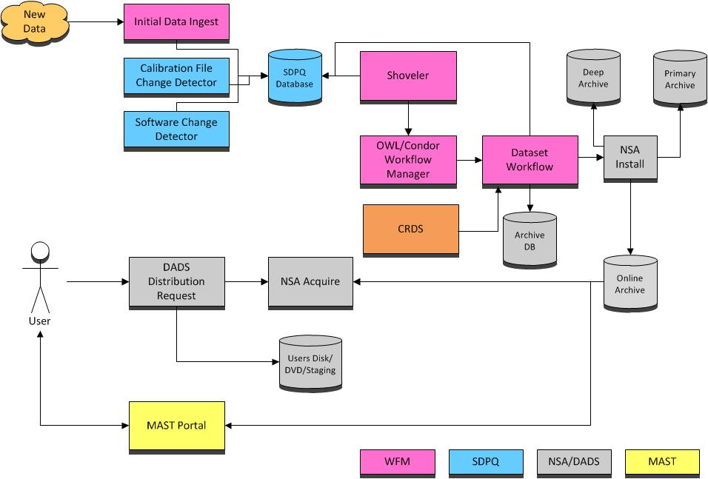
Overview: BAR/WFM/CRDS

Slide 13
Current Status
BAR
SDPQ - complete
File Storage to online cache – in progress
Working on distribution updates
WFM
Condor
Enterprise level, Open source workflow package
Open Workflow Language (OWL)
Blackboard, template for data centric processing
Shoveler - complete
Prototype CALACS pipeline
Continued development thru FY13

Slide 14
Questions/Comments

